Slide 1
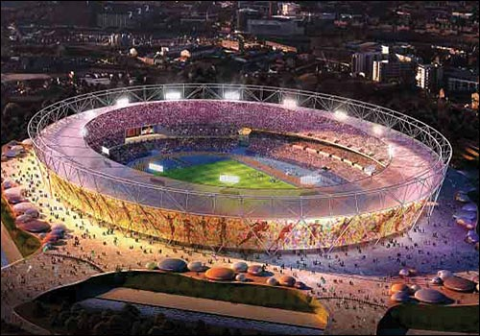


The Olympic and Paralympic Values

Slide 2
The Olympic and Paralympic Values
It takes more than being a brilliant sports man
or woman to become an Olympian or Paralympian.
Top class athletes try to live according to a set of beliefs
and ideas that help them to be the best they can be,
and to respect other competitors.
These are called the Olympic and Paralympic Values.

Slide 3
The Olympic and Paralympic Values
Olympic Values
friendship
respect
excellence
Paralympic Values
determination
courage
equality
inspiration

Slide 4
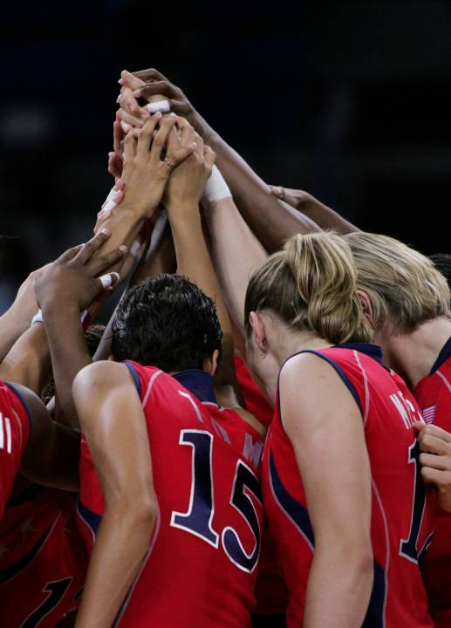
Friendship
The athletes at the
Olympic and Paralympic
Games will make lots
of new friends.
Their new friends may be
from different counties
and speak different
languages.

Slide 5
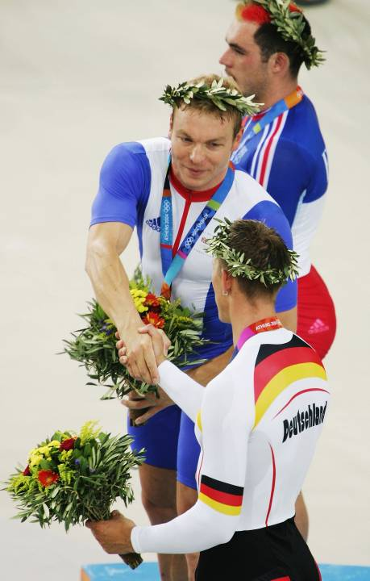
Respect
We should respect each
other, just like athletes
respect their opponents at
the Games.
Even though they are
competing against each
other, all athletes
demonstrate fair play.

Slide 6
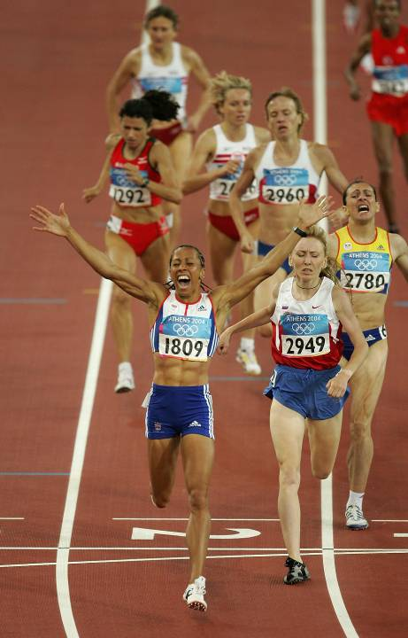
Excellence
Excellence is about how to
give your best, on the field
of play or in school.
Excellence is about taking
part and making progress,
not about how good you
are at the start.

Slide 7
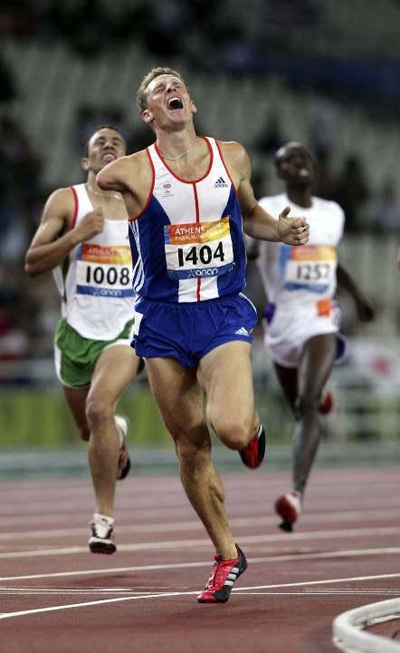
Determination
Athletes are very
determined and try very
hard to do their best.
It is much easier to give up
than it is to carry on at
something which is
physically and mentally
demanding.

Slide 8
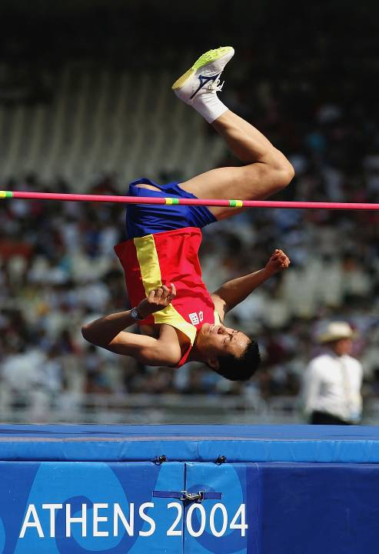
Courage
Olympians and
Paralympians show a lot
of courage.
Many of the events
require them to push their
bodies to the limits and
eliminate any fears.

Slide 9
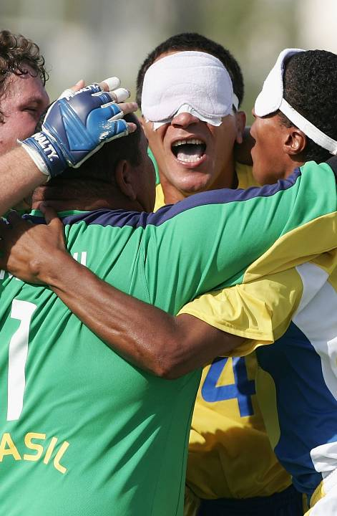
Equality
Every athlete has the right
to be treated fairly and
equally.
Paralympians are all
outstanding athletes.

Slide 10
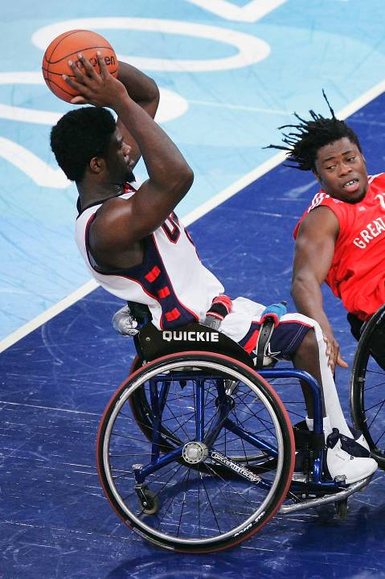
Inspiration
Olympic and Paralympic
athletes have been
inspired by others and
now they hope to
inspiring us.

Slide 11
The Olympic and Paralympic Values
Olympic Values
friendship
respect
excellence
Paralympic Values
determination
courage
equality
inspiration

