Slide 1
How have the ancient Greeks influenced our buildings?

Slide 2
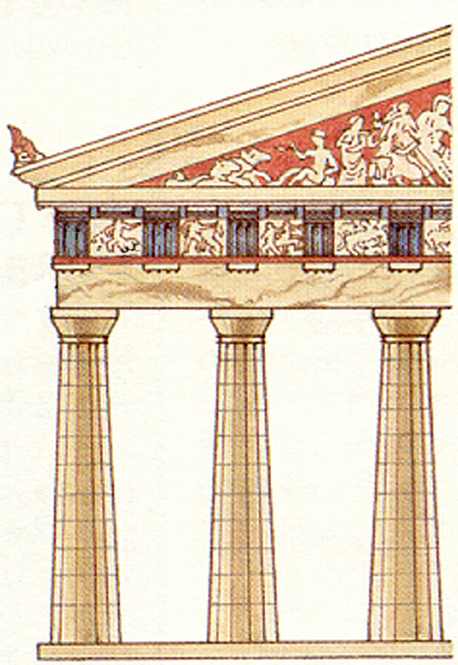
Greek Architecture
Greek architecture features pillars, called columns, decorative friezes and pediments as here:
Pediment
Frieze
Column

Slide 3
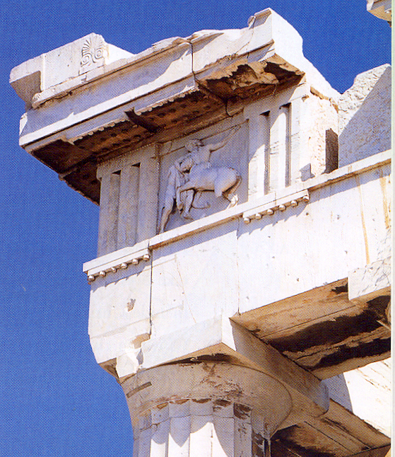
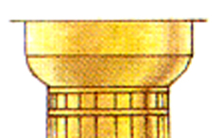
There were two main styles of architecture for important buildings in Ancient Greece – known as orders – they are Doric and Ionic. The easiest way to identify them is by the shape of tops of the columns – the capitals.
The Doric order was popular on the mainland. The columns were sturdy with undecorated capitals.
A Doric frieze had panels of relief carvings, called metopes, separated by panels of fluted stone called triglyphs.
Here are metopes, and triglyphs on the Parthenon in Athens.
Doric capital
Capitals

Slide 4
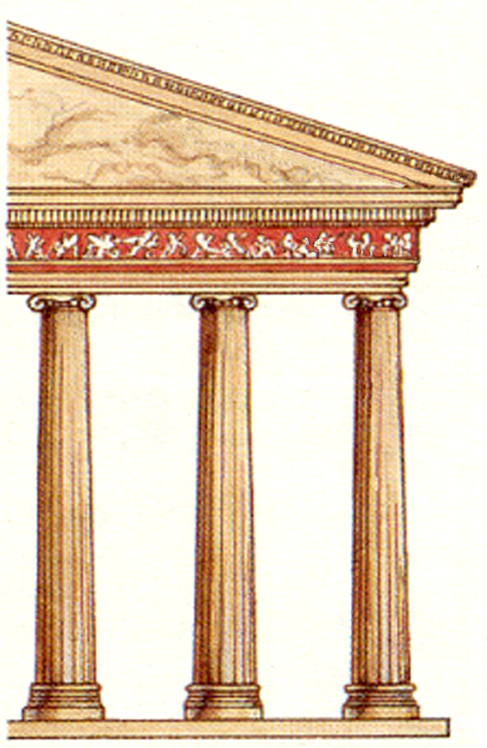
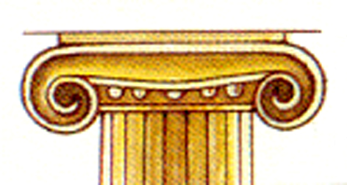
The Ionic order was popular in the eastern colonies and on the Greek islands. It featured thinner columns and more decorative capitals and bases.
Ionic friezes were continuous
Ionic capitals were decorated with curled ends called veloutes.

Slide 5
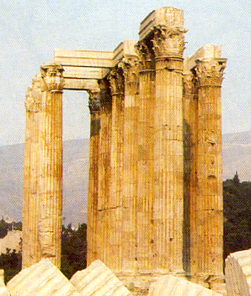
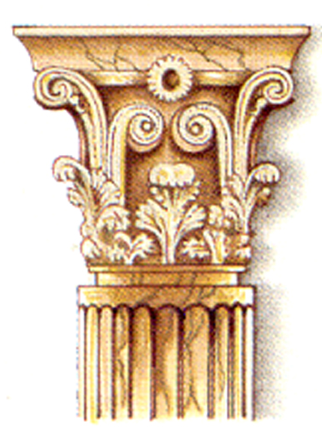
Later, a variation of the Ionic order became popular. It was called the Corinthian order but was not often used by the Greeks, it was more popular with the Romans. It featured very decorative capitals.
Corinthian capitals were decorated with acanthus leaves.

Slide 6
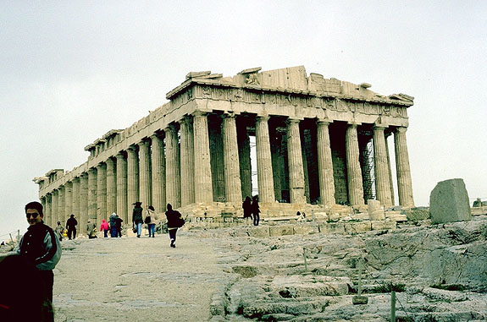
The Parthenon, Athens (448–432 BC)

Slide 7
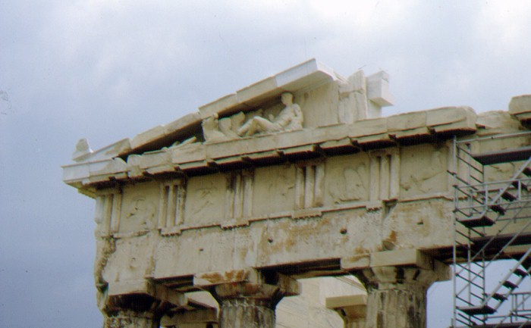
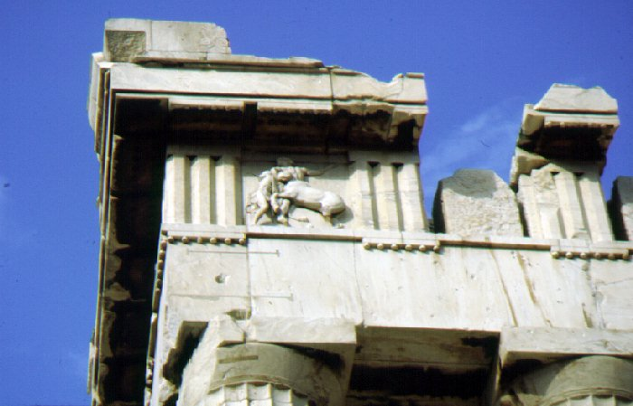
The Parthenon, Athens (448–432 BC)

Slide 8
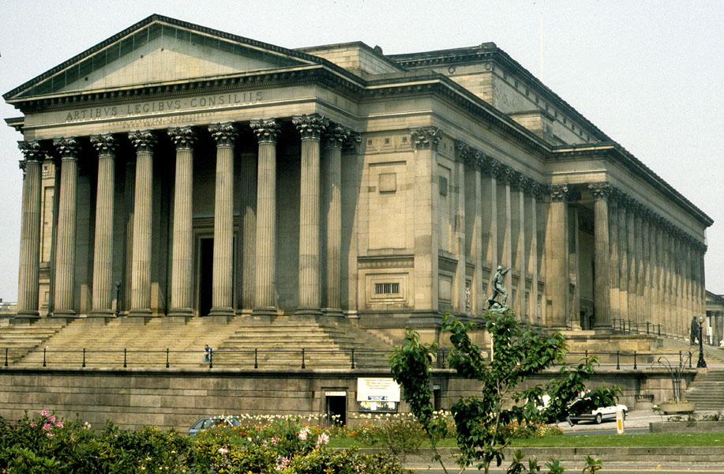
St George’s Hall, Liverpool
Originally built as law courts and a venue for musical festivals

Slide 9
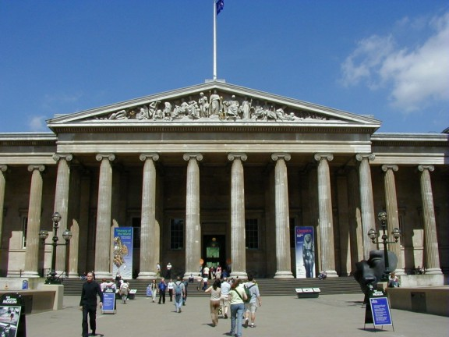
British Museum, London (1847)

Slide 10
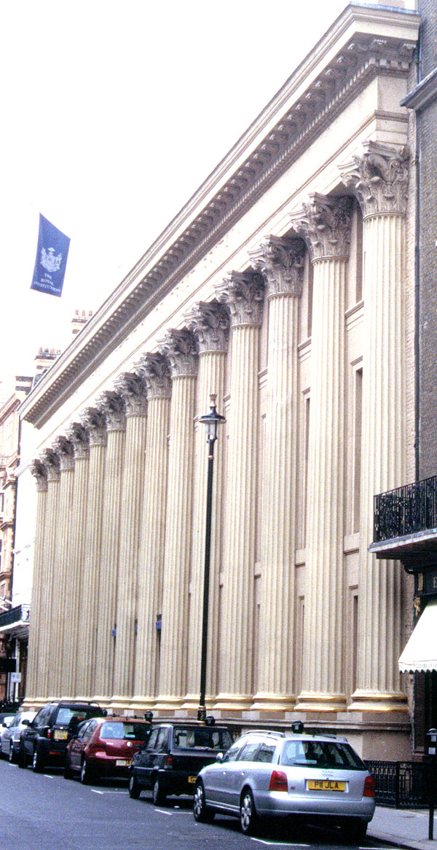
Royal Institution, London (1837)
Dedicated to scientific research and scientific education

Slide 11
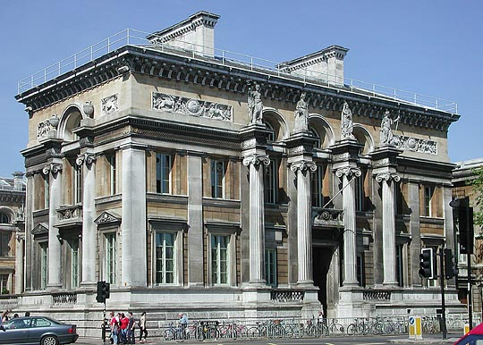
The Ashmolean Museum, Oxford
The Ashmolean is Britain’s oldest museum. This part of the building was erected in 1845.

