Slide 1
Today we are going to learn about air resistance.

Slide 2
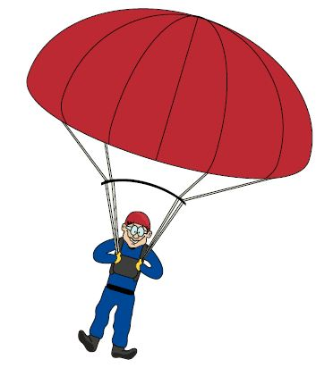
Gravity
Air resistance

Slide 3
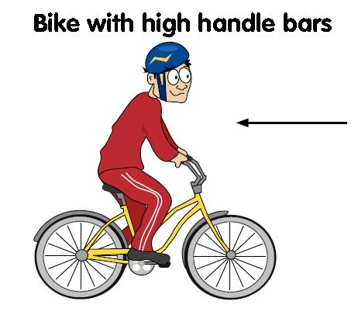
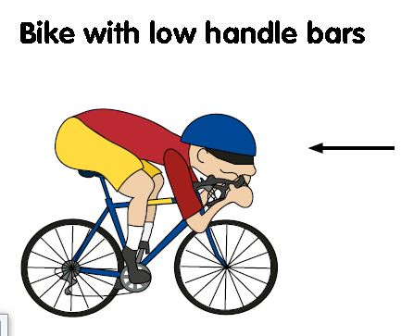
Which cyclist will be quicker? Why?
Notes:
Plastic clocks, clamp

Slide 4
You are going to investigate air resistance using parachutes.
You will need 3 carrier bags and something to put underneath the parachute – paperclip, peg, lego figure etc, and a way of timing your parachute (stopwatch or someone else counting).
Our investigation is whether the size of the parachute changes the amount of time it takes to fall to the ground.
The only change is the size of the parachute, everything else MUST remain the same, otherwise your test will not be fair!

Slide 5
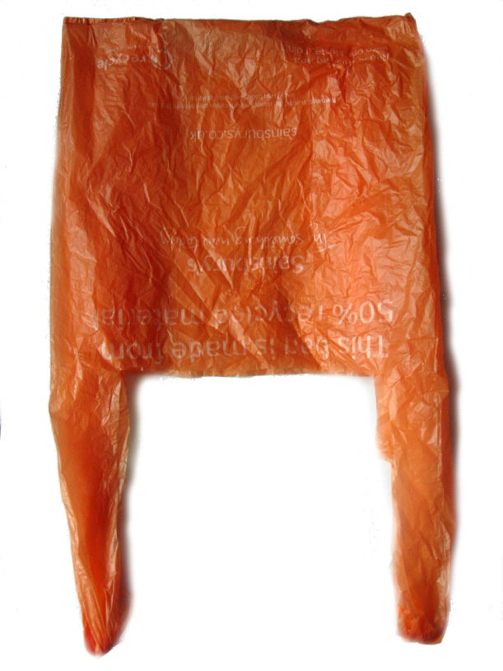
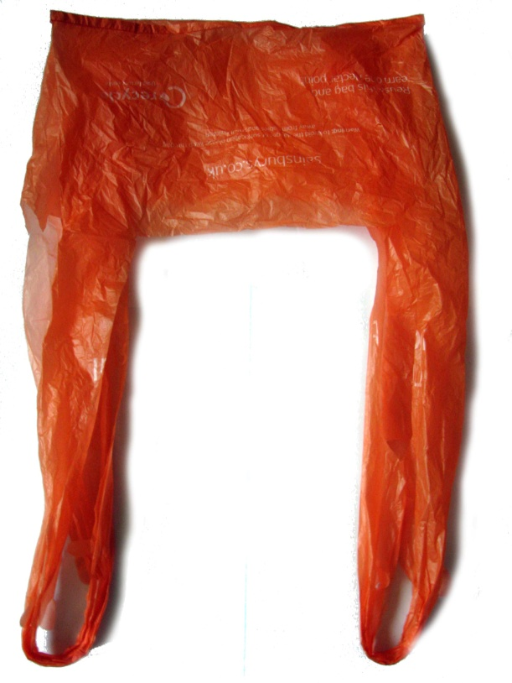
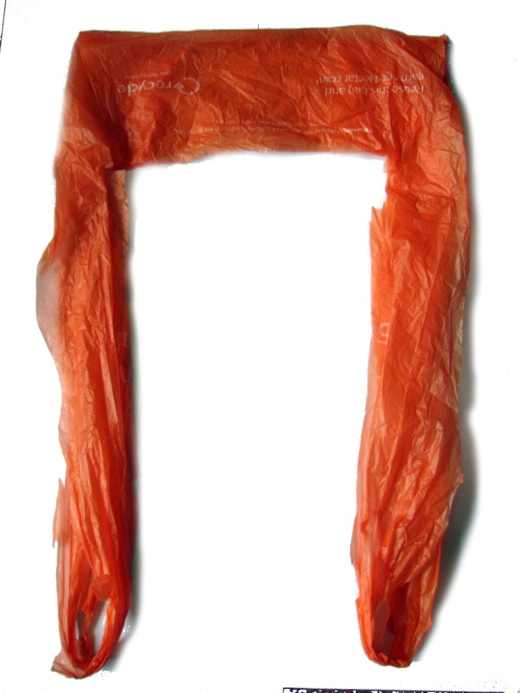
You need to cut the three bags to give different size parachutes.
Notes:
Plastic clocks, clamp

Slide 6
LO: To investigate air resistance
Once you have made your parachutes you are ready to test them but before you start make a prediction – what do you think will happen? Make sure you write this down – there is a sheet you can print from the website or write in your exercise book.
Then test your parachutes, dropping each one up to three times, and record your results.

