Slide 1
Zipwire Investigation!

Slide 2
What material is suitable for the wire?
I am going to use different materials to see which is best for a wire for a zipline.

Slide 3
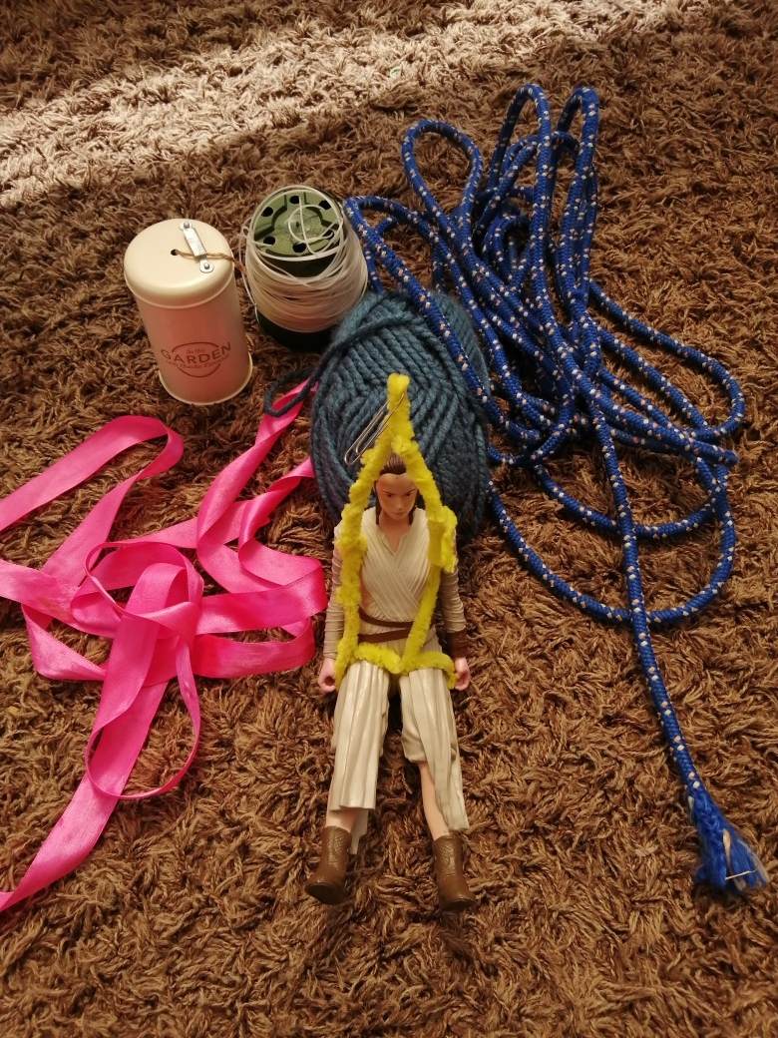
My materials
I experimented with different materials, all with different textures. The tests were with string, wool, rope, ribbon, plastic strimmer line and the harness was made of pipe cleaners and a paper clip with a Rey doll sitting in it.

Slide 4
The investigation
Firstly, I made sure to keep the harness, the place and the toy the same. The thing that needed to change every time was the material for the line. Before I started, I made a prediction that the rope would be the slowest and either the ribbon or the plastic strimmer line would be the fastest.
For each line I attached one end to the window handle and the other end to a chair leg. With each material I timed the doll from the top to bottom three times in turn.

Slide 5
Results!
Materials | Time | Average | Position
String | 1.44 sec 1.27sec 1.36sec | 1.37 sec | 2nd
Wool | 1.62 sec 1.69 sec 1.73 sec | 1.68 sec | 3rd
Rope | 18.35 sec 29.42 sec 28.05 sec | 25.27 sec | 5th
Ribbon | 1.74 sec 1.66 sec 1.68 sec | 1.69 sec | 4th
Plastic Strimmer Line | 1.13 sec 1.24 sec 1.14 sec | 1.17 sec | 1st

Slide 6
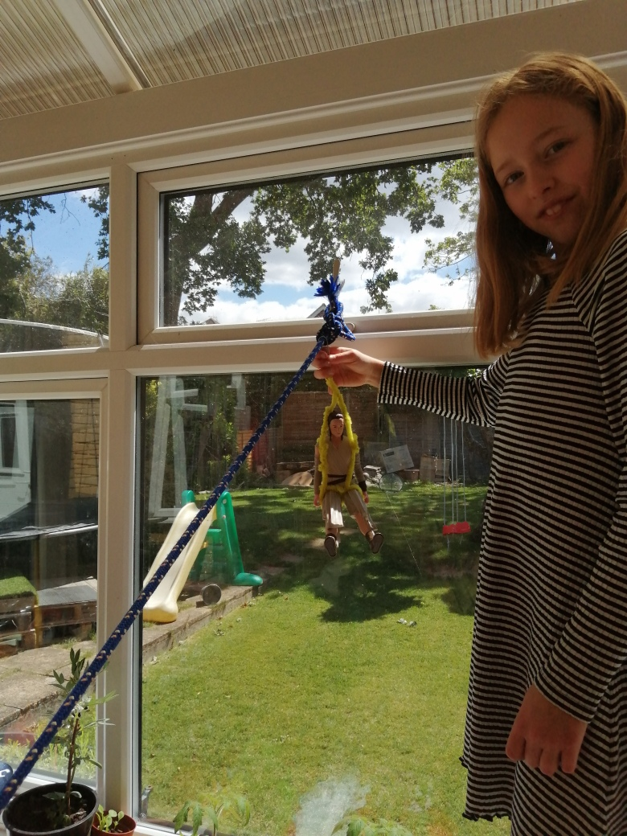
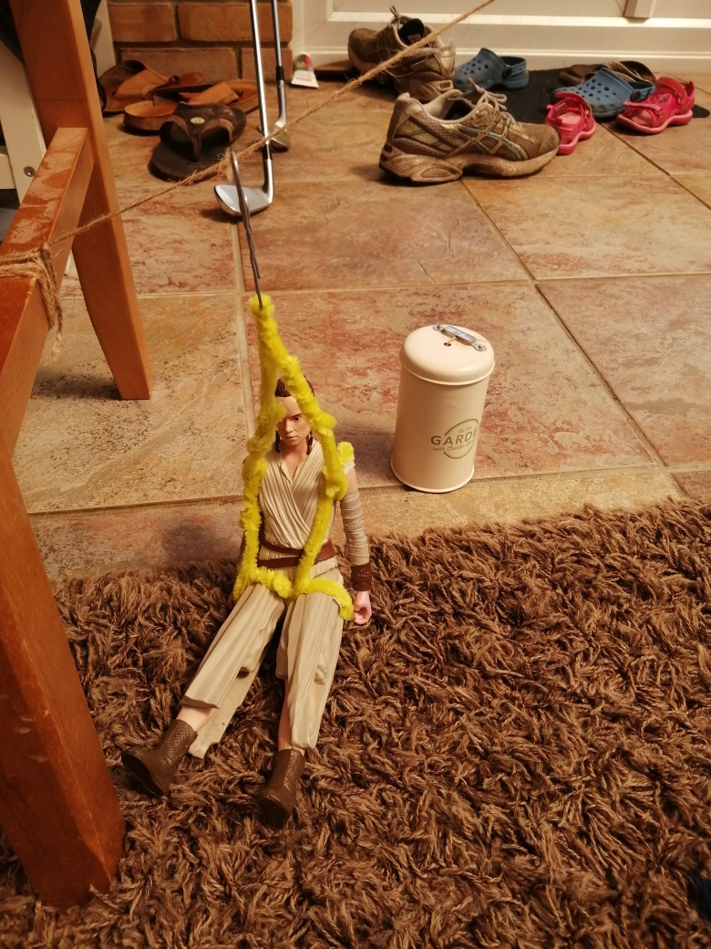
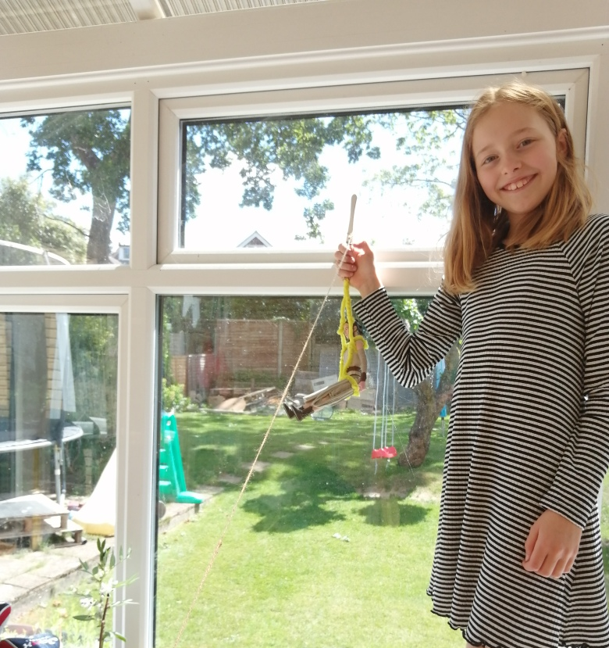
Conclusion
The fastest is the plastic streamer line because it has less friction and the rope is the slowest because it has the most friction.
In conclusion, Mrs Martin should use the plastic strimmer line because you zip the fastest.

