Slide 1
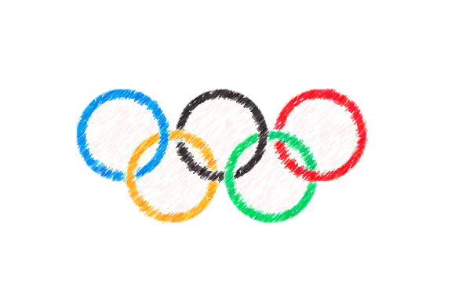
The Ancient Greek Olympics
By Sophia Roberts

Slide 2
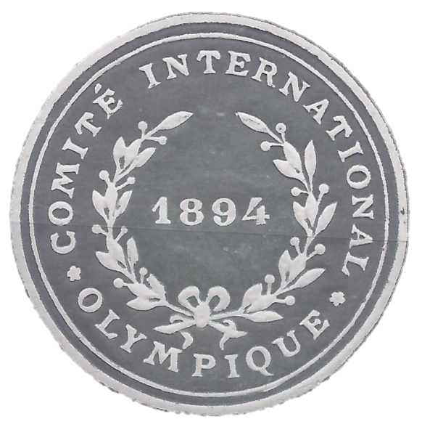
When Did It All Begin?
Records show that the first Olympic games began in 776 BC, The Ancient Greek Olympics was very popular and took place every four years. Between 8th century BC and 4th century AD, Baron Pierre de Coubertin created the International Olympic Committee in 1894, leading to the first modern Games in Athens in 1896.

Slide 3
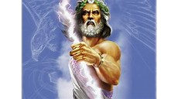
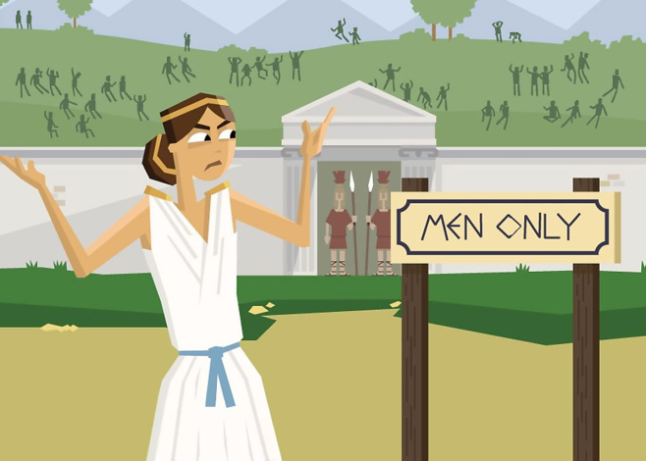
Who Could Compete And Who Could Spectate?
In the Ancient Greek Olympics, only men fluent in Greek could compete. In order to participate, the men had to compete naked. Originally, the games were part of a religious festival to honour Zeus. The spectators were allowed to be; unmarried women/girls, boys and men. Married women were not.

Slide 4
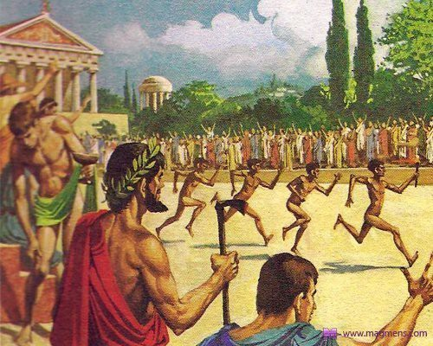
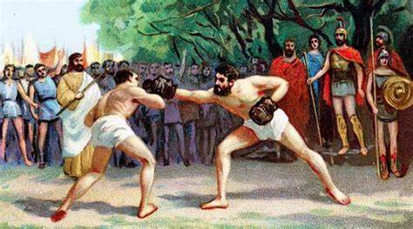
What Events Were Included?
The Ancient Greek Olympics' first ever event was a running race. The more sports were added like discus, chariot racing, long jump, javelin even wrestling and boxing. These events were won in their own way some by jumping the furthest or by crossing the finish line first.

Slide 5
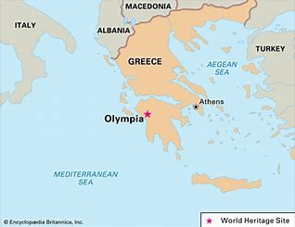
Where Were The Olympics First Held?
The Olympic games were held to be one of the two central rituals in ancient Greece, the other being the much older religious festival, the Eleusinian Mysteries. The games started in Olympia, Greece, in a sanctuary site for the Greek deities near the towns of Elis and Pisa (both in Elis on the peninsula of Peloponnesus).

Slide 6
Were There Any Rules?
Yes and there were;
Only Greek speaking men could participate
If a runner broke at the beginning of a race, they would be whipped
No one was allowed to “cast a spell” on an athlete

