Slide 1
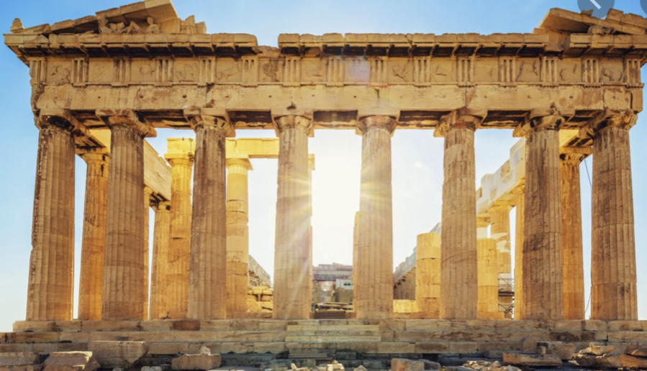
The Greek Olympics

Slide 2
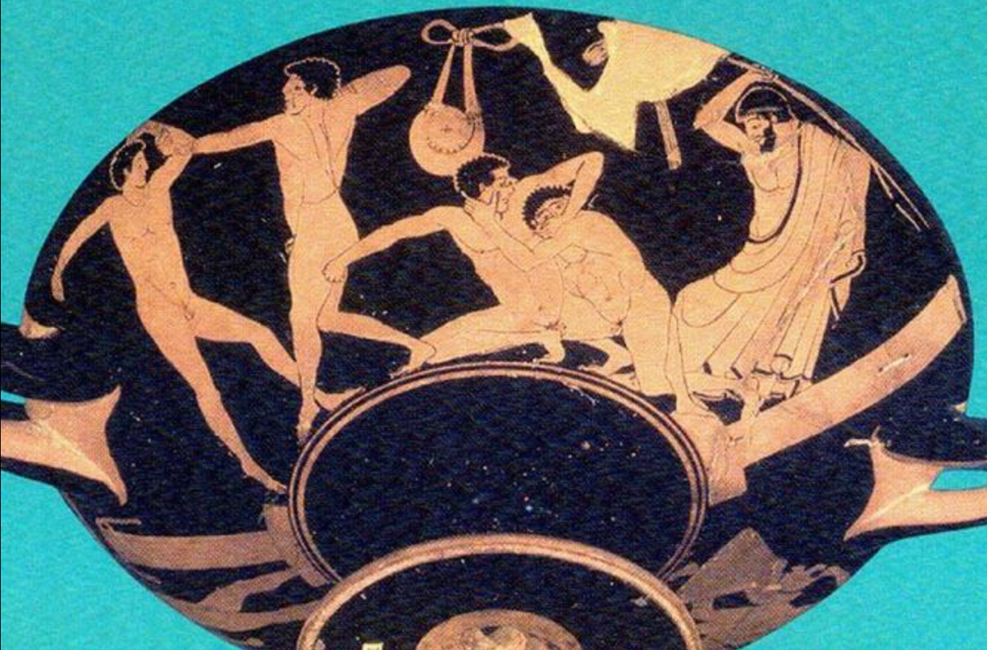

The Olympics
Greeks
The Greeks started the Olympics for the Greek god Zeus so it was a religious festival.It wasn’t held often. People would think the event was all about sports but it wasn’t. It was all about the sacrifice that was made.

Slide 3
The games
The games that were included were horse racing, chariot racing,javelin,boxing,discus,running and the long jump.Also there was wrestling but there were hardly any rules so it means that it would be extremely painful.
People came to Greece from all over the world to witness the extraordinary event. Around 45000 spectators went to the Olympic Games.
By Maya 4/5/2020

Slide 4
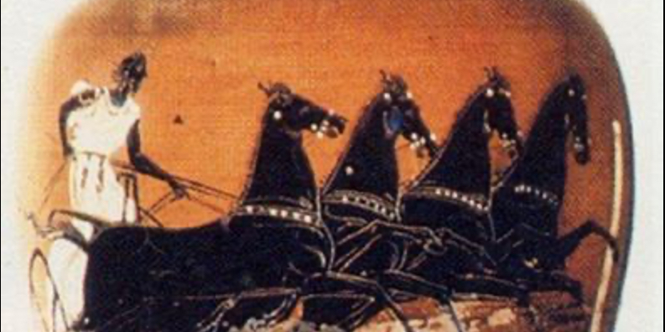
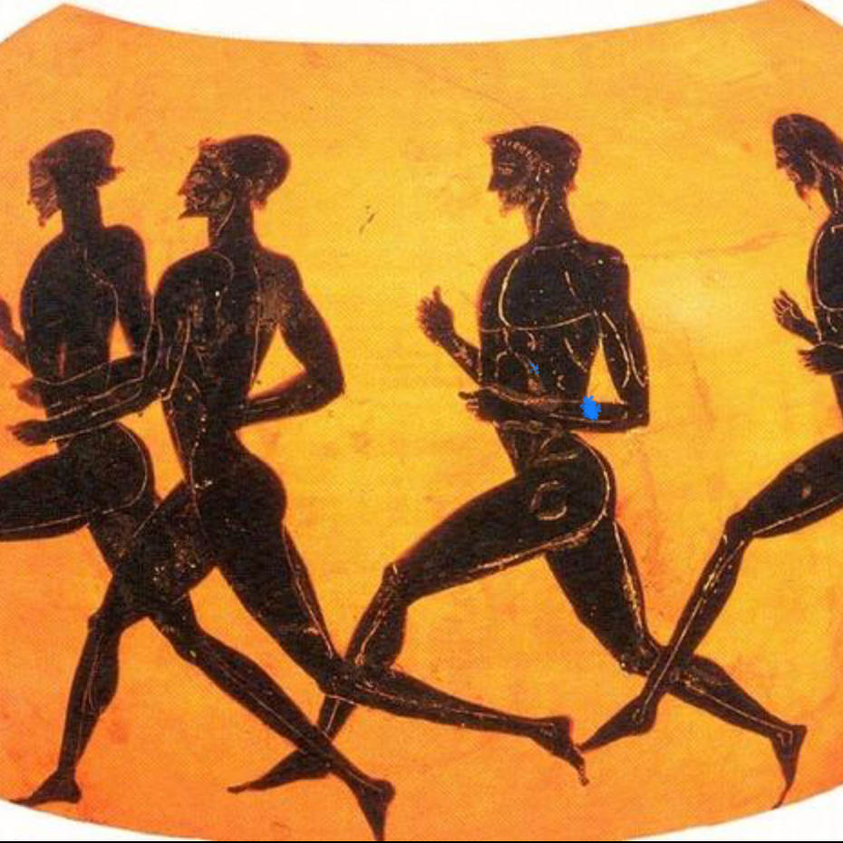
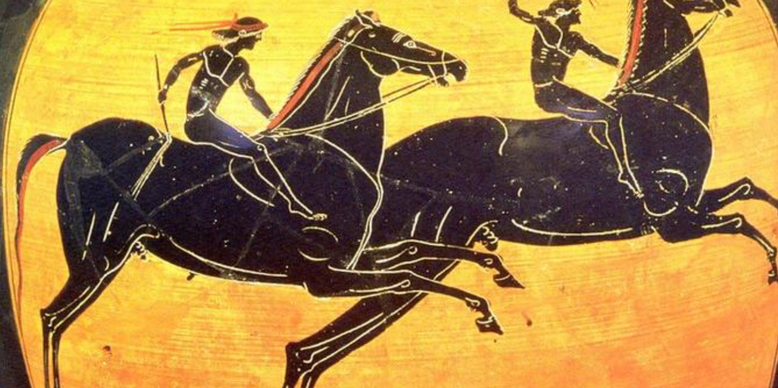

Slide 5
Why was the Olympics made?
It was held in the honour of the most important Greek god, Zeus.
Although Zeus’ temple was at the top of a mountain, the Olympics was held in Olympia.
Who will attend?
Only boys, men and unmarried women were allowed to attend the games.
Once, a married woman wanted to see her son take part so she disguised herself as a man.

Slide 6
Time
It all started around 2700 years ago in 776 BC .
It is held every 4 years.
It was the biggest sporting event of the ancient calendar.
By Maya 4/5/2020

Slide 7


