Slide 1
Water Resistance

Slide 2
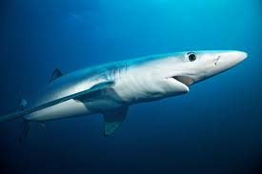
Water Resistance
More streamlined objects move easily through water.
Like this shark!

Slide 3
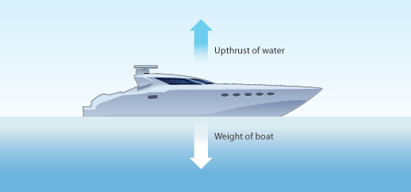
Floating
Gravity pulls objects downwards
Up-thrust is the force that helps things float.
If the weight of an object is greater than the up-thrust from the water, the object will sink.

Slide 4
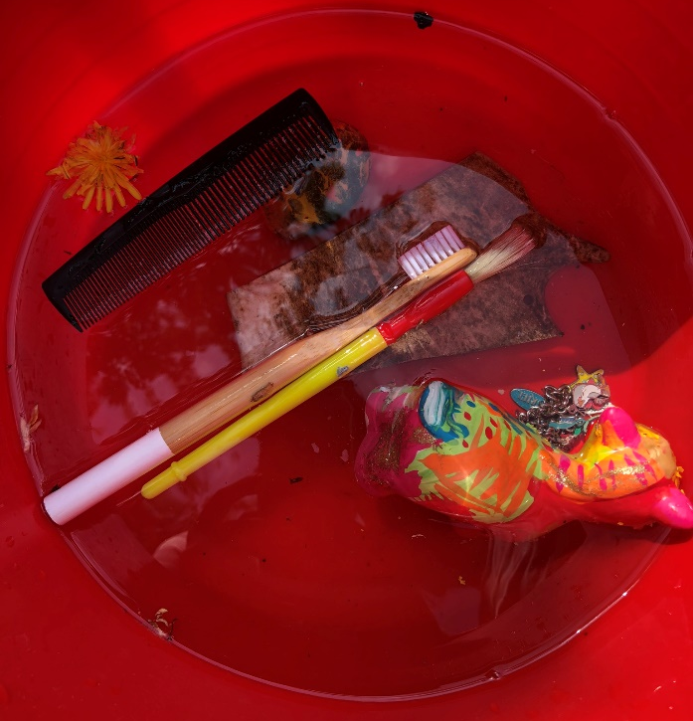
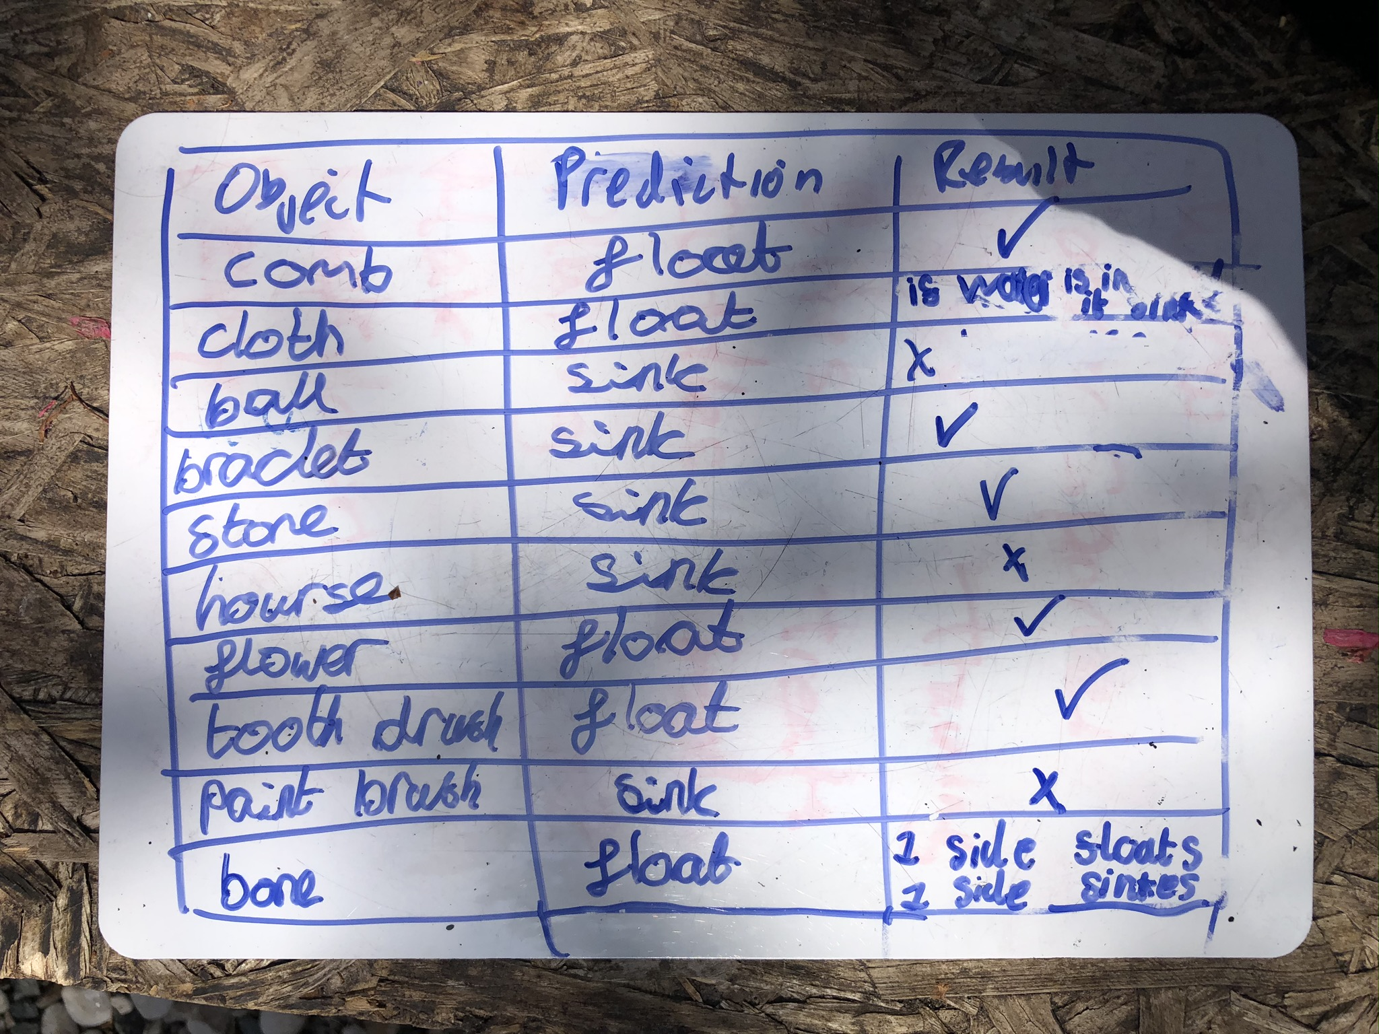
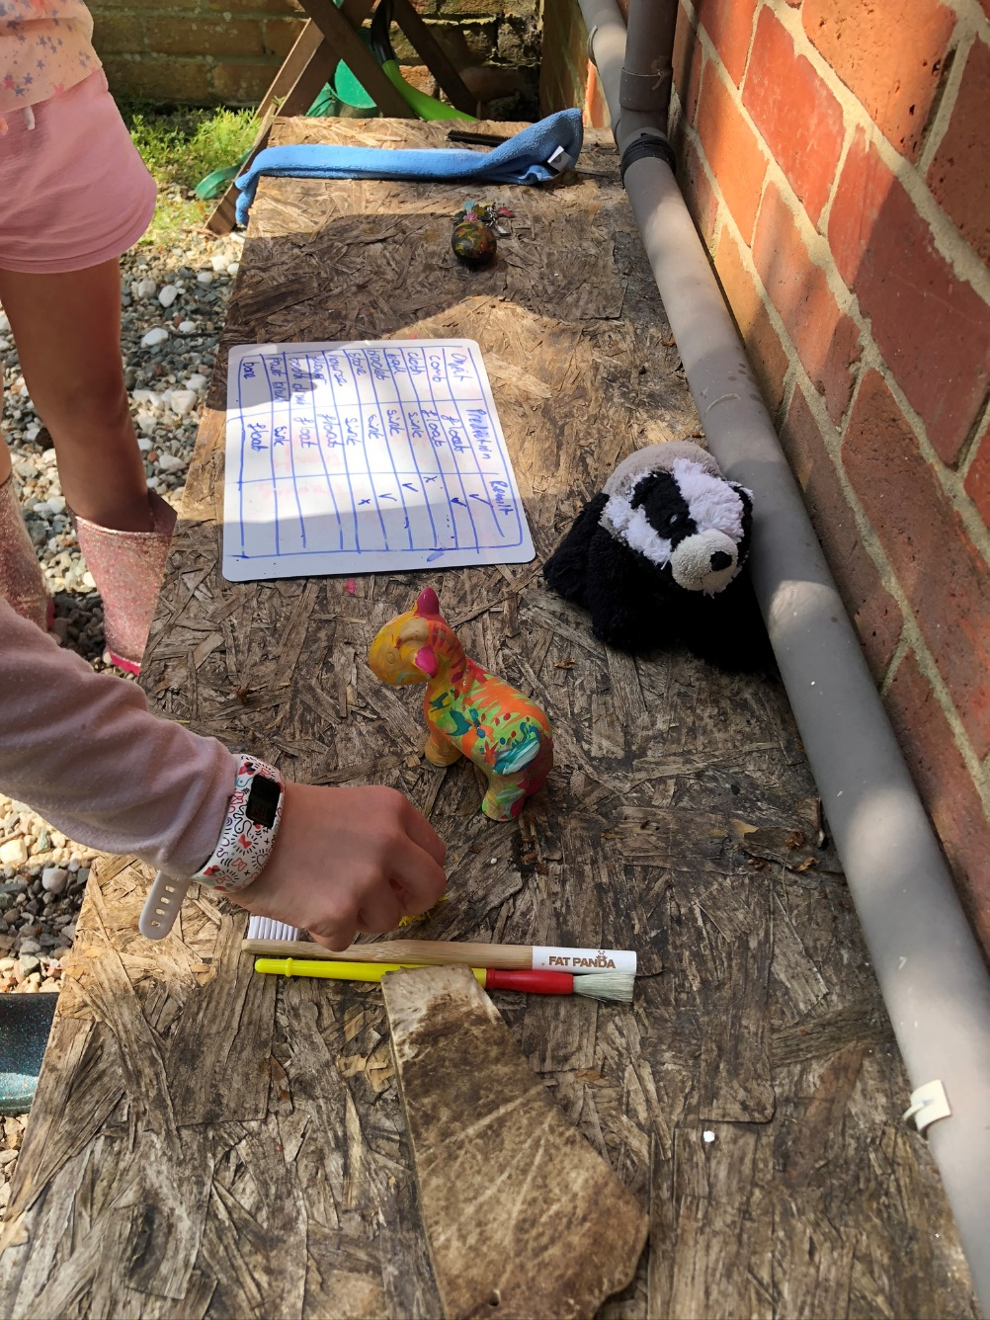
Investigating Floating and Sinking
We tested 10 objects to see if they floated or sank.

Slide 5
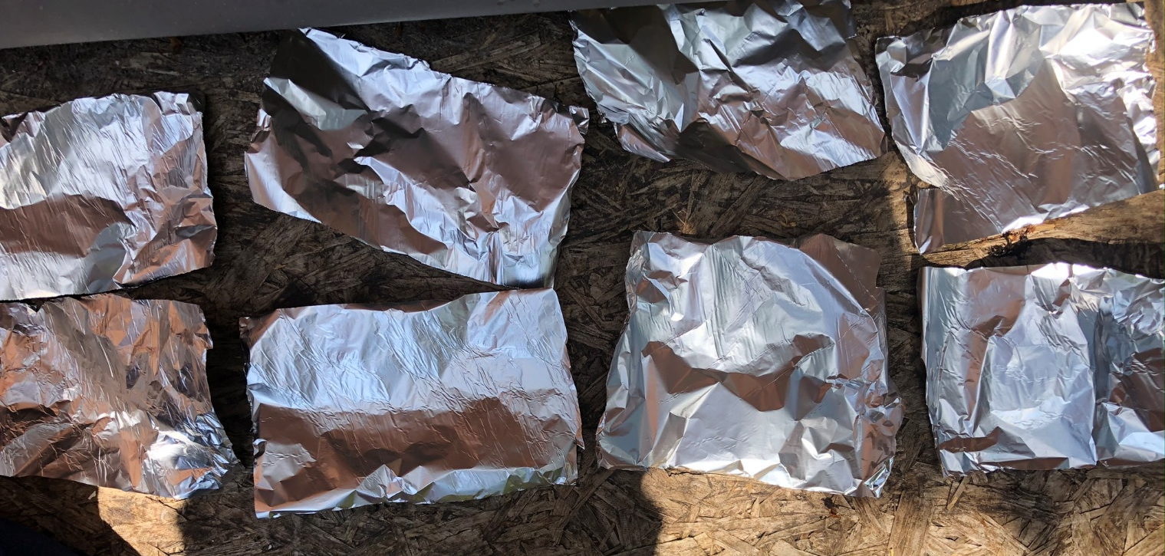
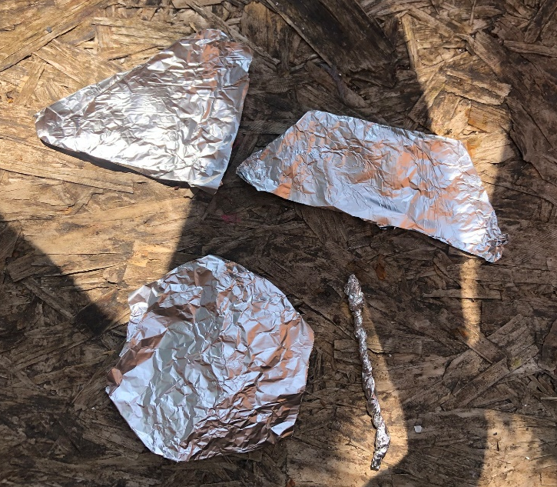
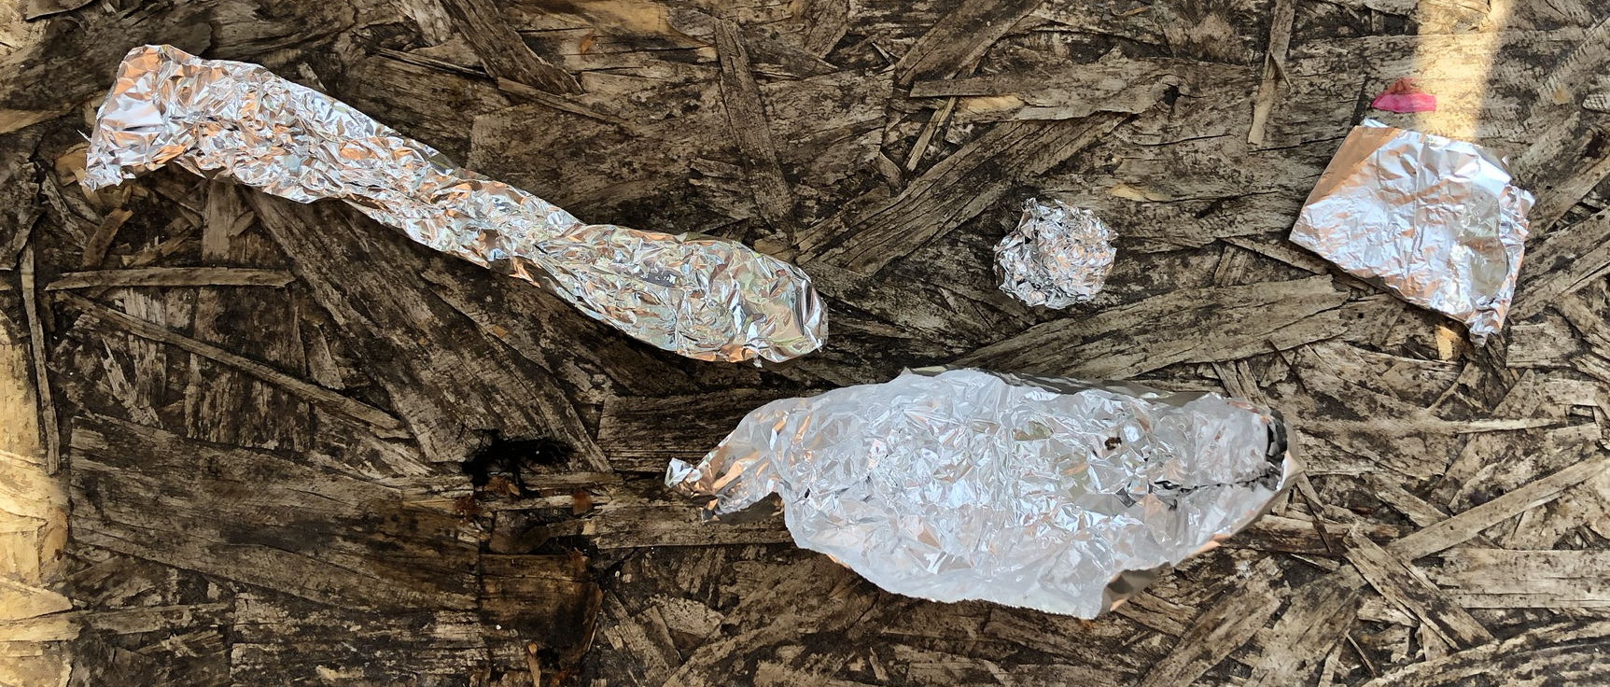
Investigating Floating and Sinking
We then made shapes with tin foil to see if the shape effected how well something floats.
We used the same size piece each time so it was a fair test.
They all floated!
We expected some to sink.

Slide 6


