Slide 1

Olympics

Slide 2
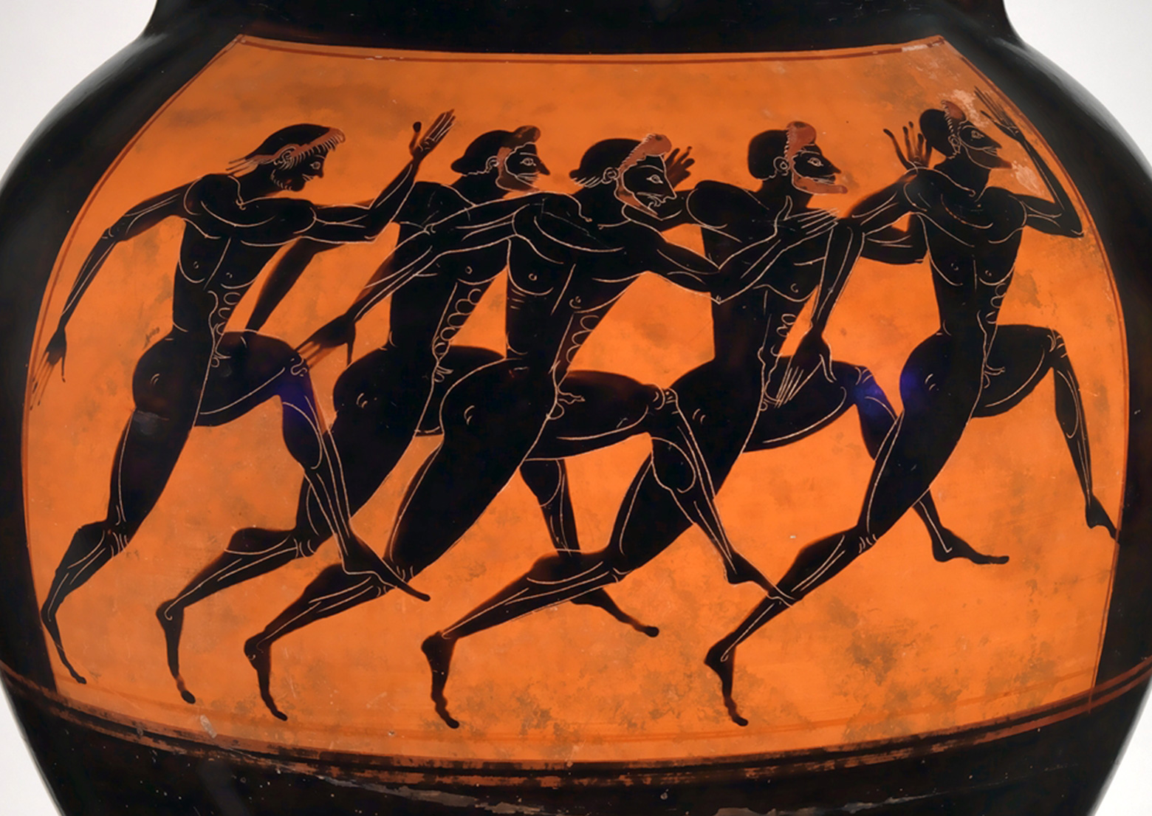
Ancient Greeks
The first Olympics started in the year 776bc when a baker Coroebus became the first Olympic champion.
It happened once every four years and was started by the Greeks. The games were for there top god Zeus. To start with there was only one advent and the games were heled in the same place. Only men were allowed and the winner got a crown of olive branches or a wreath.

Slide 3
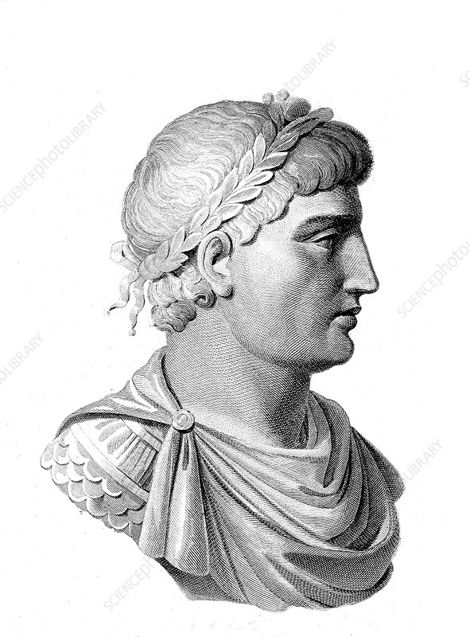
Christian Emperor
391ad a Christian Emperor Theodosius banned pagan practise.
After, there were no more Olympic games . 1500 years later in 1896 the modern Olympics started again in Athens Greece. When it was reheld there were 241 athletes from 14 countries.

Slide 4
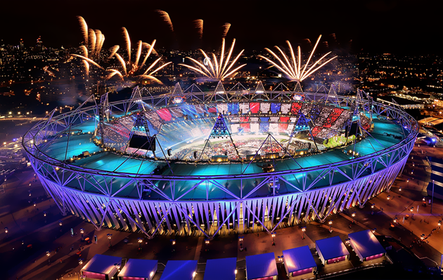
Modern Games
Women first competed in 1900.
The Paralympics began to be held for people with disabilities and the youth games are for 14 to 18s compete. Now there’s one for the summer and one for the winter.

Slide 5
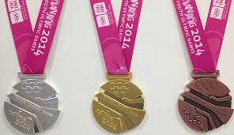
Winners
Silver
Gold
Bronze
Winners get medals
In modern Olympics, third place wins bronze, second place wins silver, first place wins gold.
First place medals are not actually made of gold but silver covered in a thin layer of gold.

Slide 6
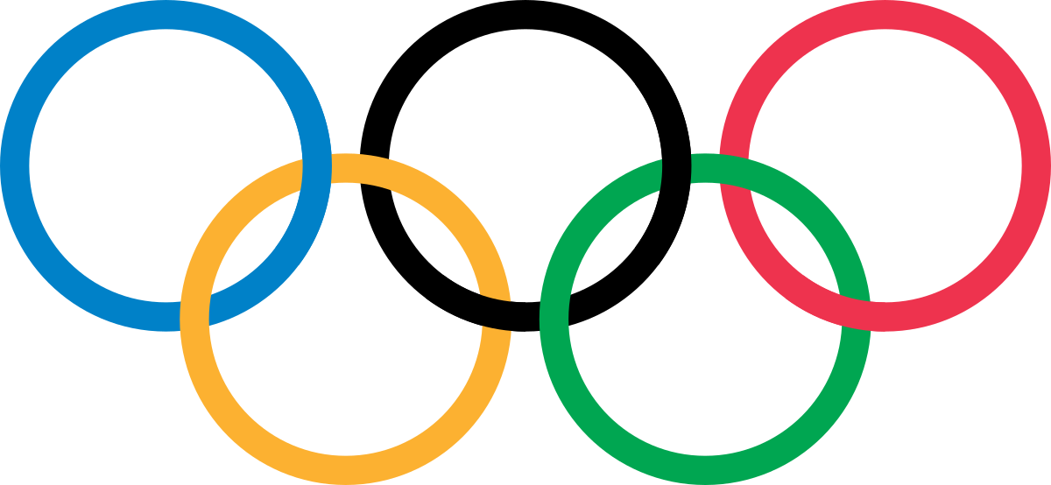
Rings
The rings interlock.
The colours are blue, yellow, black, green and red. The colours are because every flag in the world had at least one of those colours on it.

Slide 7

Flame
The lighting of the torch is a reminder of the ancient myth when Prometheus stole fire.
The torch lights a cauldron that stays lit until the last day of the games. When the flame is out it marks the official end of the games.

