Slide 1
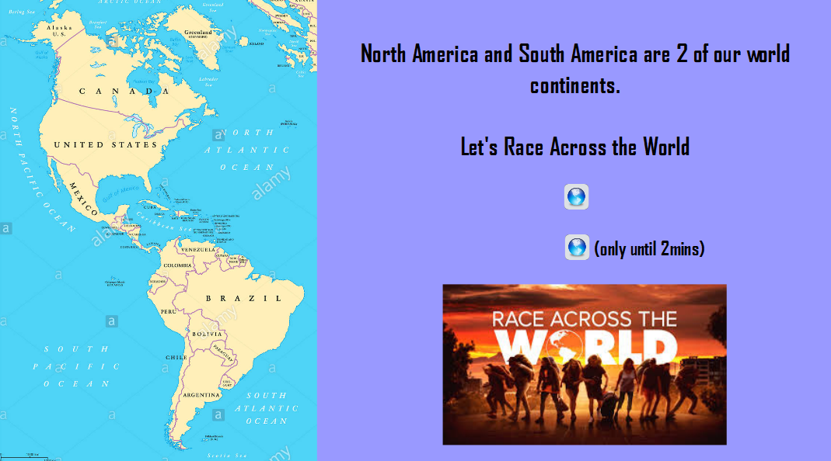
Click on the squares for the video

Slide 2
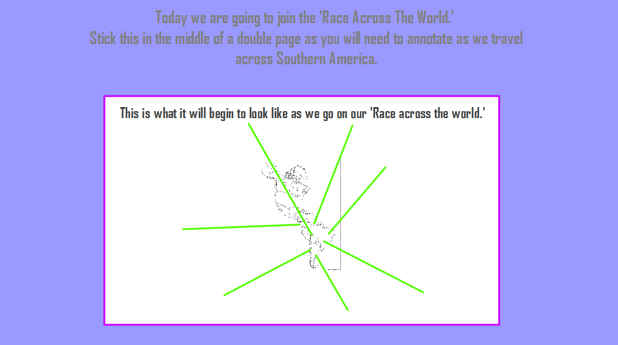

Slide 3
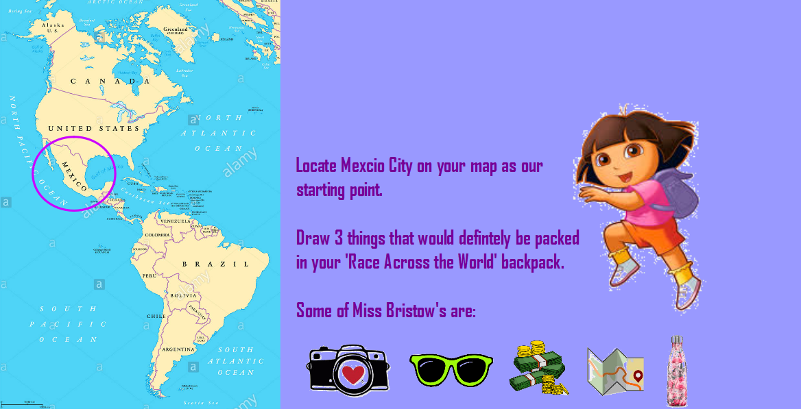

Slide 4
Year 6’s – Watch the Palenque video on the Merdon VRC
https://merdon-junior-school.primarysite.media/

Slide 5
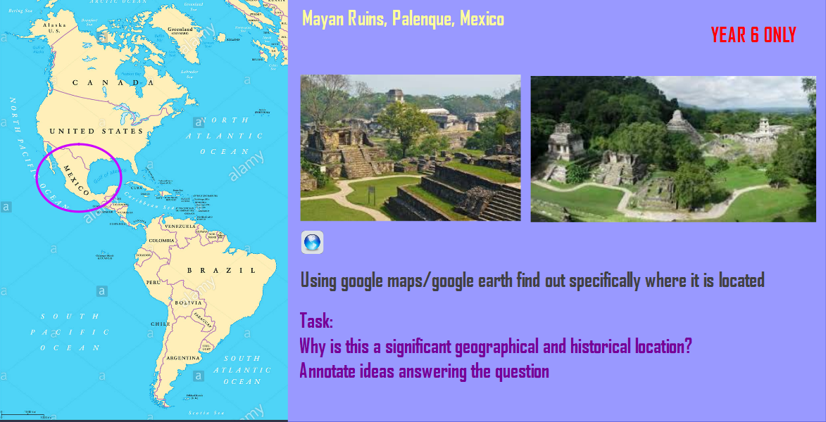

Slide 6
Watch the Desert Video on the Merdon VRC

Slide 7
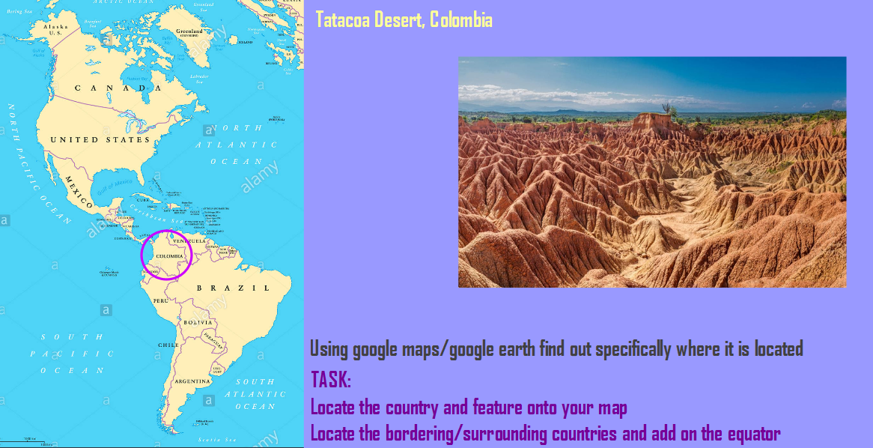

Slide 8
Watch the Rainbow Mountain video on the Merdon VRC

Slide 9
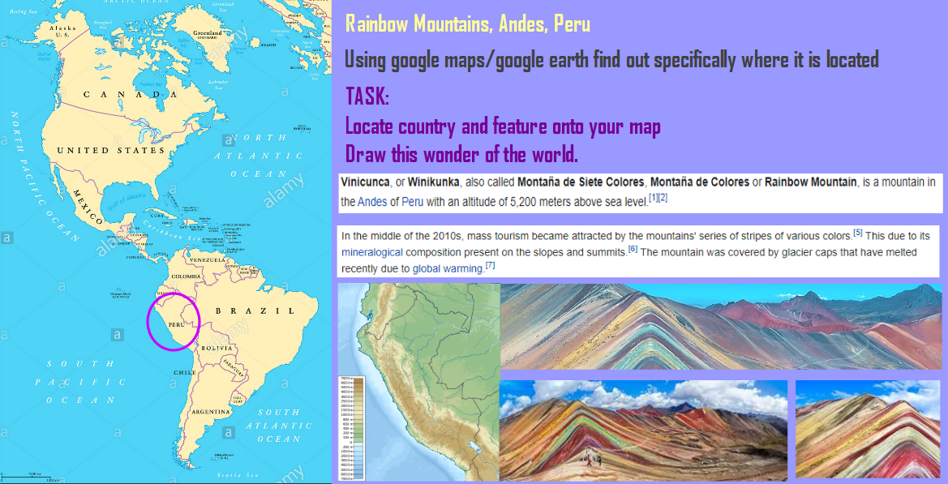

Slide 10
Watch the Salt Lake video on the Merdon VRC

Slide 11
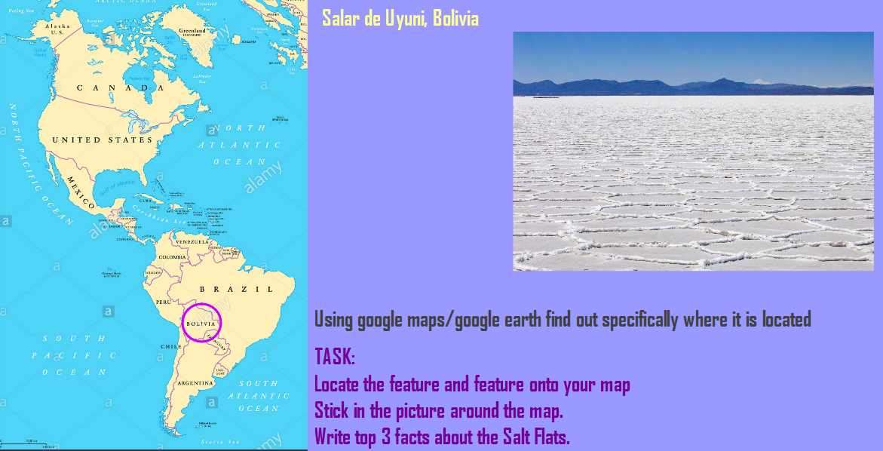

Slide 12
Watch the Waterfall video 1 and 2 on the Merdon VRC

Slide 13
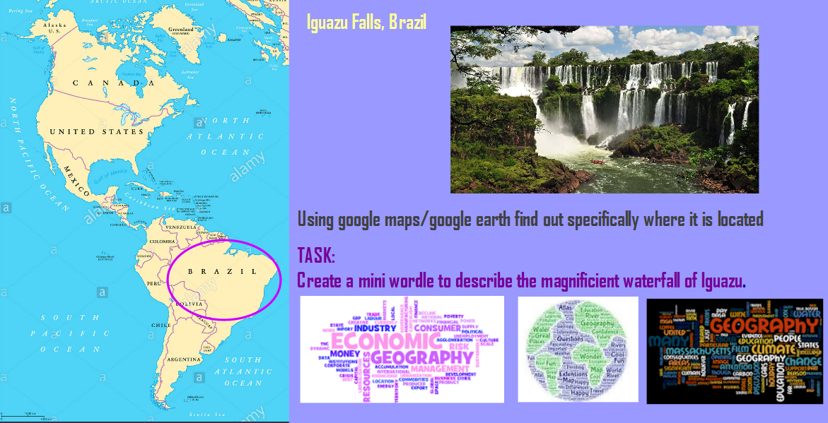

Slide 14
Watch the Ushuaia video on the Merdon VRC

Slide 15
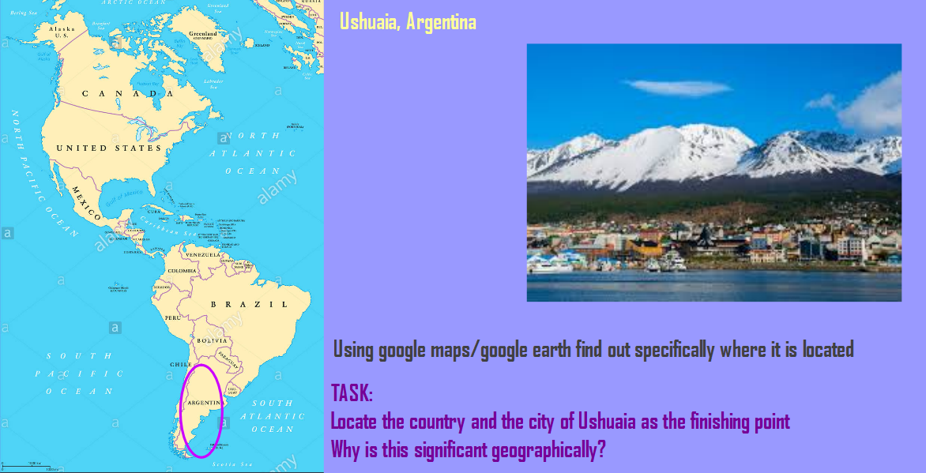

Slide 16
Sporcle
North America
South America
World

