Slide 1
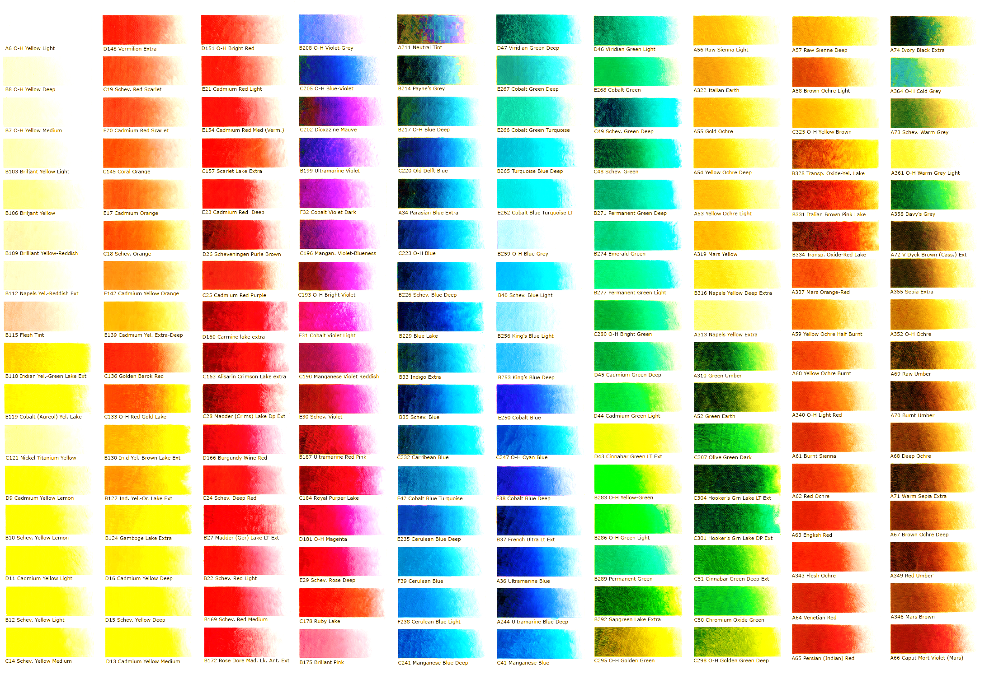
What colour are you today?
If you could describe how you
Are feeling in a colour what
would it be and why?

Slide 2
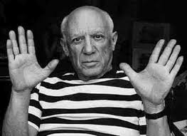
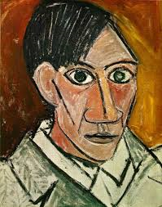
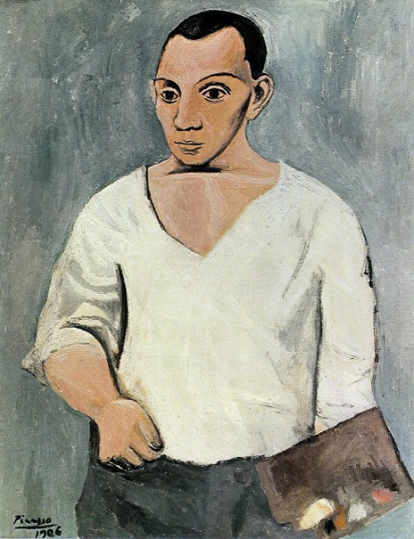
Picasso and Cubism.
Tell your partner what you already know.

Slide 3
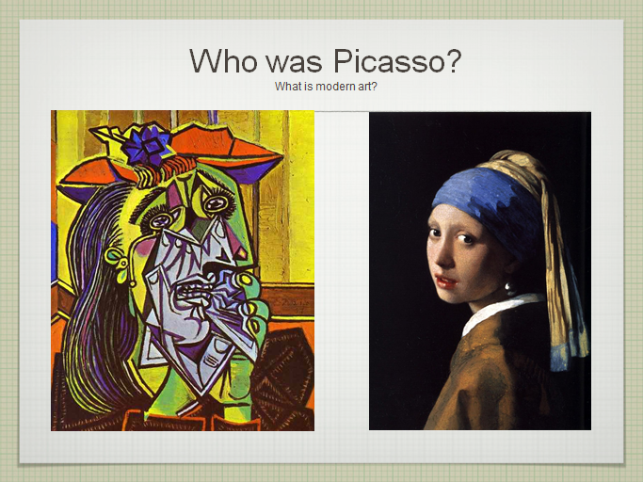


Let’s remind ourselves.
What do you know?

Slide 4
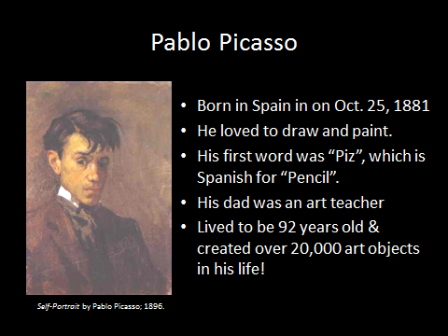

Five facts about Picasso

Slide 5
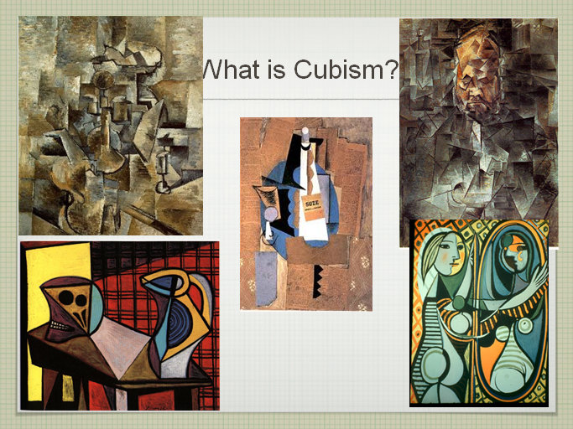

Slide 6
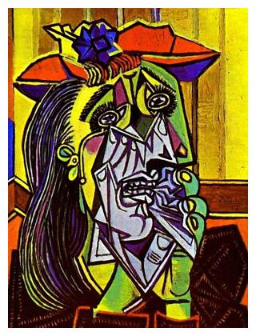
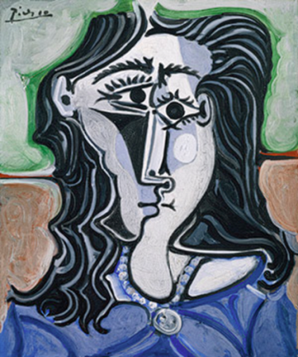
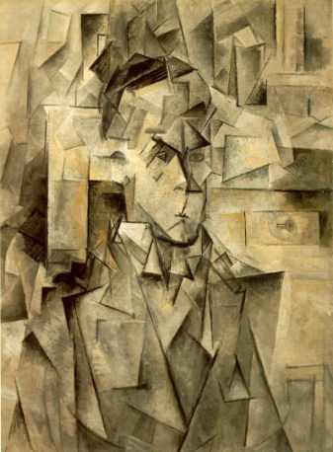
Five facts about Cubism
Cubism was an innovative art movement pioneered by Pablo Picasso and Georges Braque.
In Cubism, artists began to look at subjects in new ways in an effort to depict three-dimensions on a flat canvas.
They would break up the subject into many different shapes and then repaint it from different angles.
Cubism paved the way for many different modern movements of art in the 20th century.
The movement started in 1908 and lasted through the 1920s.

Slide 7
WALT respond to the work of
Pablo Picasso

Slide 8
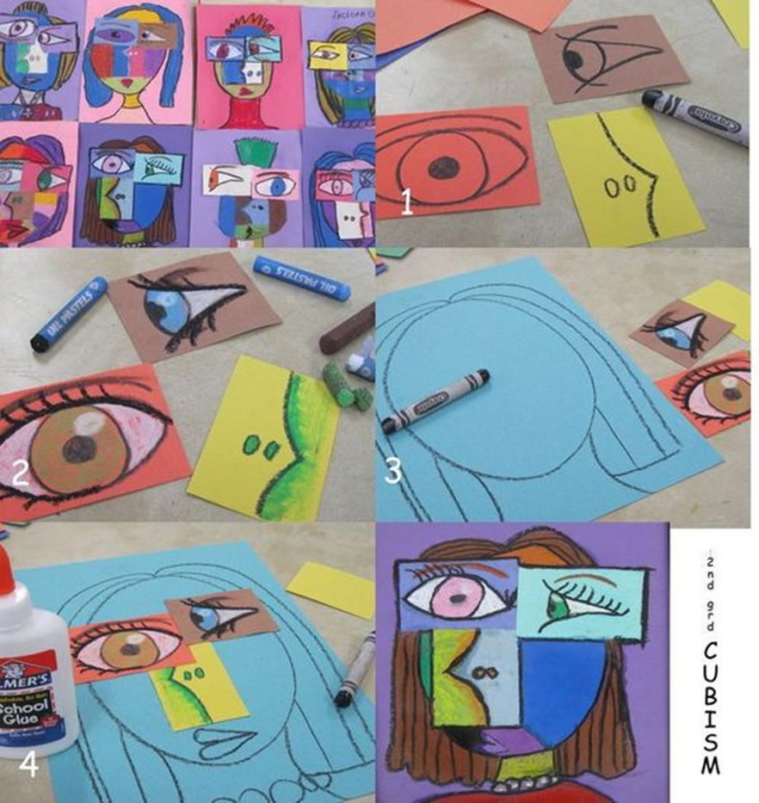

Slide 12



