Slide 1
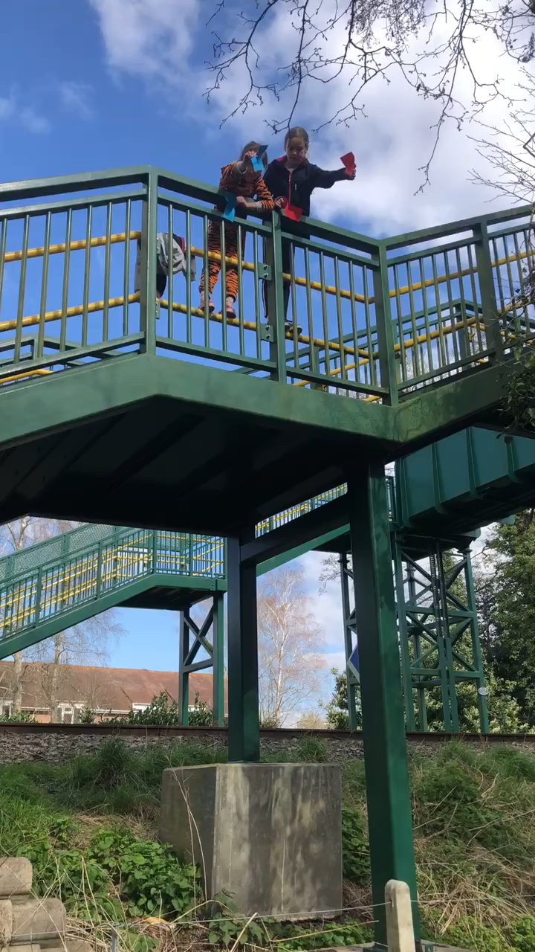
We dropped our helicopters but they didn’t fly very well.

Slide 2
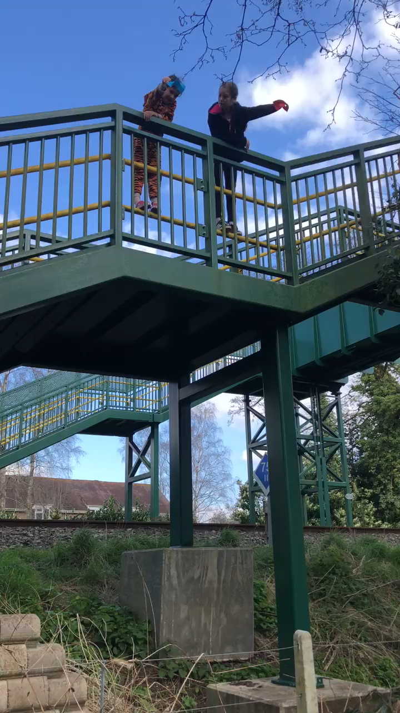
We added blue tack to our helicopters and they spun and flew really well.

