Slide 1
My home learning
Conwy

Slide 2
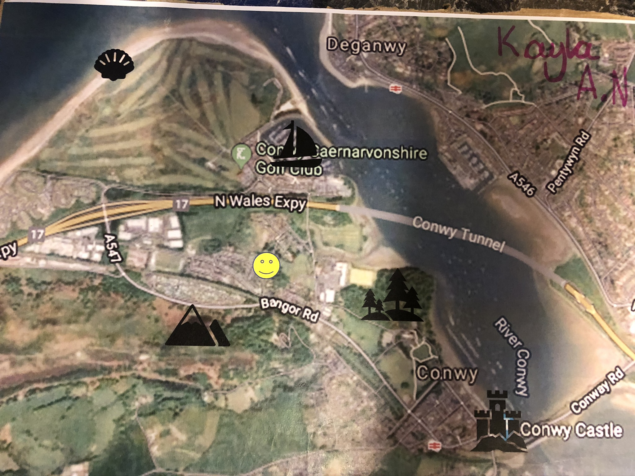
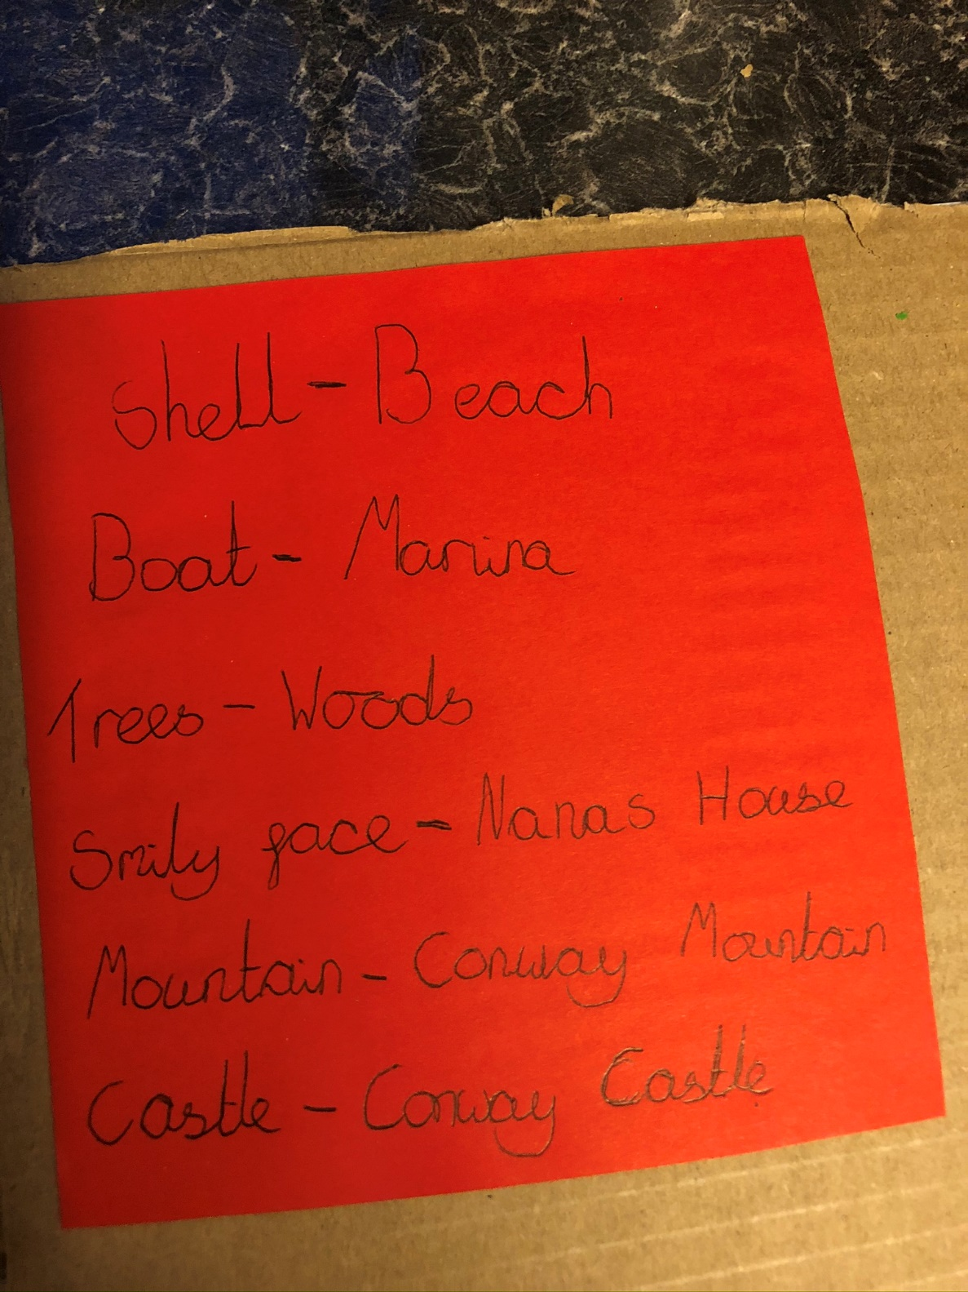
Key

Slide 3
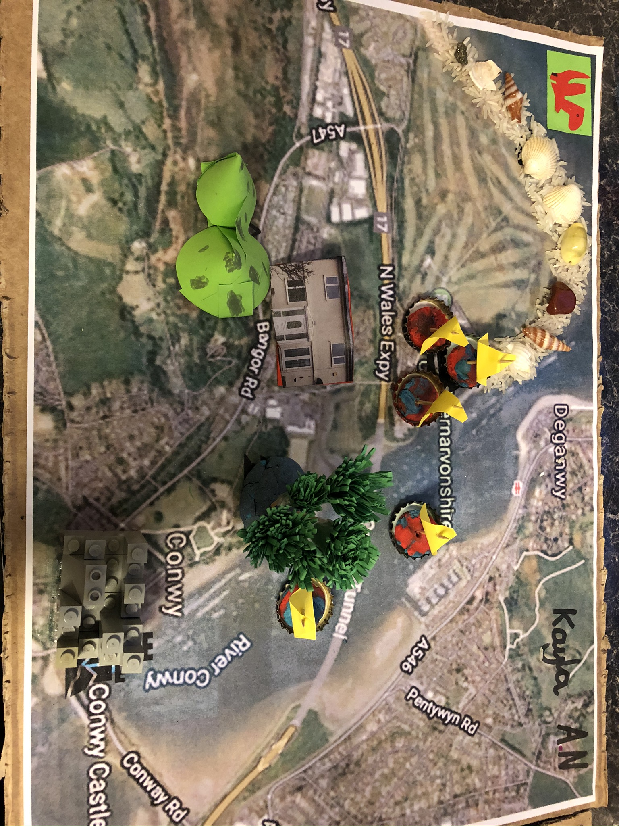
This is Conwy in the North of Wales. I am going to give you a tour!

Slide 4
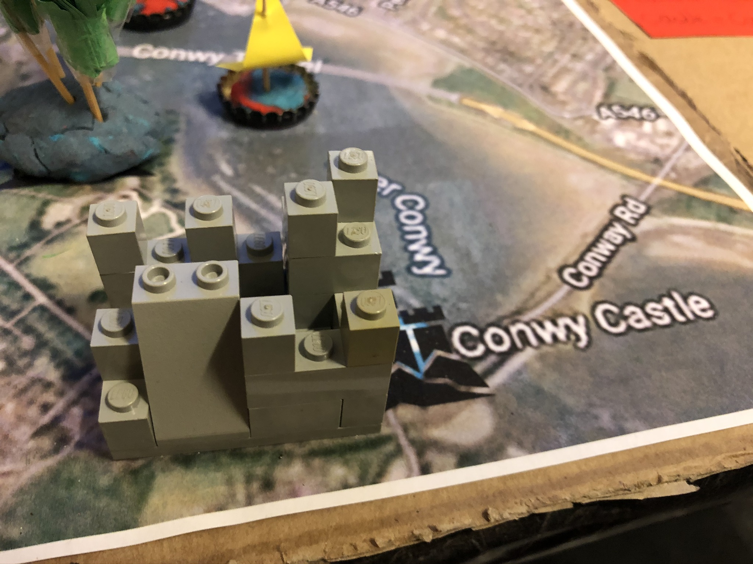
This is Conwy Castle it sits next to the River Conway. Following the English Civil War the Castle was damaged by the Parliamentary armies. It is now a complete ruin that you can visit.

Slide 5
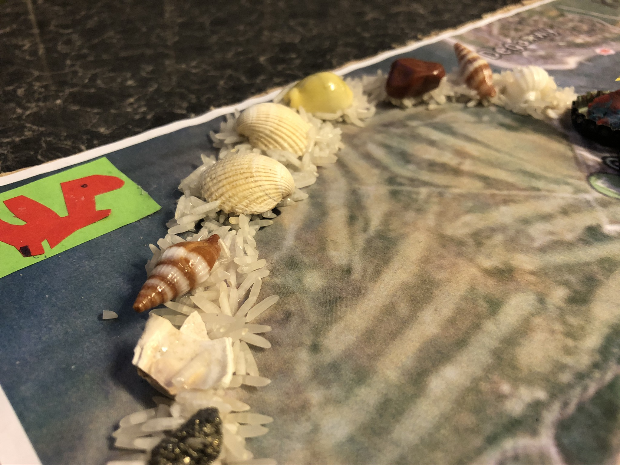
The beach runs from the marina to the end of the golf course. It’s the perfect place for a dog walk /run as the sun rises. It is a sandy beach. If its clear you can see all the way to Llandudno.

Slide 6
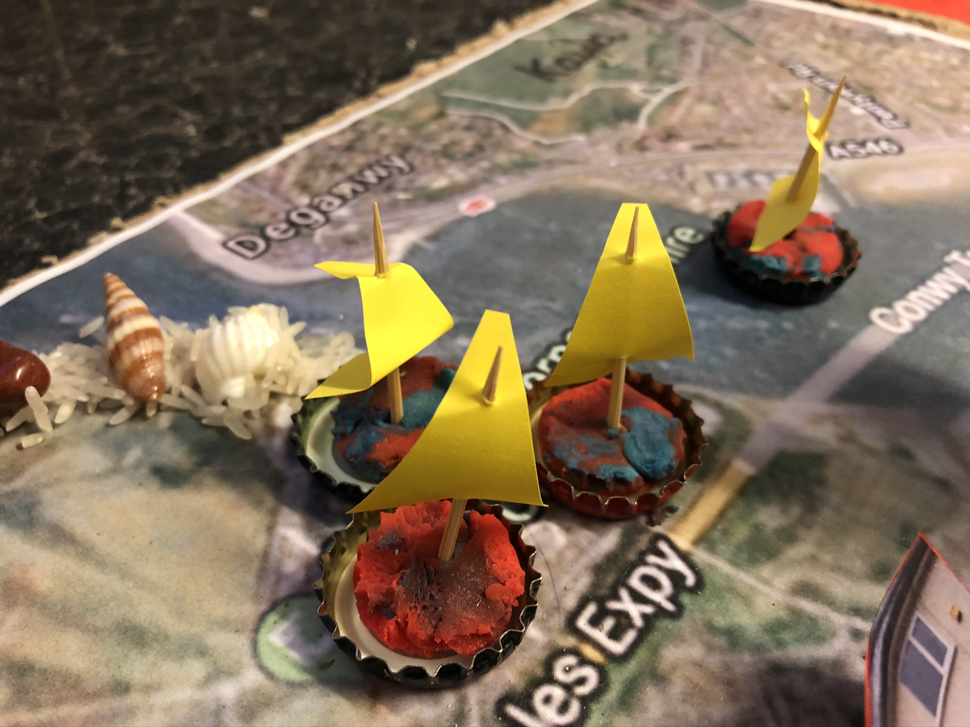
Here is where you park your boat if you are not using it. It’s in the shape of an oval with houses around the edge. With a parting to let the ships/boats go in and out.

Slide 7
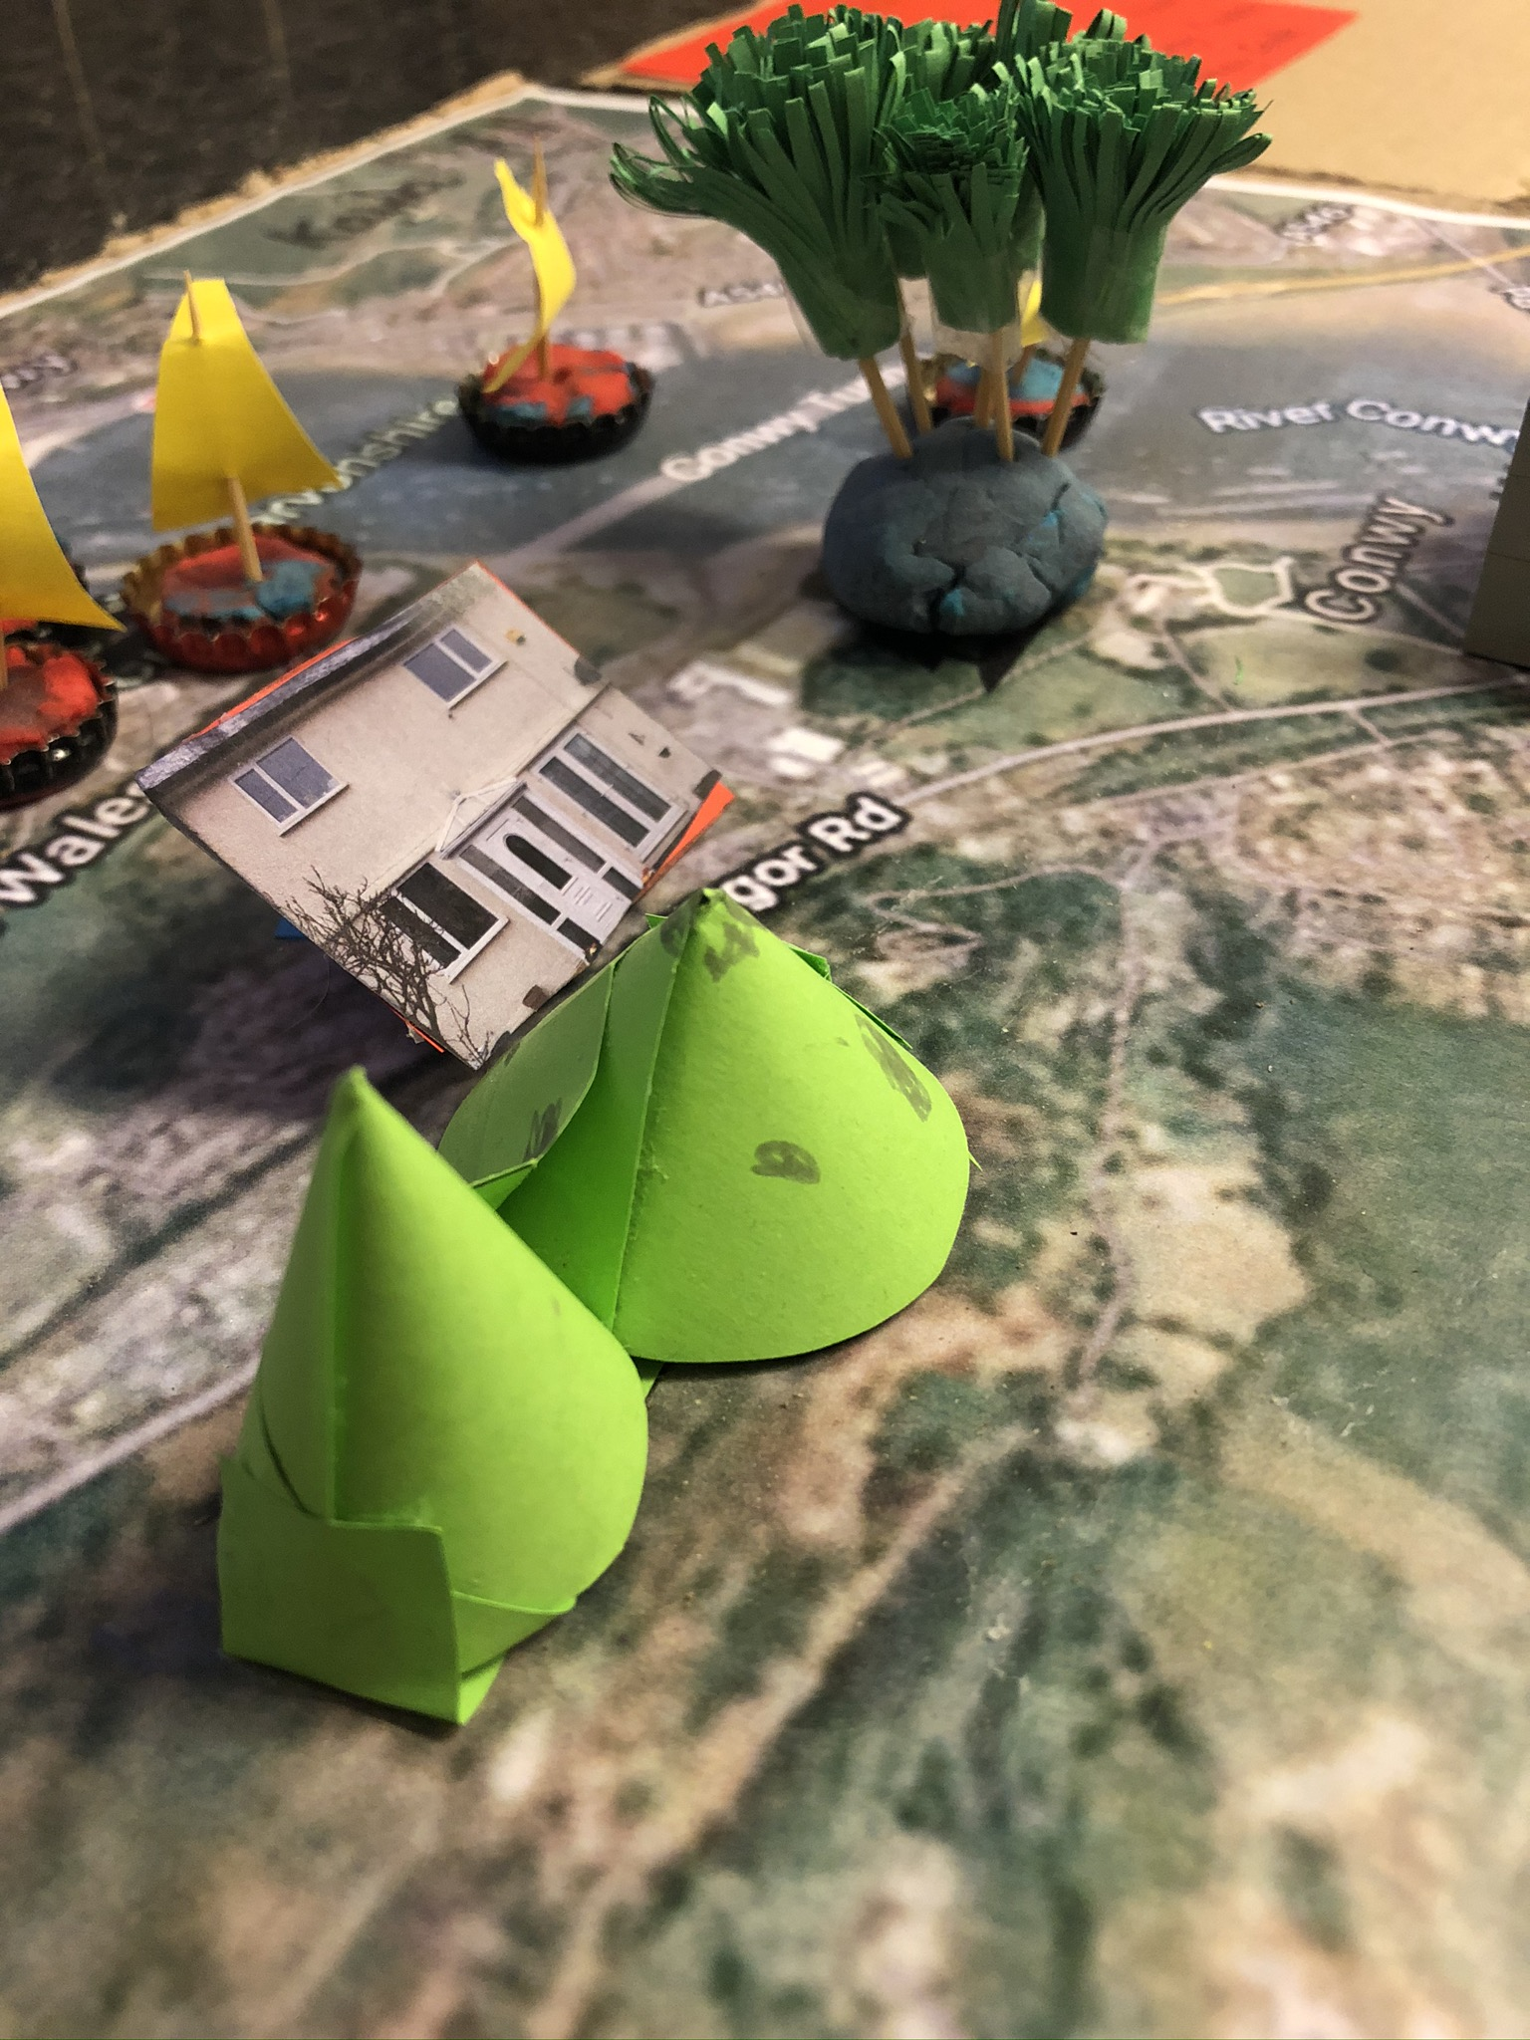
This is Conwy mountain I have climbed it more than once. There’s barely any snow on top unless your lucky . It is 244m tall and can be seen from Llandudno!

Slide 8
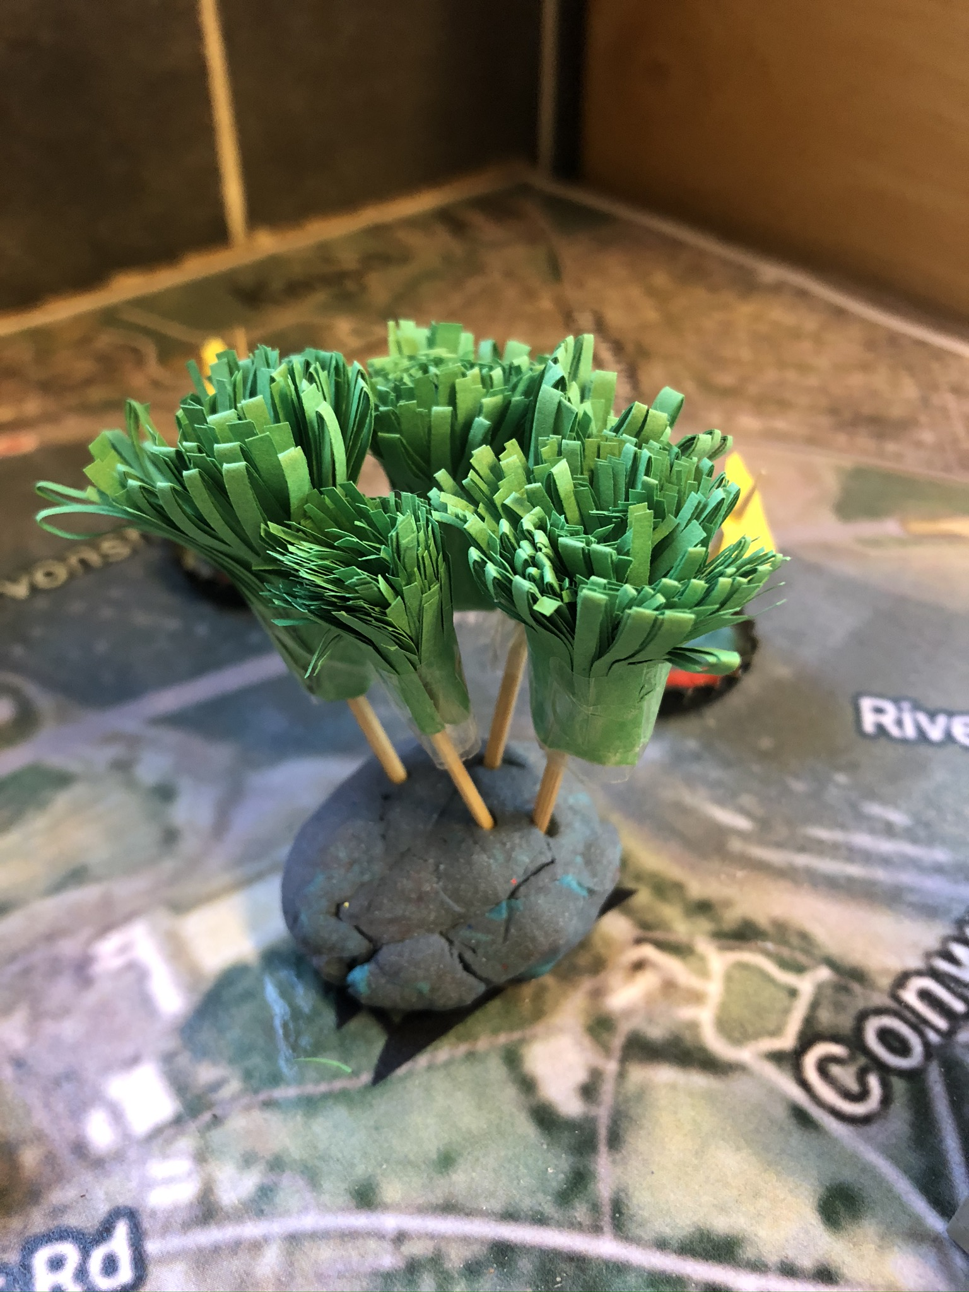
This is Bodlondeb Woods I walk the dog there and have walked through in the dark. Me and my Dad ran ahead and hid in the trees and scared the others . We said BOO!!!

Slide 9
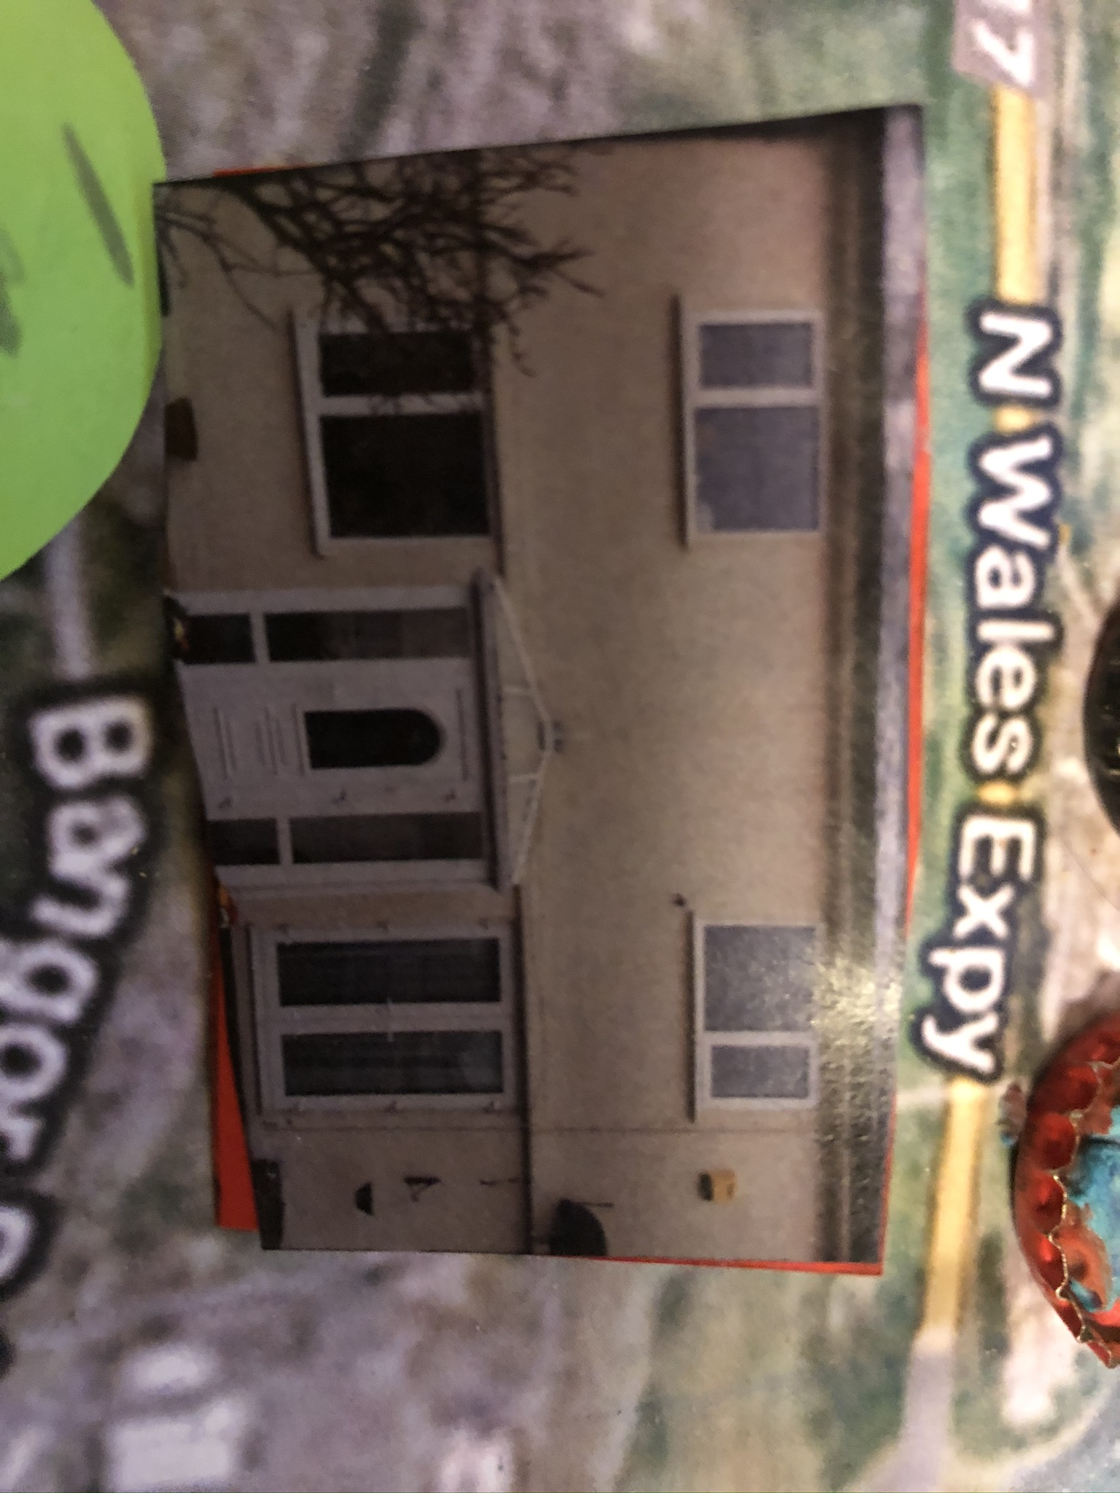
Finally, this is Nana’s house she lives on Gorsefield Road . I stay there when I visit Conwy. Also, this is were my Dad grew up.

