Slide 1
Ernest Shackleton

Slide 2
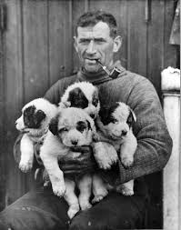
Fun Facts!
He was born in Ireland
He was second out of ten children
His father was a doctor
Ernest did not like school except reading and poetry
Had always been drawn to the South Pole

Slide 3
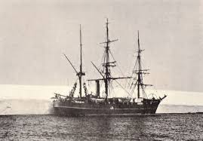
1901
Earnest went on his first expedition when he was 25 but he was sent home because he was sick!
Ships name-Discovery

Slide 4
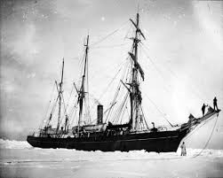
1907
On his second trip he made it within 97 miles of the South Pole before he had to turn back .
Ships name-Nimrod

Slide 5
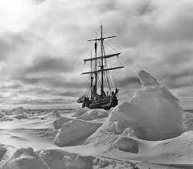
1914
After two attempts, he set the target of going past the South Pole via Antarctica. He left for his trip in August. After leaving their ship got stuck in ice and sadly sunk, they were on ice for over a year. The crew took small boats to Elephant island. Shackleton and two men went to South Georgia to find help. No one died on this expedition thanks to three words Shackleton never quits!!!
Ships name - Endurance

Slide 6
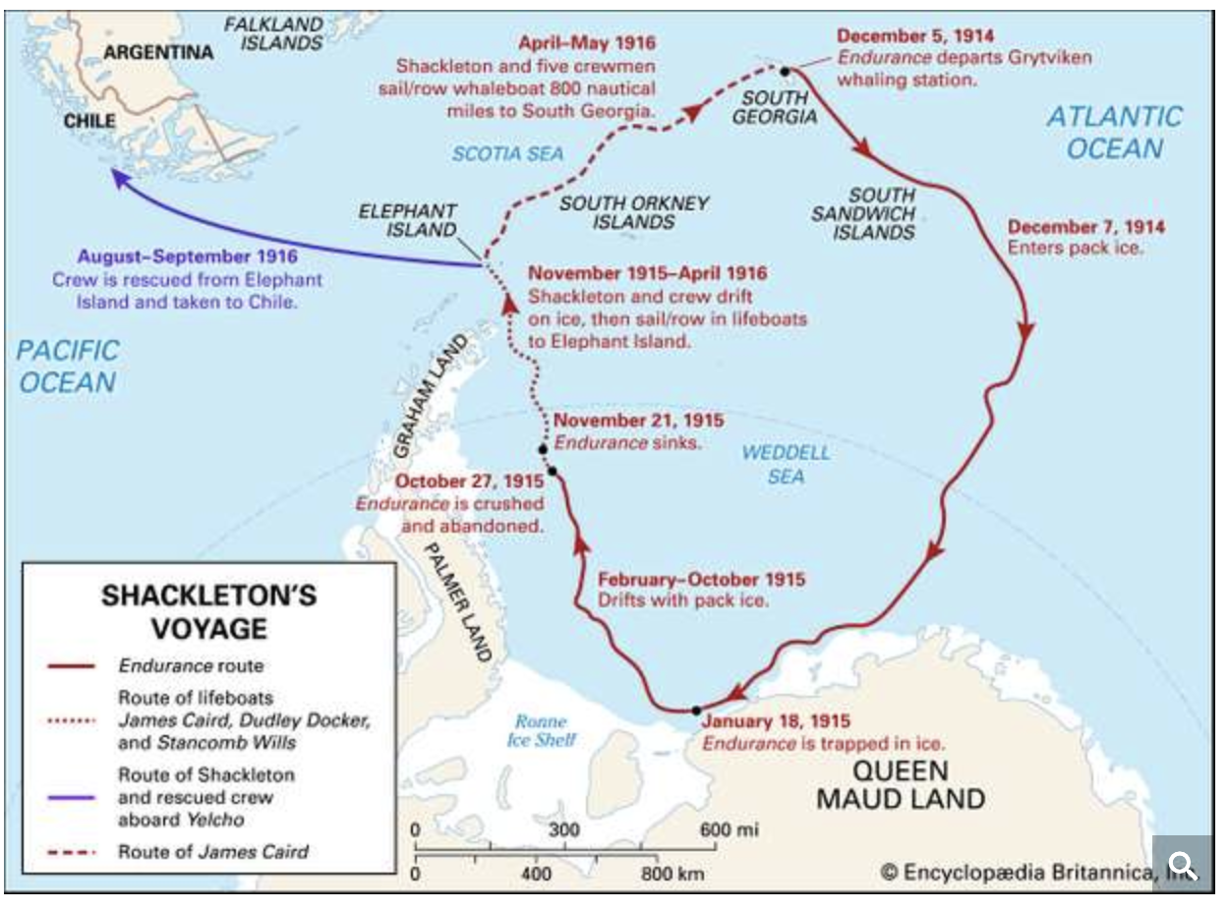
1922
Sadly on his 4th expedition he died from a heart attack in South Georgia.

