Slide 1


Welcome to Asia

Slide 2
Aim of the meeting
Help to develop strong year group link
Put a face to the names
Develop the relationship between home and school
Explain home learning
Share key systems and daily routines
Any questions?

Slide 3
Your Year Group team
The team
Teachers:
North Asia – Mrs Holyoak
Support staff – Mrs Hackett
South Asia – Miss Bristow
Support staff – Mrs Owen, Mrs Stroud and Miss Knight
Across the school, the other year groups are
Y3 Europe, Y4 Africa, Y6 America

Slide 4
Home School Relationship
Reading – at least 3 times a week please!
Multiplication and division facts up to 12 x 12 by end of Year 4 (5x ,10x, 2x, 3x, 4x, 8x)
Supporting events and trips
Volunteering in school particularly with reading in the afternoon.
Merdon Association.

Slide 5
Helping in school….
Volunteers Wanted!!
Are you interested in becoming more involved
in school life?
Are you able to volunteer some of your time
(no matter how little!) to support us with:
Parent Readers
Trips
Fundraising
Gardening
• And much, much more!!
Come along to the Macmillian Coffee morning or speak to a member of the office team about applying to be a volunteer!

Slide 6
What is Home Learning?
Weekly home learning – on line, Maths and Spelling, this is linked to their learning from that week in school or from previous learning.
Rockstar times tables
How long should it take?
Will be on the school website.
Topic home learning will come out at the start of each half term. It can be creative and is led by children’s ideas.
It will be displayed at the parent outcome.

Slide 7
Parent Outcome
These are half termly events that enable you to come in and celebrate your children’s achievements.
Outcome this half term is Friday 18th October at 9.15 – 10.00 am.

Slide 8
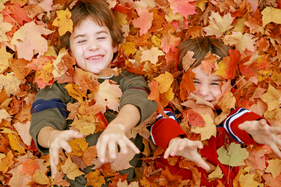
Our Creative Curriculum
We aim to provide a vibrant and exciting curriculum that inspires children to want to learn.
We are proud of our approach with awards from the School of Sanctuary, delivering Refugee and RE weeks whilst being responsive to the world around us.
Outdoor Learning will require outdoor clothes. We will let you know when in advance
Trips, residentials and visitors

Slide 9

Systems and Routines
Healthy snacks – no nuts
After school clubs
PE days plus running
IGNITE and HEART
Library Day
Working towards Awards- House points, Raffle Tickets, Pen Licence, Worker of the Week, HEART awards, HEART pin badges

Slide 10
So far…
All the children have settled in well and are becoming familiar with our routines.
Have visited the library and have all taken out at least one book.
Have been introduced to our topic for this term – Odd and the Frost Giants

Slide 11
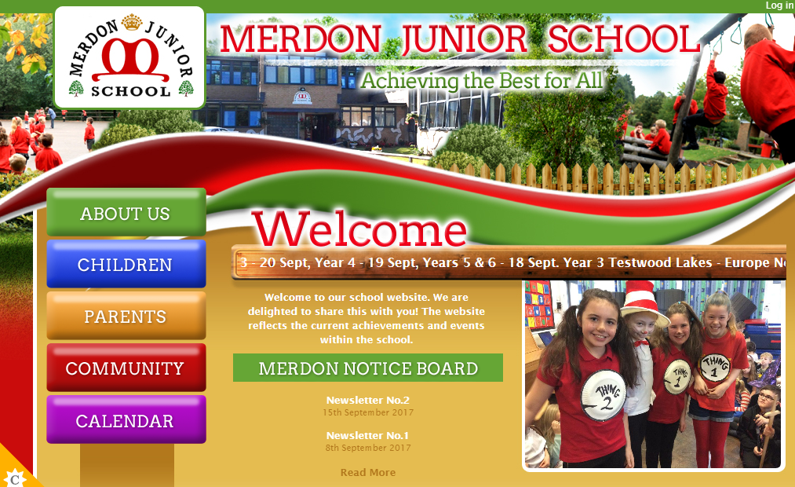
The Website…
You will be able to access;
Your child’s class page with updates on learning and homework
School calendar
Whole school events
Policies
Newsletters
Updates
Safeguarding and E-Safety

Slide 12
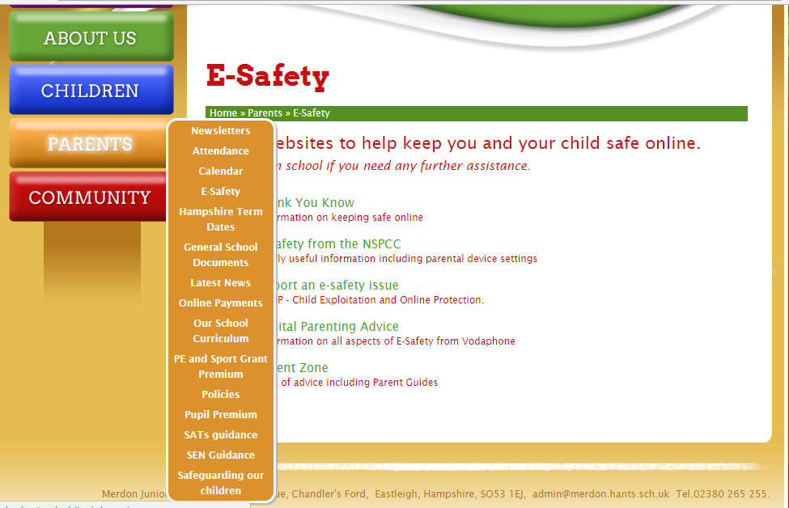
Important information:

Slide 13
Open door policy
Got some exciting news to share? Come and speak to us!
To discuss your child’s progress we have parents evening on 22nd and 24th October.
If you think you are eligible for free school meals, please speak to the office about applying.
Our Designated Safeguarding Lead is Miss Loosemore and our Deputy DSL is Mrs Tones.
Our pastoral team includes ELSA and FEIPS.
Our SENCo is Mrs Tones.

Slide 14
Coming up…
Macmillan Coffee Morning – 27th September
INSET 25th October.
Parent Outcome : 18th October 9.15am
Kingswood information evening 30th September 3.45pm
Thank you for coming- any questions?

