Slide 1
Kingswood
Monday 10th February
–
Friday 14th February

Slide 2
Just a reminder that we require the medical form and full payment of £260 by Friday
31st January.
If you have any questions please do not hesitate to contact the school.

Slide 3
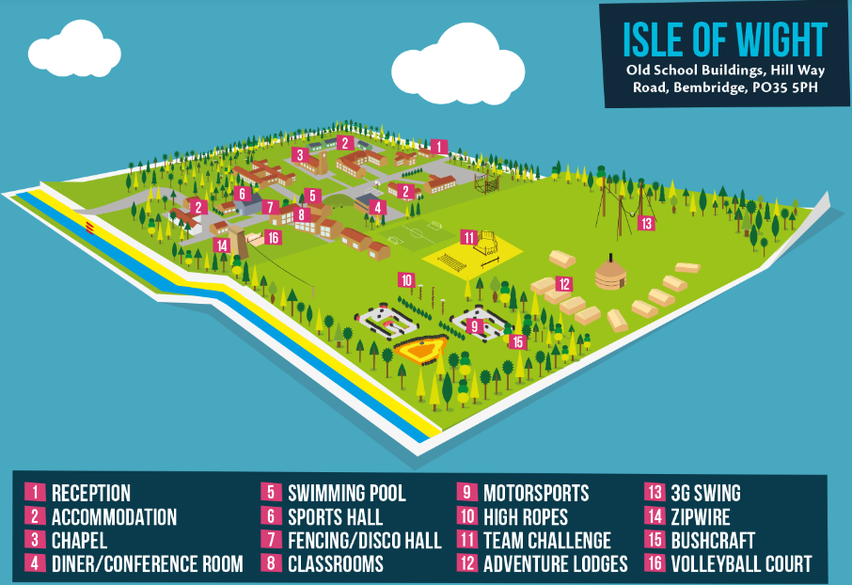
What does the site look like?

Slide 4
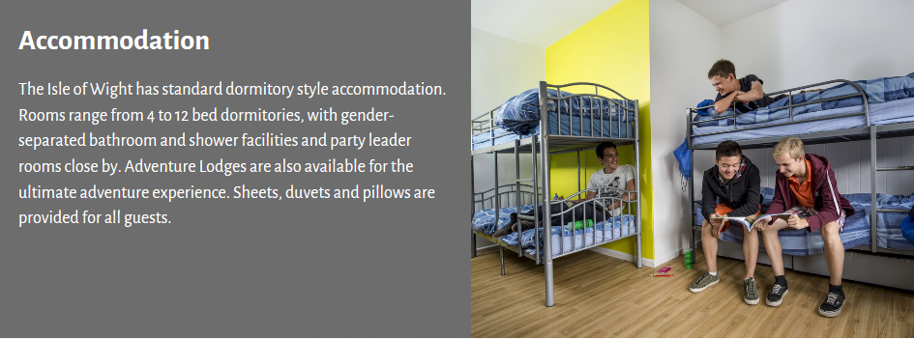
Kilgerran House

Slide 5
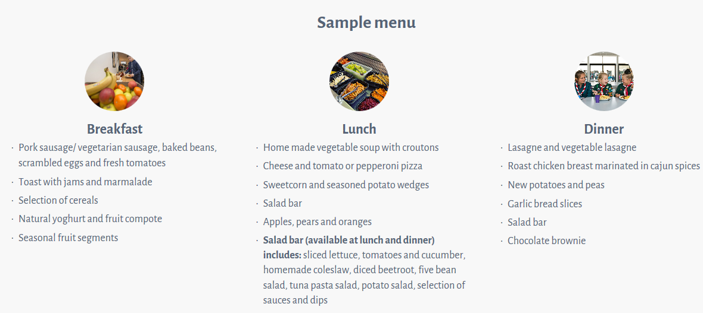
A typical menu

Slide 6
Day One
Monday 10th February
Arrive at usual time and enter via Year 5 door – sign in any required medication
The coach is due to arrive at 10.30
Arrive in Portsmouth
Ferry to IoW 12:00. You need lunch in a carrier bag.
Coach to Kingswood to arrive at 13:30.
Welcome tour
Activity 1
Dinner 17.35
Evening activity

Slide 7
Tuesday, Wednesday, Thursday
Breakfast
Two activities
Lunch
Three activities
Evening meal
Two activities
Bedtime

Slide 8
Activities Include…
3G Swing
Problem Solving
Orienteering
Nightline
Scrapheap challenge
Archery
Aeroball
Low Ropes
Bottle Rockets
Rock Pooling
Campfire
Fencing
Buggy Build
Indoor Cimbing

Slide 9
Friday
Activities 09:30 – 12:00
Lunch
Pick up at 14:00
Ferry 15:00
Arrive back at school around 16:30

Slide 10
Staff
Mrs Holyoak
Miss Bristow (First Aid)
Miss Loosemore/Mrs Tones
Mrs Whitford
Mrs Yates
Mrs Hackett (First Aid)
Miss Gover

Slide 11
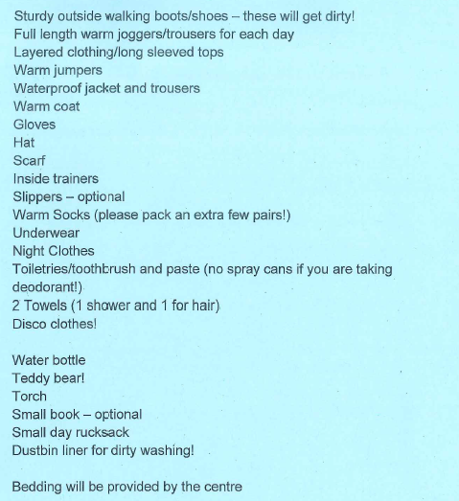
Kit list

Slide 12


