Slide 1


Welcome to Africa
Year 4

Slide 2
Aim of the meeting
Help to develop strong year group link
Put a face to the names
Develop the relationship between home and school
Explain home learning
Share key systems and daily routines
Any questions?

Slide 3
Your Year Group team
Year 4 team:
North Africa – Mrs Simmonds
South Africa- Mrs Yates and Mr Perkins

Slide 4
Home School Relationship
Reading – at least 3 times a week please!
Multiplication and division facts up to 12 x 12 by end of Year 4 (5x ,10x, 2x, 3x, 4x, 8x)
Supporting events and trips
Volunteering in school particularly with reading in the afternoon.
Merdon Association.

Slide 5
Helping in school….
Volunteers Wanted!!
Are you interested in becoming more involved
in school life?
Are you able to volunteer some of your time
(No matter how little!) to support us with:
• Governors
•PTA – Merdon Association
• Parent Readers
• Trips
• Fundraising
• And much, much more!!
If so, please come and talk to the office staff about completing a DBS check.

Slide 6
What is Home Learning?
Weekly home learning – On line, Maths (Mathletics and Rockstar) and Spelling, this is linked to their learning from that week in school or from previous learning.
How long should it take?
Will be on the school website.
Topic home learning will come out at the start of each half term. It can be creative and is led by children’s ideas.
It will be displayed at the parent outcome.

Slide 7
Parent Outcome
These are half termly events that enable you to come in and celebrate your children’s achievements.
Once a term these events will be interactive outcomes, where the children will present something to you e.g. performances to watch, or recipes to try.
At other times the outcome will be an opportunity for you to come and see what your child has been learning.

Slide 8

Systems and Routines
Classroom resources – table organisers
Healthy snacks – no nuts
After school clubs
PE days -Tuesday and Friday
Book bags
IGNITE and HEART
Library Day - Wednesdays
Working towards Awards- House points, Raffle Tickets, Pen Licence, Worker of the Week, HEART awards, HEART pin badges

Slide 9
So far…
All the children have settled in well and are becoming familiar with our routines.
Have visited the library and have all taken out at least one book.
Have been introduced to our topic for this term – Ancient Egypians.

Slide 10
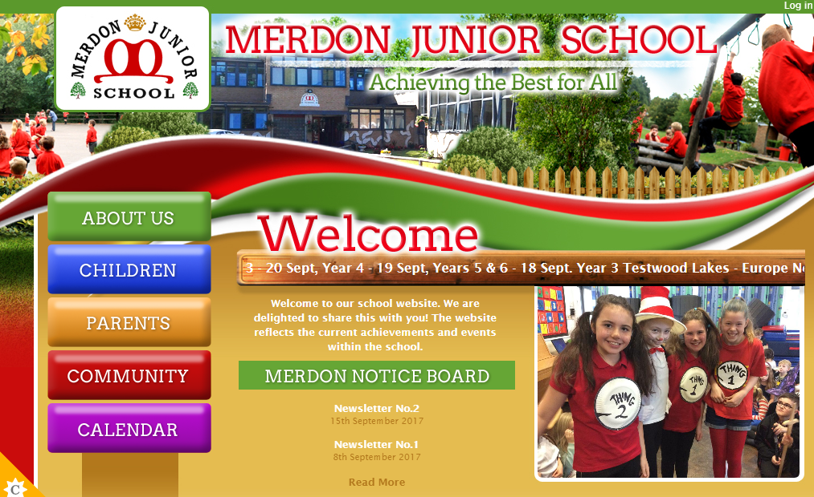
The Website…
You will be able to access;
Your child’s class page with updates on learning and homework
School calendar
Whole school events
Policies
Newsletters
Updates
Safeguarding and E-Safety

Slide 11
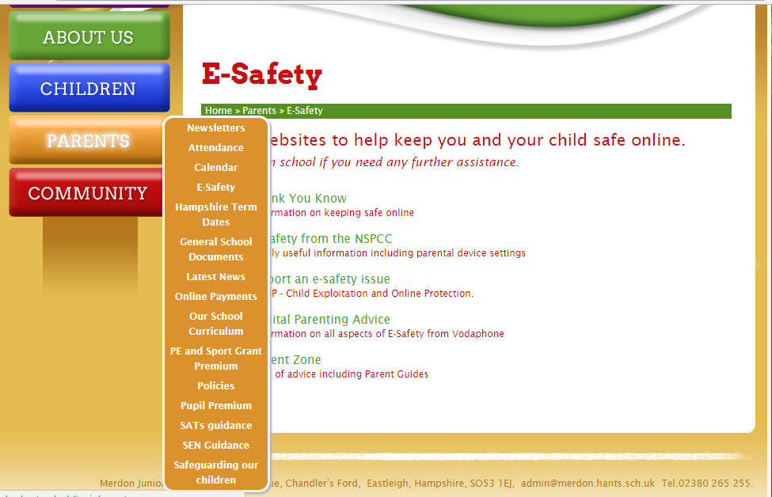
Important information:

Slide 12
Open door policy
Got some exciting news to share? Come and speak to us!
To discuss your child’s progress we have parents evening on 22nd and 24th October.
If you think you are eligible for free school meals, please speak to the office about applying.
Our Designated Safeguarding Lead is Miss Loosemore and our Deputy DSL is Mrs Tones.
Our pastoral team includes ELSA and FEIPS.
Our SENCo is Mrs Tones.

Slide 13
Coming up…
Egyptian Day 23rd September!
Macmillan Coffee Morning – 27th September
Parent Outcome : 17th October 2-3pm
Parents evening 22nd and 24th October
INSET 25th October.
Thank you for coming- any questions?

