Slide 1
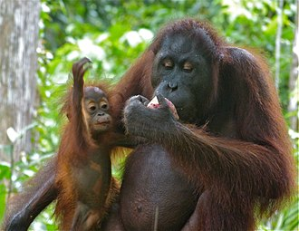
Bornean Orangutan
PONGO PYGMAEUS
CRITICALLY ENDANGERED

Slide 2
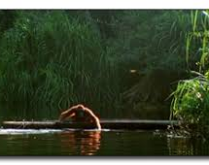
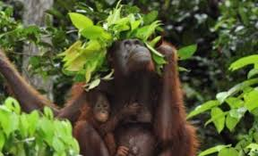
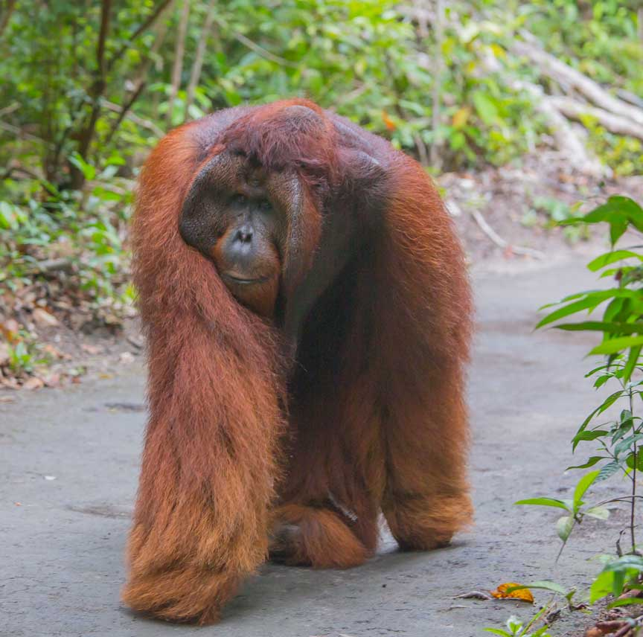
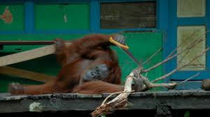
INTERESTING FACTS
Some can row canoes.
They don’t like getting wet so they make leaf umbrellas.
They are really strong.
They can use tools like humans.

Slide 3
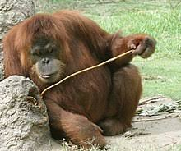
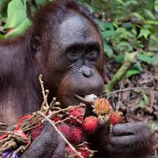
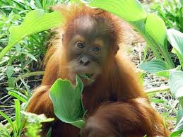
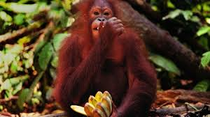
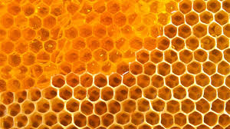
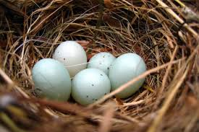
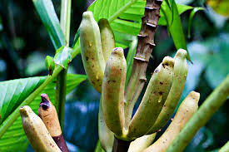
Diet
Berries
Seeds from a fruit
Leaves
Insects
Other things they eat:

Slide 4
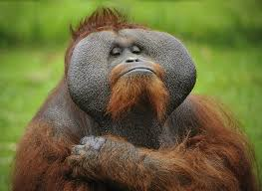
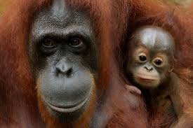
Description
Can grow to three times the size of us
Orange fur
No fur on their faces its just black skin.
Females don’t have large cheek flaps
Males have large cheek flaps
Second largest ape after the gorilla

Slide 5
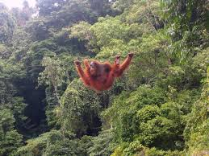
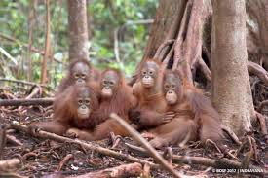
Habitat
Bornean rainforest.
Forest floor which is mostly dry.
Tree canopy which can be wet.

