Slide 1
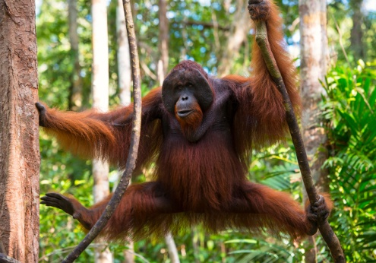
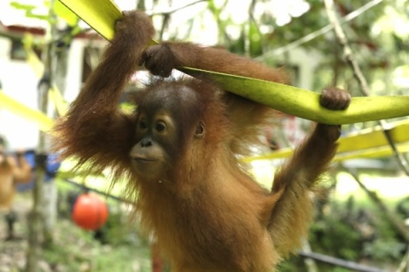
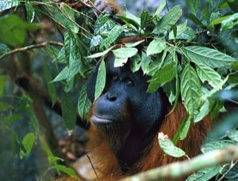
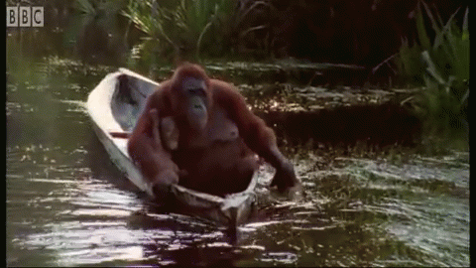
Orang-utans
Orang-utans are very intelligent animals
and are one of the greatest apes.
orang-utans are one of the animals of risk of extinction so do what ever you can to save these amazing creatures so that we haven`t lost one of
our close relatives. SAVE ORANGE LIVES!!!!!!!!
As you can see in this picture, they’re replacing the home to lots of animals with farmland.
Orang-utans don`t like getting wet and because they are really clever, they make umbrellas out of leaves.
Orang-utans have lots of different abilities such as being able to hold tools like we do and copying others. One of their most impressive talents is that they can paddle a boat .WOW!!!

Slide 2
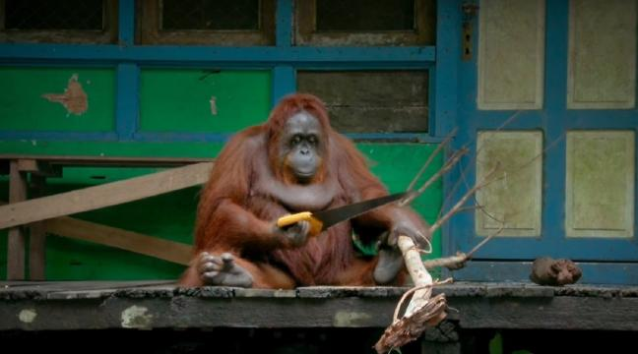
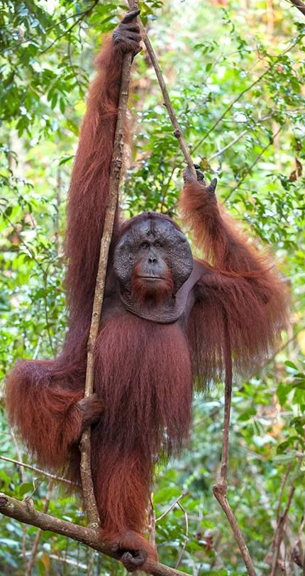
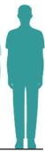
Facts:
Because they`ve lived partly in our world as well as theirs, they can give us insight into what we have in common. They have the same hands that can do
anything our hands can do, like DIY!
Orang-utans are 3X bigger than us humans as adults
Look at the
difference:

