Slide 1
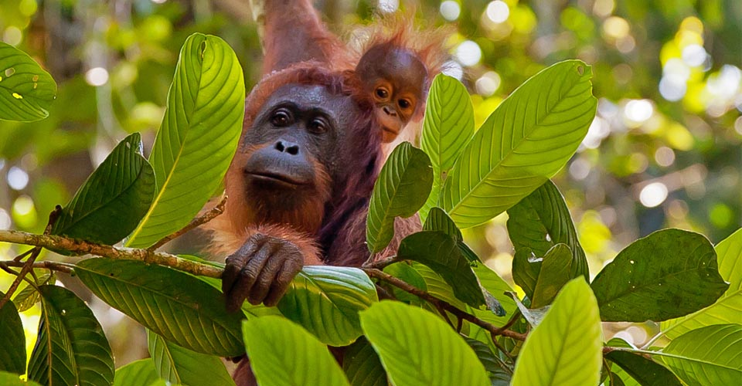
Orang-utan fact file by Isabelle Drayton

Slide 2
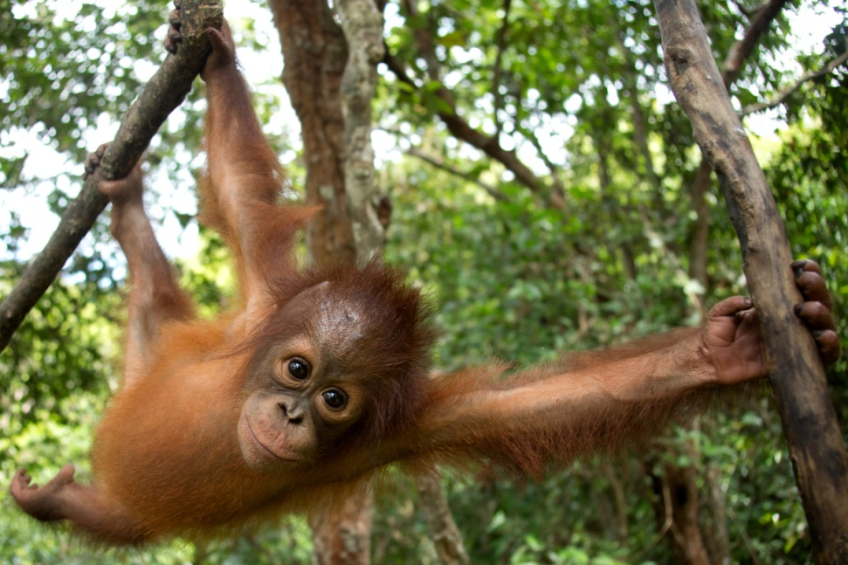
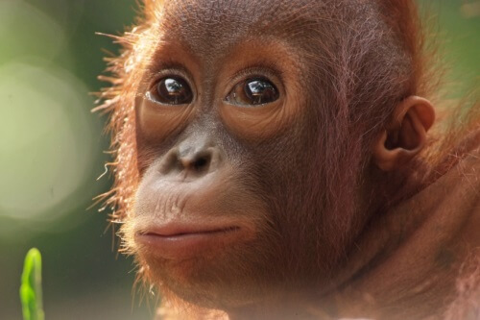
Description
Orang-utans are best known for their orangey-red fur.
Orang-utans have long arms.
Orang-utans can stretch their arms over 2 meters from finger tip to finger tip.
Orang-utans learn from their mothers.

Slide 3
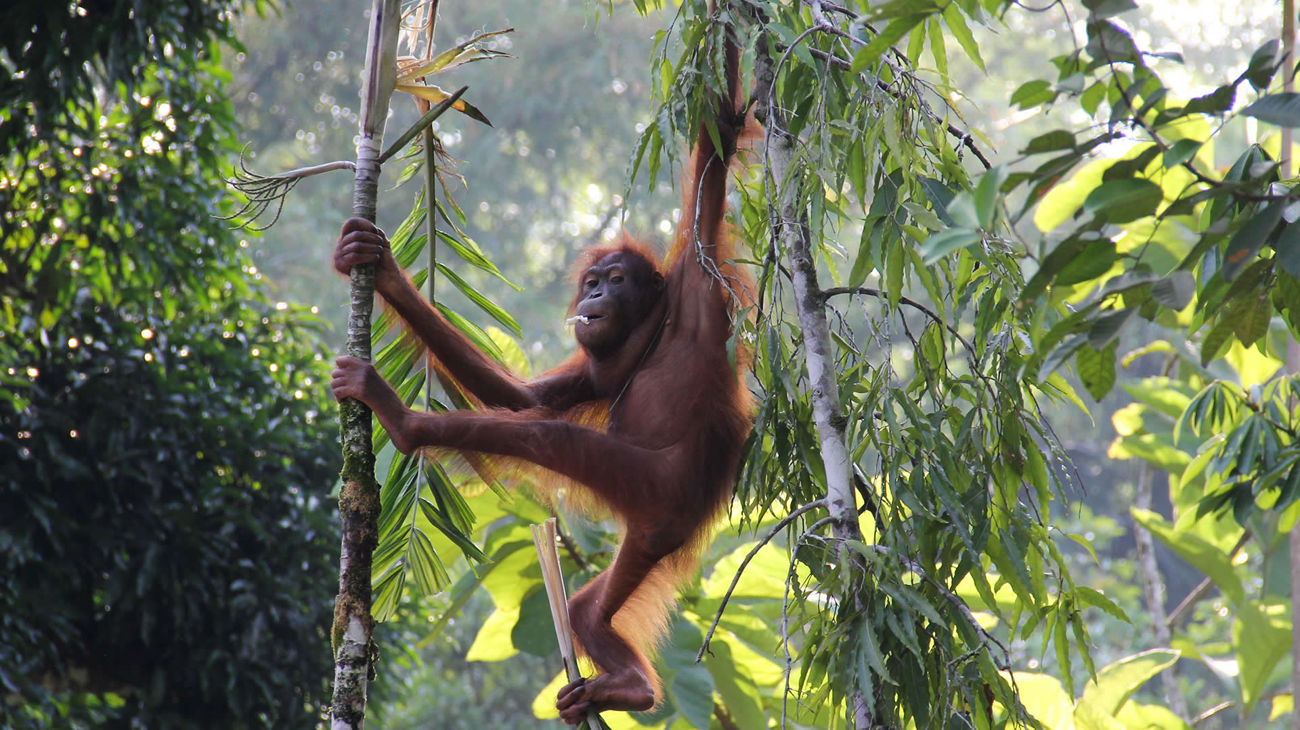
Habitat
Sumatra
Borneo
Orang-utans are only found in the rainforests

Slide 4
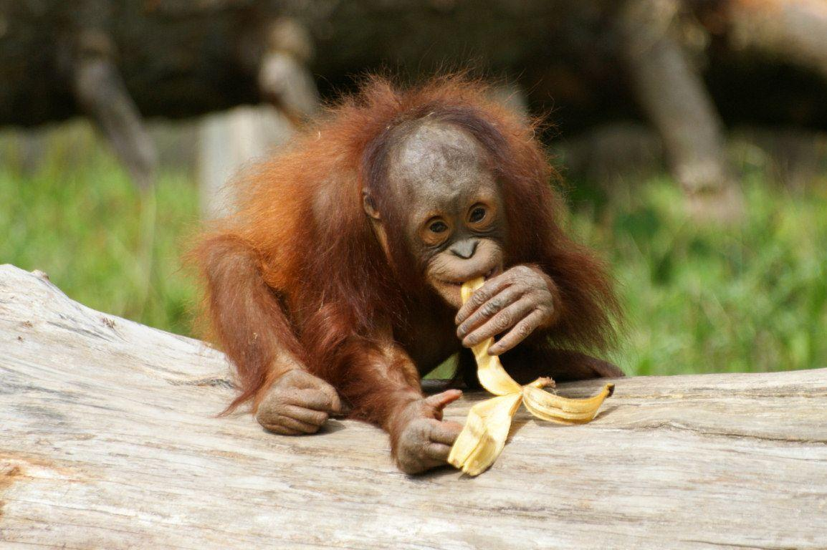
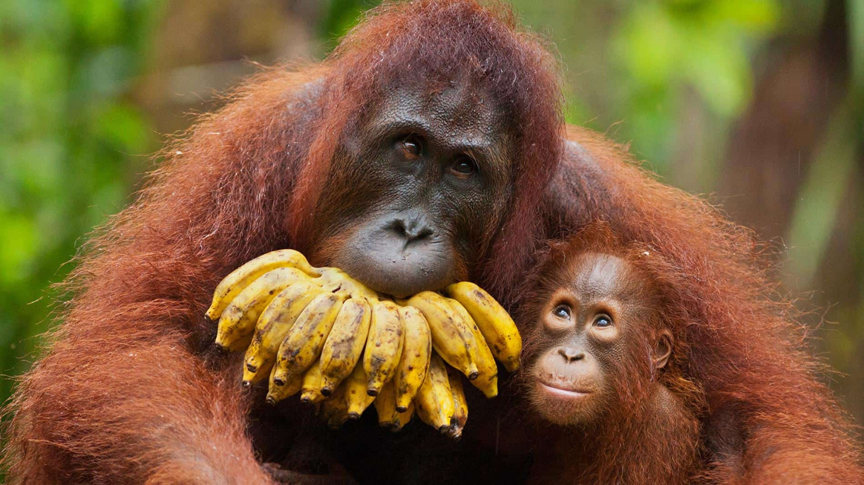
What Orang-utans eat
Leaves
Bananas
Ripe fruit
Bark
Honey
Insects
Durian fruit (which is really stinky) ☺
They don’t mind eating with their feet.

Slide 5
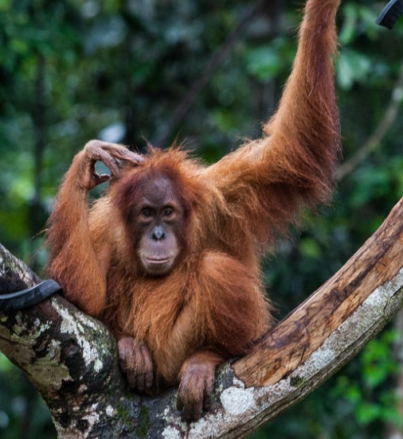
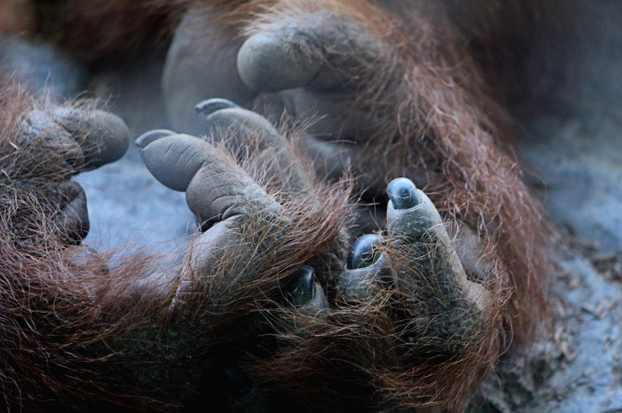
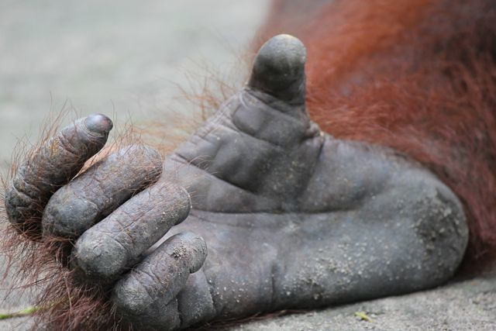
Facts about Orang-utans
Orang-utans can grow up to be 3 times the size of a fully grown human.
Orang-utans have fingers on their hands AND feet.
Orang-utans can live up to 45 years.
Orang-utans are the heaviest tree living animal weighing up to 100kgs

Slide 6
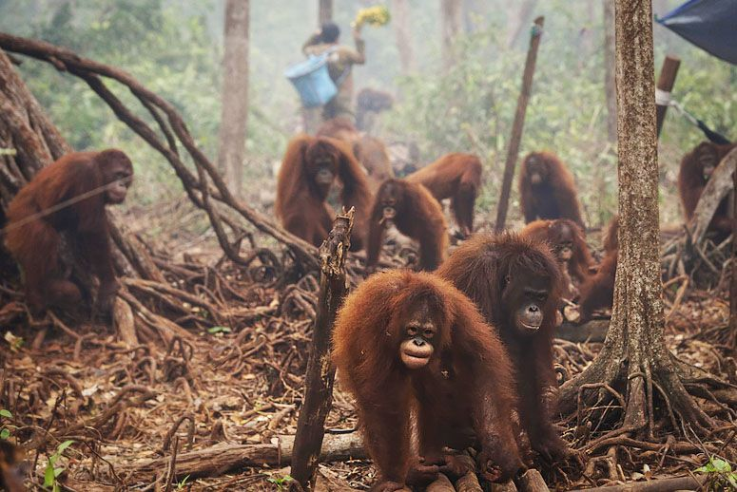
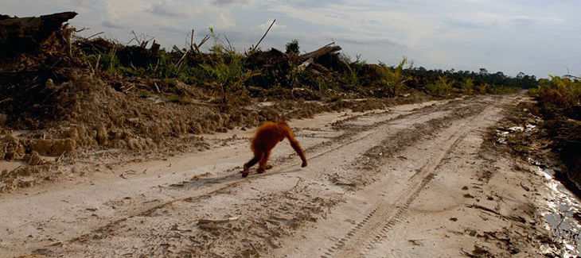
Deforestation
Orang-utans are losing their homes due to deforestation.
Deforestation is when people go into the rainforest and cut down all the trees and that leaves the Orang-
utans homeless
because they
build nests in the
trees.

Slide 7
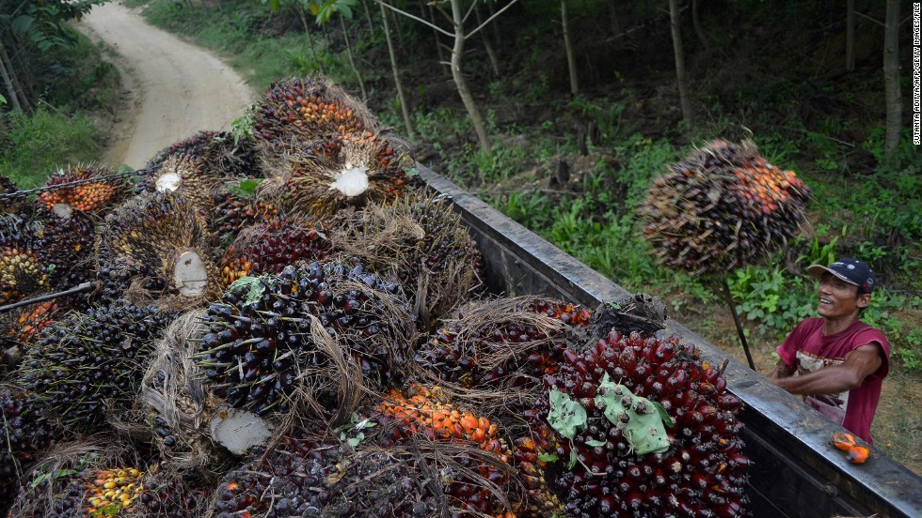
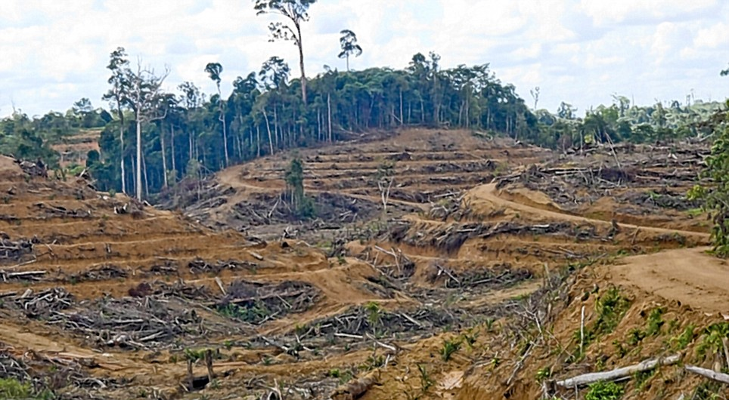
Palm Oil
Palm oil is used in most of our everyday products like:
Food
Shampoo
Deodorant
Lipstick
This is bad is because this contributes to deforestation and reduces the safe places for Orang-utans

Slide 8
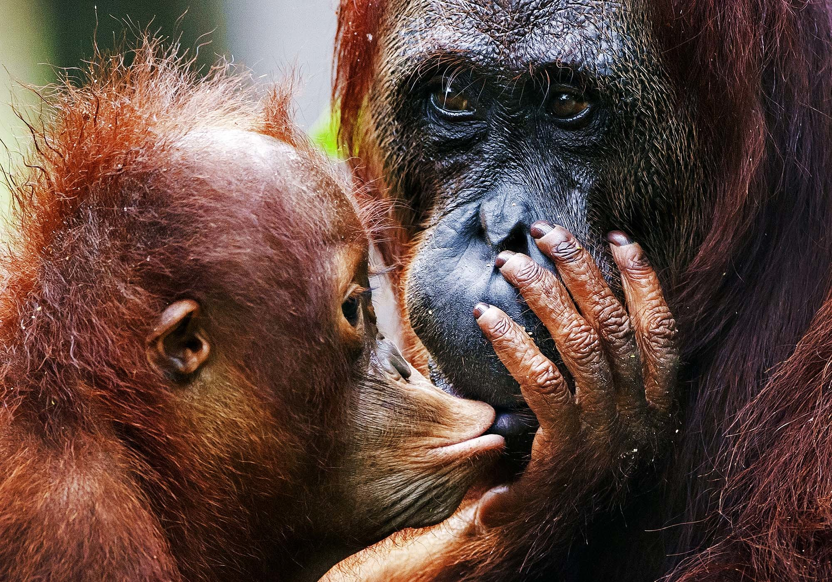

Slide 9

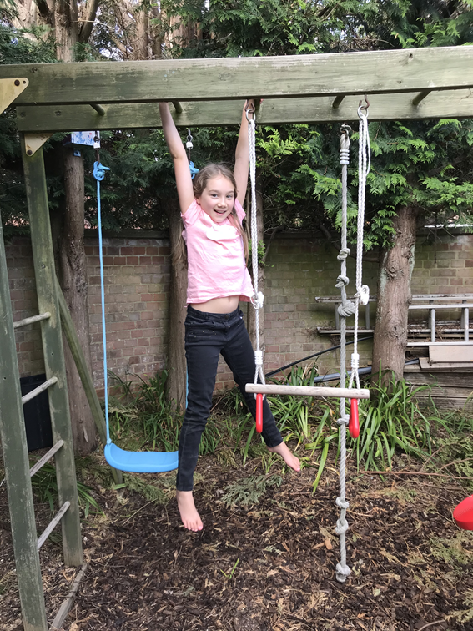

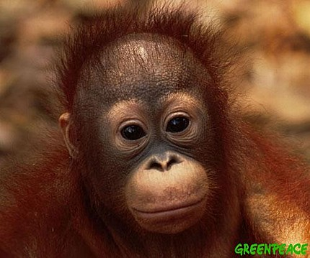
The
End

