Slide 1


Meet the Teacher
Welcome to Year 6
The Year 6 team is Mrs Whitford, Mrs Mellish, Mrs Townsend
PPA Cover – Mrs Howells, Mrs Ivory & Mrs Way

Slide 2
The School Golden Rules
Be Safe
Be Kind
Be Respectful

Slide 3
How you can help at home
Homework - Google Platform plus paper homework later in the year. This is set on Thursday for the following Tuesday.
Timestables - TTRS
Spelling and handwriting
Reading
Talk to us!

Slide 4
PE
PE – kits PE lessons are on Wednesday and Friday for swimming this term (then in school PE on Mondays from after half term)
.

Slide 5
Information on the School Website
The website contains lots of information including;
Your child’s class page with updates on learning
School calendar
Policies
Safeguarding your child - E- safety
Weekly Newsletters
Information on FSM, SEN and wellbeing provision

Slide 6
Safeguarding
The Designated Safeguarding Team lead is Mrs Russell
Mrs Pugh and Mrs Caine are deputies, who alongside Mrs Diskin and the whole staff, prioritise safeguarding and well-being.
If you have ANY concerns about any child, please contact Mrs Diskin or Mrs Russell.
There is a safeguarding page on the school website.

Slide 7
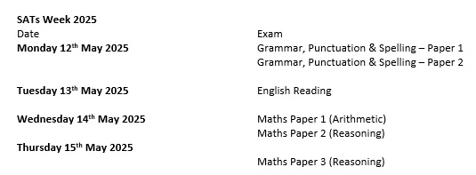
And finally…SATS
We will give out further information
about this later in the year.

Slide 8

Any questions?

