Slide 1


We’re Solent Mind, your local mental health charity.
We’re here to make sure anyone with a mental health problem has somewhere to turn for advice and support.

Slide 2


Slide 3

Listen to someone else's ideas about your thoughts
Talking about your problems with a family member can help you get ideas about new ways of dealing with your problem or worries. Sharing your thoughts can also help you feel calmer and listened to.

Slide 4

Be active
Physical activity can help you feel calmer, stronger, and better able to deal with emotional stresses. Try something you enjoy e.g. walking the dog, dancing, gardening.

Slide 5

List your achievements
When you have done something you feel proud of, write it down. Remember to include the everyday tasks, like shopping, or preparing a meal. When you feel stressed, read the list to give yourself a boost.

Slide 6

Take a regular break
Give yourself a brief break when you feel things are getting on top of you – get a hot drink or a glass of water

Slide 7

Take control
Get started by doing one task you feel you can manage; for example, making an appointment or doing the dishes.

Slide 8

Get organised
Make a list of jobs; tackle one task at a time; alternate dull tasks with interesting ones

Slide 9
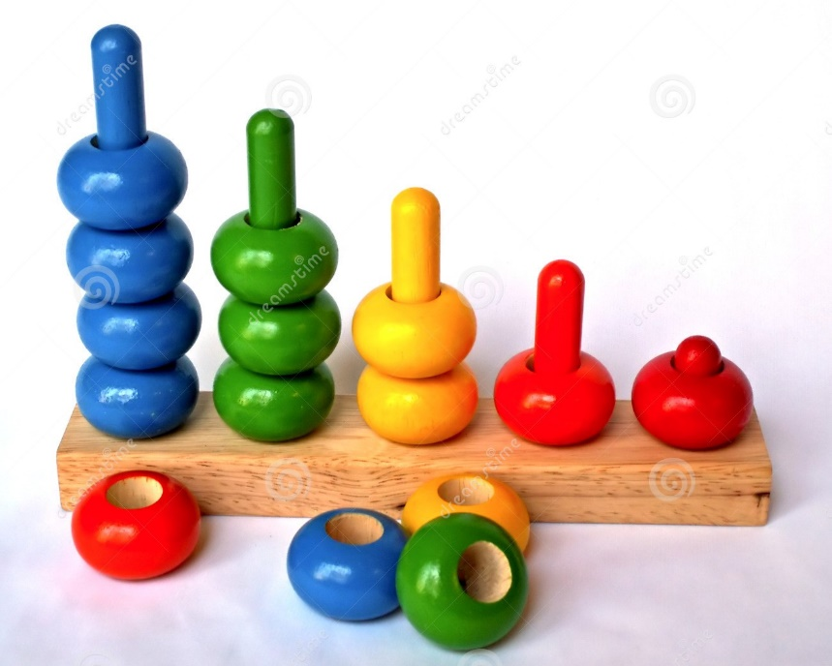
Sort out your worries
Divide them into those that you can do something about (either now or soon) and those that you can’t.

Slide 10

Find out what triggers your worries and thoughts
You can then think about what you can stop doing or change to be able to manage the triggers better.

Slide 11


Things to do in your day
Learning
Open the window and take some big deep breaths and feel the sun on your face
Reading
Gardening
Cooking/baking for your family
Going out for 1 piece of exercise per day
P.E- (Joe Wicks is a good one 9am every week day on Youtube)
Cooking
Tidying up and doing small jobs for your family around the house
Being creative
Quiet time watching a film or TV programme
Having a dance and sing
Listening to your favourite music or and audio book

Slide 12


Slide 13


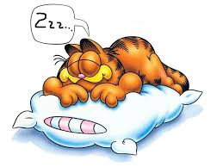

5 Things to make sure you are doing
Eating well
Having a good nights sleep
Exercising every day
Talking to your family about your worries, thoughts and feelings
Drinking water and staying hydrated

Slide 14
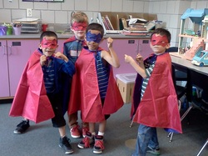
Remember there are fun practical things you can do to help you cope staying inside, have a look at these:
Imagine yourself as a Superhero
Dress up as your favourite superhero for the day, it will make you feel strong and able to cope with anything.

Slide 15
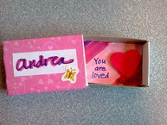
Instant coping boxes/ Self soothe boxes
Make yourself a comfort box and put all of your favourite things you could use to make yourself happy. It could be pictures of your friends and family to little keepsakes.

Slide 16

FOR PARENTS
Try these small ideas you can use with your children

Slide 17

Create a worry jar with your child. Find a real glass or plastic jar.
Have your child decorate it (which is the really fun part) and then label it with a name (e.g., ‘Johnny’s Worry Jar’ or ‘My Worry Jar’).
Once the jar is finished, help your child write down all his or her worries in a list on paper.
You and your child can then cut each worry into its own strip of paper. Fold each worry and put it in the jar.
Once all the worries are inside, have your child close the jar.

Slide 18
Schedule Worry Time
The next step is to schedule “Worry Time”. Worry time is a set time of day when your child has permission and is encouraged to worry as much as he or she wants. This specific time serves as another way to contain the worries. The key is to remember that when worry time is over, you and your child know that the worrying must end for the day.
Choose 10-15 minutes a day after school or after supper (but not right before bed) and write down when worry time is on the worry jar (e.g., 4 PM to 4:15 PM). You may want to set a timer or alarm to notify your child that worry time has begun. Once worry time starts, your child can open the worry jar, look inside, and proceed to worry all he or she wants. Your child can choose to review all the worries or focus on one or two each day. Depending on the child and your child’s developmental age, worry time can be spent alone or with you. To end worry time, have a timer or alarm sound to indicate that worry time is over for the day. Your child should close the jar to put his or her worries away.
Of course, it is normal for worries to come up at other times during the day. After all, your child may be an expert worrier (like so many of us). If a worry appears at another time, you or your child can write it down and “save the worry” for worry time. That is, remind your child that it is not the right time to worry and he or she can think about the worry at the next worry time.
By using the worry jar, at some point your child will likely tell you that he or she is no longer worrying about something he or she had previously put in the jar. This is the exciting part for your child as this discovery represents success at overcoming a worry! Celebrate these moments together and make a big deal out of it. Have your child remove the worry and rip it up.
Similarly, you may also notice that your child decides to skip worry time some days as he or she feels they don’t need it. This is another sign of success to be reinforced and recognised!

Slide 19

Things for you to talk through with your children..

Slide 20
Connect with others. Develop and maintain strong relationships with people around you who will support and enrich your life.
Take time to enjoy. Set aside time for activities, hobbies and projects you enjoy.
Participate and share interests. Join a club or group of people who share your interests.
Contribute to your community. Volunteer your time for a cause or issue that you care about.
Take care of yourself. Be active and eat well – these help maintain a healthy body.
Challenge yourself. Learn a new skill or take on a challenge to meet a goal.

Slide 21
Challenge yourself. Learn a new skill or take on a challenge to meet a goal.
Deal with worries. Be aware of what triggers your worries and how you react. You may be able to avoid some of the triggers and learn to prepare for or manage others.
Rest and refresh. Get plenty of sleep. Go to bed at a regular time each day and practice good habits to get better sleep. Sleep restores both your mind and body.
Notice the here and now. Take a moment to notice each of your senses each day. Simply ‘be’ in the moment – feel the sun and wind on your face and notice the air you are breathing.
Ask for help. This can be as simple as asking a friend, teacher/family member to help and listen to you. Always share with others, they can help change a mountain into a mole hill which is easier to climb.

Slide 22


