Slide 1


Keep Calm and
Make Music
EASTER EGGSTRAS!
Musical fun and games for KS2

Slide 2


EASTER EGGSTRAS
Things to do for KS2

Slide 3

Go on a sound hunt
Print this page and have fun ticking off the things you find
A recorded sound A crunchy sound
A shaky sound A ticking sound
A water sound An electronic
sound
A bubbly sound An unusual sound
Which sound is your favourite? ………………………..

Slide 4
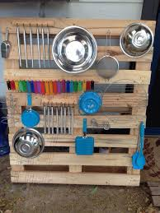
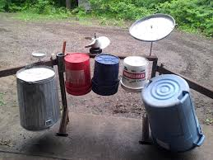
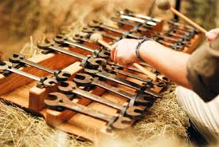
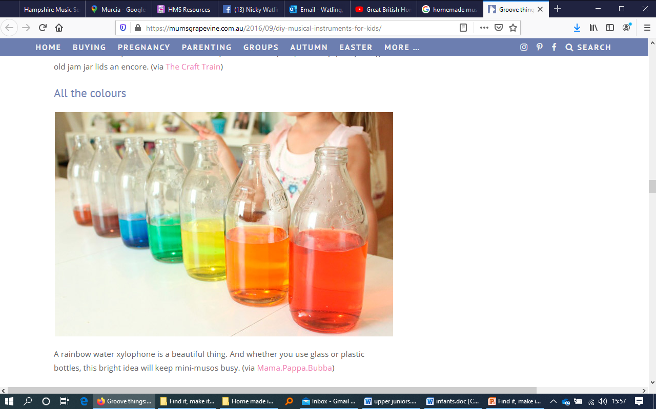
Make kitchen/garden instruments
How many different types of sound
can you make?
Can you make an instrument that
will play a tune
e.g. Hot Cross Buns?

Slide 5





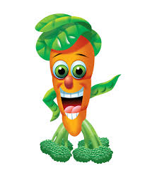
Make a sensory walk
Be sure to include something
for each of our 5 senses
Hear Smell See
Touch Taste

Slide 6

Energisers!
Click the links below to sing and dance along to some fun tunes….
Zumba Kids
Jailhouse Rock
Cartoons Which Doctor
Don’t worry, be happy

Slide 7

Musical colouring
Print the following slides or follow this link to download a free colouring sheet from the BBC
http://teach.files.bbci.co.uk/bringthenoise/colourings/be_in_the_band_colouring.pdf

Slide 8

Musical colouring
Print me out and colour me in

Slide 9

Musical colouring
Print me out and colour me in

Slide 10

Musical colouring
Print me out and colour me in

Slide 11



Fun Musical Apps
Here are some fun apps you could try:
Toca Band – App for iPhone/ iPad
Chrome Music Lab
find at: https://musiclab.chromeexperiments.com/
Incredibox
find at: https://www.incredibox.com/

