Slide 1
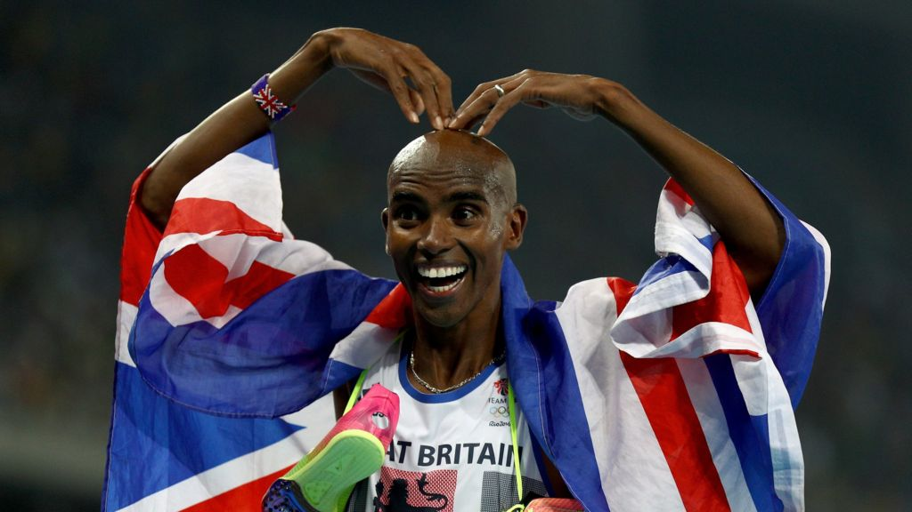
Sir Mohammad Farah
Mo Farah is a famous athlete runner
Mo Farah was born in 23 of march 1983
He always try's his hardest and gives 110%
Mo runs 126 to 135 miles a day. That is a lot!!
Mo has a twin brother, Hassan
Mo won a dual gold medals at the London Olympics.
Mo has a wife and 4 children
Mo Sometimes trains on a treadmill underwater. Wow
In the 2012 Olympics he won gold in the 10,000 metres and the 5,000 metres
Mo is a very determined person
One day Mo would like to work with Children and raise the next generation of athletes
He has won loads of GOLD meds
He wanted to play for Arsenal Football Club as a right winger
He was born in Somalia not England
Hi Motto is Keep climbing that ladder…..but don’t lose sight of the fun
Mo Has won the great north run 4 times

