Slide 1

Welcome to AFRICA
Year 4

Slide 2
Team Africa
North Africa
Mrs Simmonds, Mrs Tones and Mrs Buckley.
South Africa
Mrs Holyoak and Mrs Wooton

Slide 3
Weekly Homework expectations
Reading – at least 3 times a week please!
Banded books are read at school-Read for pleasure at home
Multiplication and division facts up to 12 x 12 by end of Year 4 (5x ,10x, 2x, 3x, 4x, 8x)
This supports the 4 x a week Rockstar sessions -children can practice their times tables online on Rockstars. They can also still use Mathletics . Homework will be set weekly to revise the weeks Math topic.
Spelling through Spelling Shed the words are also on the website.
Their logins for Spelling Shed, Mathletics and Rockstars are the same
In the event of a Bubble closure– Learning will be set on Google Classroom
https://merdon-junior-school.secure-primarysite.net/information-for-parents-4/

Slide 4
Systems and Routines
Healthy snacks – no nuts
PE days are on Wednesday and Friday-please wear kits to school
Our Learning Values are IGNITE and our Behaviour values are HEART
Home work set on Thursday for the following Tuesday.
There are regular opportunities to hand wash and sanitise hand throughout the day.
Lunch is eaten in classrooms.

Slide 5
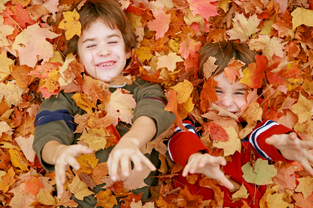
Our Creative Curriculum
We aim to provide a vibrant and exciting curriculum that inspires children to want to learn.
We are proud of our approach with awards from the School of Sanctuary, delivering Refugee and RE weeks whilst being responsive to the world around us.
Outdoor Learning will require outdoor clothes. We will let you know when in advance
Trips, residential and visitors are currently on hold. New and exciting ways to provide experiences and opportunities are being looked at.

Slide 6
So far…
All the children have settled in well.
Have visited the library and have all taken out at least one book.
Have been introduced to our topic for this term –Our Planet.
They have already produced some fantastic work see our class pages on the website. https://merdon-junior-school.secure-primarysite.net/autumn-1-17/

Slide 7
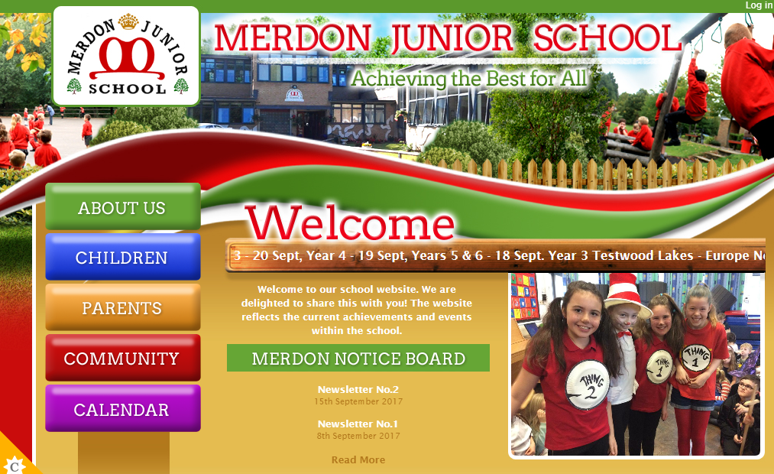
The Website…
You will be able to access;
Your child’s class page with updates on learning and homework
School calendar
Whole school events
Policies
Newsletters
Updates
Safeguarding and E-Safety

Slide 8
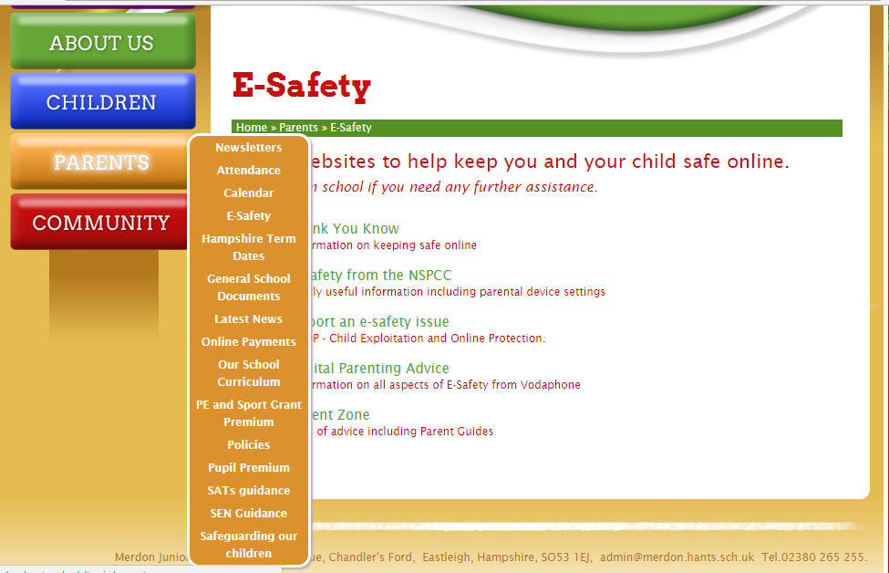
Important information:

Slide 9
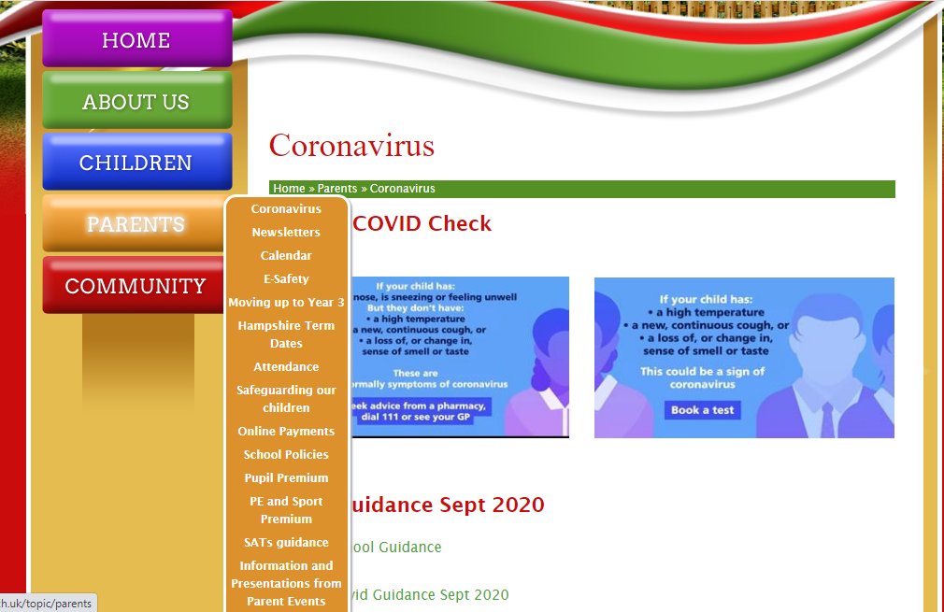
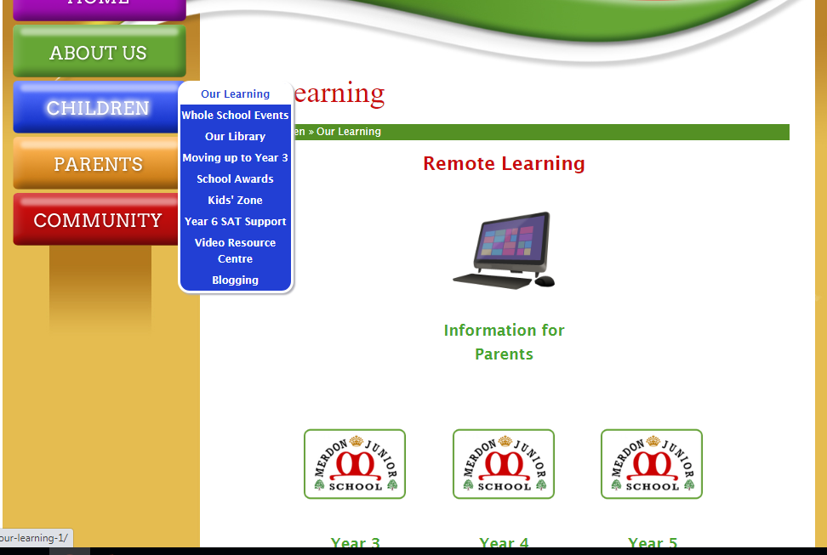
Coronavirus information:

Slide 10
Open door policy
Got some exciting news to share? Get your child to share with us.
If you think you are eligible for free school meals, please speak to the office about applying.
Our Designated Safeguarding Lead is Miss Cunnigham and our Deputy DSL is Mrs Tones.
Our pastoral team includes ELSA and FEIPS.
Our SENCo is Mrs Tones.

Slide 11
And finally
We expect them to complete homework and hand in on time.
We want then to be responsible for their resources and personal possessions.
Most of all we want them to enjoy their final year at Merdon, even in these challenging times.

