Slide 1


Welcome to AFRICA
Another important step in your child’s journey
Notes:
JT

Slide 2
Aim of today
Help to develop strong year group link
Put a face to the names
Develop the relationship between home and school
Explain homework and home learning
Share key systems and daily routines
Answer any questions
Notes:
JT

Slide 3
Your Year Group team
North Africa – Miss Turner, Miss Loosemore and Miss Gover supported by Mrs Owen
South Europe - Mrs Yates supported by Miss Phillips
Across the school, the other year groups are
Y3 Europe, Y5 Asia, Y6 America
Notes:
JT

Slide 4
Home School Relationship
A really valuable link so that your child knows that we are working together to help them.
Through weekly English and Maths home learning on line.
Topic home learning (half termly)
Reading – at least 3 times a week please (raffle ticket for every full page –just keep going!)
Multiplication and division facts up to 12 x 12 by end of Year 4
Supporting events and trips
Volunteering in school particularly with reading in the afternoon.
Merdon Association.
Governors
Notes:
JT

Slide 5
What is Home Learning?
Weekly home learning – Mathletics and Spelling Shed. The tasks will be linked to their learning from that week in school or in preparation for the week ahead.
How long should it take?
The school website
Homework drop in club on Friday and Monday lunchtimes to support busy home lives!
Notes:
JT

Slide 6
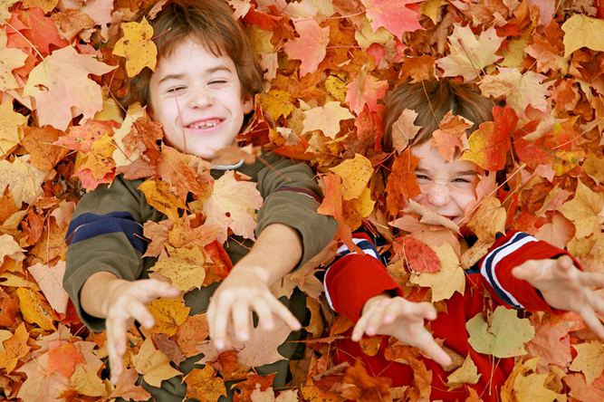
Topic Home Learning
Topic home learning will come out at the start of each half term. It can be creative and is led by children’s ideas.
Certificates of effort are awarded to the children. The children will share each others’ work in class.
All of the children’s work will be shared with parents at the end of topic outcome.
For this ½ term: All work is to be in by 12th October . All pieces of work will be on display during the parent outcome.
Notes:
JT

Slide 7
End of Topic Outcome
These are half termly events that enable you to come in and celebrate your children’s achievements.
Once a term these events will be large outcomes, where the children have worked as part of the topics to present something to you e.g. performances to watch, or recipes to try. At other times the outcome will be spending time with your children in class enabling them to show you their learning. Some will involve your participation!
Notes:
JT

Slide 8

Systems and Routines
New Home/school diaries
PE days is Friday
Library Day –Wednesday
Reading books
Healthy snacks – no nuts please!
IGNITE values
Our HEART values
After school clubs
Be Inspiring – Out of school achievements displayed and in the Newsletter – We want to know!
Our Reward system- House points, Raffle Tickets, Pen Licence, Learner of the Week linked to IGNITE values, Snakes and Ladders – phone calls home to celebrate!
Notes:
EY

Slide 9
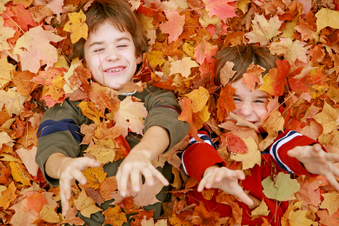
Our Creative Curriculum
We provide a vibrant and exciting curriculum that inspires children to want to learn.
Outdoor Learning will require outdoor clothes. We will let you know when in advance
Trips, residentials and visitors
Egyptian dress up day 18.10.18
A history trip in the Spring TBC
A Tour of Britain trip in the Summer TBC
The Year 4 Camp 24.5.19
Notes:
EY

Slide 10
So far…
All the children have settled in well and are becoming familiar with our routines.
Have visited the library and have all taken out at least one book.
Have been introduced to our topic for this term –Out of Africa
Been introduced to our new Working Walls to support our approach to English and Maths
Notes:
EY

Slide 11
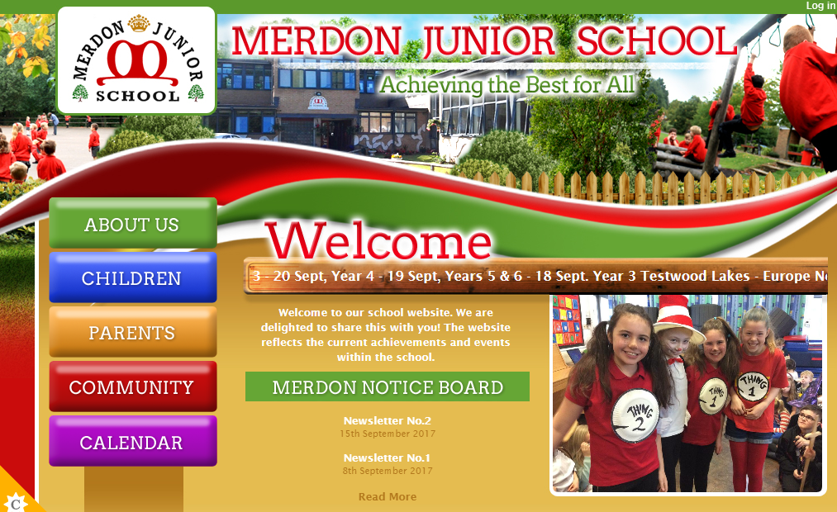
The Website…
You will be able to access;
Your child’s class page with updates on learning and homework
School calendar
Whole school events
Policies
Newsletters
Updates
Safeguarding and E-Safety
Notes:
EY

Slide 12
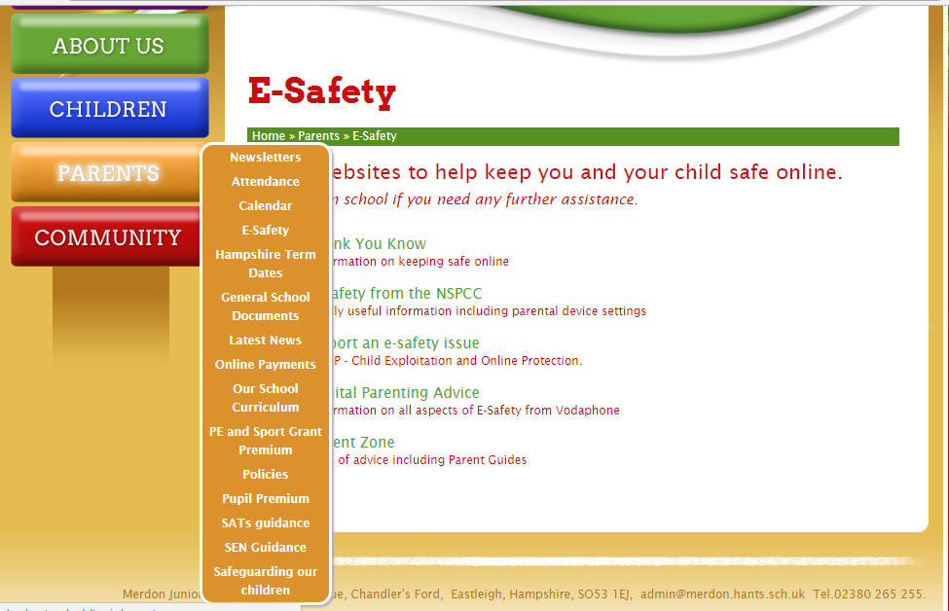
Important information:
Notes:
EY

Slide 13
Open door policy
Got some news to share? Want to speak about your child’s progress? Come and speak to us or arrange an appointment with the office.
If you think you are eligible for free school meals, please speak to the office about applying.
Our Designated Safeguarding Lead is Miss Loosemore or Deputy DSL, Mrs Tones.
Our pastoral team includes ELSA and FIEPS.
Our SENCo, Mrs Tones, can signpost you to further support. We are available for support beyond education.
Notes:
ZL

Slide 14
Coming up…
Macmillan Coffee Morning – 28th September - 9am
  Bring a cake!
  After school cake sale
  Chance to meet other parents and sign up for volunteering
English and Maths open evenings
  English – 4th October 2018 – 6pm
  Maths - 8th November 2018 - 6pm
Parent Outcome – outdoor learning 15.10.18 2pm
INSET day - 19th October.
Notes:
ZL

Slide 15
Helping in school….
Volunteers Wanted!!
Are you interested in becoming more involved
in school life?
Are you able to volunteer some of your time
(no matter how little!) to support us with:
Parent Readers
Trips
Fundraising
Gardening
• And much, much more!!
Come along to the Macmillian Coffee morning or speak to a member of the office team about applying to be a volunteer!
Notes:
ZL

