Slide 1


Welcome to europe
Another important step in your child’s journey

Slide 2
Aim of the meeting
Help to develop strong year group link
Put a face to the names
Develop the relationship between home and school
Explain home learning
Share key systems and daily routines
Any questions?

Slide 3
Your Year Group team
Year 3 Teachers:
North Europe –Mrs Smith ( Mon, Tues, Wed) Mrs Leach ( Wed, Thurs, Fri)
South Europe- Mrs Beckett
Y4 Africa, Y5 Asia, Y6 America
Support staff –Mrs Wotton, Mr Read

Slide 4
Home School Relationship
A really valuable link so that your child knows that we are working together to help them.
Through weekly home learning on line tasks
Topic home learning (half termly)
Reading – at least 3 times a week please (raffle ticket for every full page –just keep going!)
Multiplication and division facts up to 12 x 12 by end of Year 4 (5x ,10x, 2x, 3x, 4x, 8x)
Supporting events and trips
Volunteering in school particularly with reading in the afternoon.
Special activity helpers – visits, DT etc
Merdon Association.

Slide 5
Helping in school….
Volunteers Wanted!!
Are you interested in becoming more involved
in school life?
Are you able to volunteer some of your time
(No matter how little!) to support us with:
• Parent Readers
• Trips
• Fundraising
• And much, much more!!
If so, please come and talk to the office staff about completing a DBS check.

Slide 6
What is Home Learning?
Weekly home learning – On line, Maths and English, this is linked to their learning from that week in school or from previous learning.
How long should it take?
Will be on the school website

Slide 7
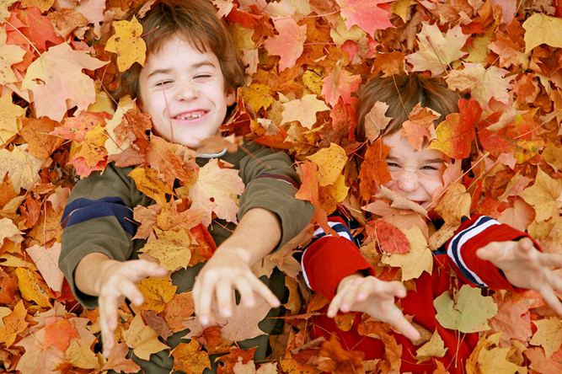
Topic Home Learning
Topic home learning will come out at the start of each half term. It can be creative and is led by children’s ideas.
Certificates of effort are awarded to the children. The children will peer assess each others’ work and together with the teacher, decide whose will be displayed.
10 from each year group will be displayed as part of an open evening event. All of the children’s work will be shared with parents at the end of topic outcome.
For this ½ term: All work is to be in by 11th October . It will all be on display during the parent outcome.

Slide 8
End of Topic Outcome
These are half termly events that enable you to come in and celebrate your children’s achievements.
Once a term these events will be large outcomes, where the children have worked as part of the topics to present something to you e.g. performances to watch, or recipes to try. At other times the outcome may be spending time with your children in class enabling them to show you their learning.

Slide 9

Systems and Routines
Classroom resources – table organisers
Healthy snacks – no nuts
After school clubs
New diaries
PE days (Monday Wednesday)
Book bags
Independence
Library Day -Friday
Working towards Awards- House points, Raffle Tickets, Pen Licence, Worker of the Week, HEART awards, HEART pin badges

Slide 10
Curriculum Days
What? Outdoor Learning, Science, Art, DT, Music)
Outdoor Learning:
Dates to be confirmed.
Where?
Kit…

Slide 11
So far…
All the children have settled in well and are becoming familiar with our routines.
Outdoor Learning sessions
Have visited the library and have all taken out at least one book.
Have been introduced to our topic for this term – Flint and Fire
Have already been on a visit to enrich our learning

Slide 12
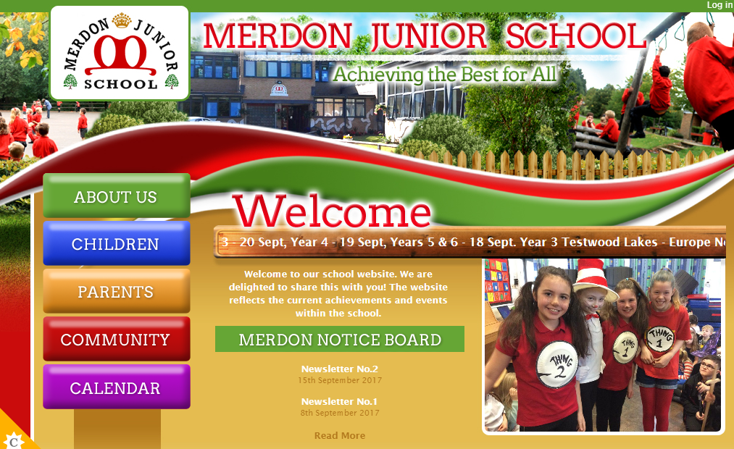
The Website…
You will be able to access;
Your child’s class page with updates on learning and homework
School calendar
Whole school events
Policies
Newsletters
Updates
Safeguarding and E-Safety

Slide 13
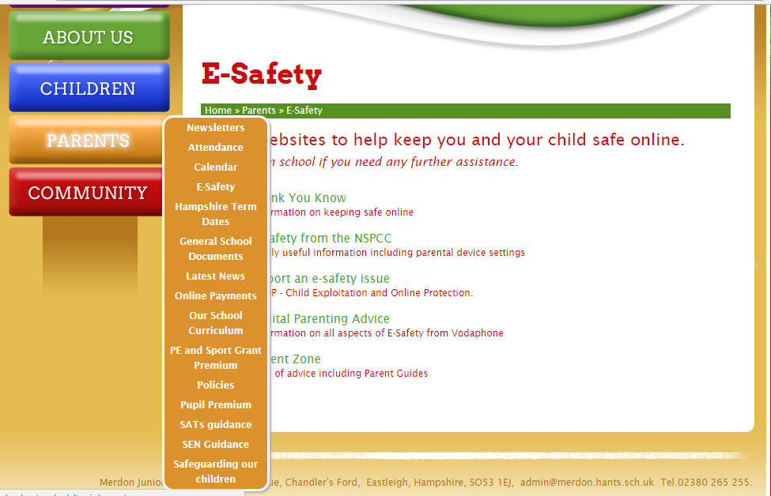
Important information:

Slide 14
Open door policy
Got some news to share? Want to speak about your child’s progress? Come and speak to us or arrange an appointment with the office.
If you think you are eligible for free school meals, please speak to the office about applying.
Concerned about a child’s welfare? Speak to our Designated Safeguarding Lead – Miss Loosemore or Deputy DSL, Mrs Tones.
Our pastoral team includes ELSA and FIEPS.
Our SENCo, Mrs Tones, can signpost you to further support. We are available for support beyond education.

Slide 15
Coming up…
Outdoor learning sessions – tomorrow!
Christmas Performance – 18th/19th December
INSET 19th October.
Parent Outcome : Thursday 18th October
1.45 – 3.00pm
Superhero Day….29th October!
Thank you for coming- any questions?

