Slide 1


Welcome to Asia
Another important step in your child’s journey

Slide 2
Aim of the today
Help to develop strong year group link
Put a face to the names
Develop the relationship between home and school
Explain homework and home learning
Share key systems and daily routines
Answer any questions?

Slide 3
Your Year Group team
The team
Teachers:
North Asia – Mrs Holyoak and Miss Rendle
Support staff – Miss Knight, Mr Read and Mrs Buckley
South Asia – Miss Bristow
Support staff – Mrs Bartlett, Mrs Caine and Mrs Buckley
Across the school, the other year groups are
Y3 Europe, Y4 Africa, Y6 America

Slide 4
Home School Relationship
A really valuable link so that your child knows that we are working together to help them.
Through weekly home learning on line tasks
Topic home learning (half termly)
Reading – at least 3 times a week please (raffle ticket for every full page –just keep going!)
Multiplication and division facts up to 12 x 12 by end of Year 4 (5x ,10x, 2x, 3x, 4x, 8x)
Supporting events and trips
Volunteering in school particularly with reading in the afternoon.
Special activity helpers – visits, DT etc
Merdon Association.
Governors

Slide 5
Helping in school….
Volunteers Wanted!!
Are you interested in becoming more involved
in school life?
Are you able to volunteer some of your time
(no matter how little!) to support us with:
Parent Readers
Trips
Fundraising
Gardening
• And much, much more!!
Come along to the Macmillian Coffee morning or speak to a member of the office team about applying to be a volunteer!

Slide 6
What is Home Learning?
Weekly home learning – On line, Mathletics and Spelling Shed. This will be linked to their learning from that week in school or in preparation for the week ahead.
How long should it take?
The school website
Homework drop in club on Friday and Monday lunchtimes to support busy home lives!

Slide 7
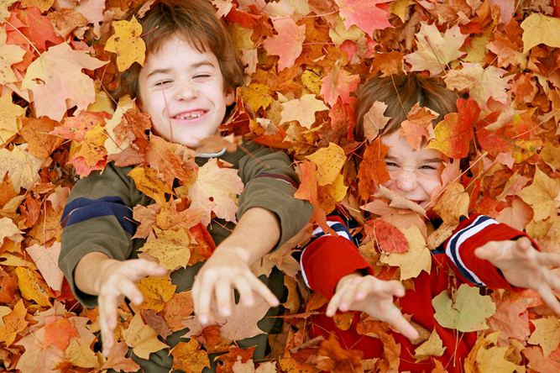
Topic Home Learning
Topic home learning will come out at the start of each half term. It can be creative and is led by children’s ideas.
Certificates of effort are awarded to the children. The children will share each others’ work in class.
All of the children’s work will be shared with parents at the end of topic outcome.
For this ½ term: All work is to be in by 11th October . All pieces of work will be on display during the parent outcome.

Slide 8
End of Topic Outcome
These are half termly events that enable you to come in and celebrate your children’s achievements.
Once a term these events will be large outcomes, where the children have worked as part of the topics to present something to you e.g. performances to watch, or recipes to try. At other times the outcome may be spending time with your children in class enabling them to show you their learning. Some will involve your participation!

Slide 9

Systems and Routines
Classroom resources – table organisers
Healthy snacks – no nuts please!
After school clubs
New Home/school diaries
PE days (Wednesday and Thursday)
Reading books and Book bags
IGNITE values – What are they? - Independence
Our HEART values - Be a role model! HEART pin badges
Be Inspiring – Out of school achievements displayed and in the Newsletter – We want to know!
Library Day - Tuesday
Our Reward system- House points, Raffle Tickets, Pen Licence, Learner of the Week linked to IGNITE values, Snakes and Ladders – phone calls home to celebrate!

Slide 10
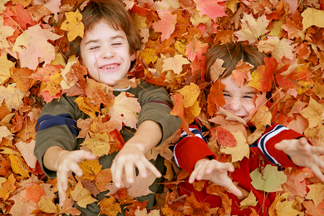
Our Creative Curriculum
We aim to provide a vibrant and exciting curriculum that inspires children to want to learn.
We are proud of our approach with awards from the School of Sanctuary, delivering Refugee and RE weeks whilst being responsive to the world around us.
Outdoor Learning will require outdoor clothes. We will let you know when in advance
Trips, residentials and visitors – what is coming up this year?

Slide 11
So far…
All the children have settled in well and are becoming familiar with our routines.
Have visited the library and have all taken out at least one book.
Have been introduced to our topic for this term – Odd and the Frost Giants
Been introduced to our new look Working Walls to support our approach to English and Maths

Slide 12
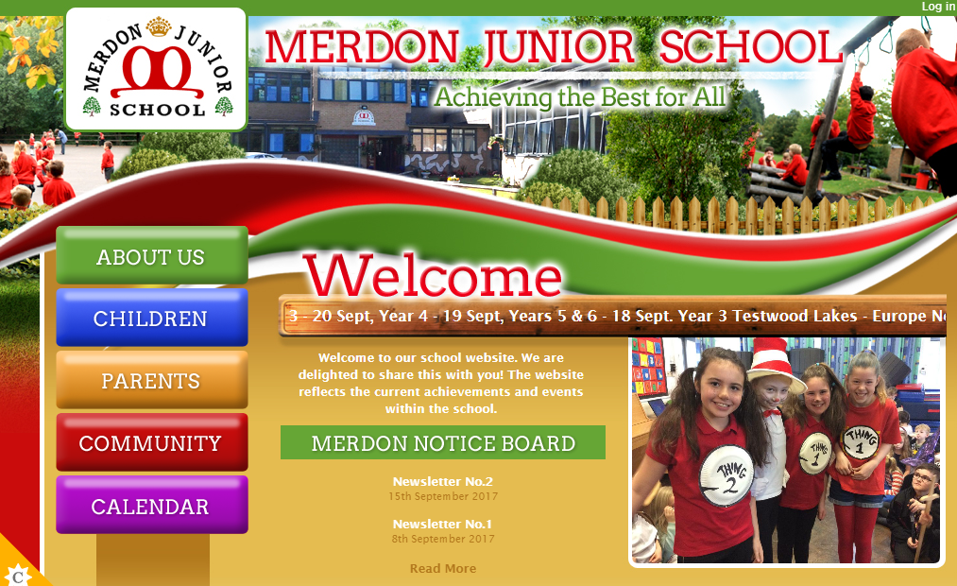
The Website…
You will be able to access;
Your child’s class page with updates on learning and homework
School calendar
Whole school events
Policies
Newsletters
Updates
Safeguarding and E-Safety

Slide 13
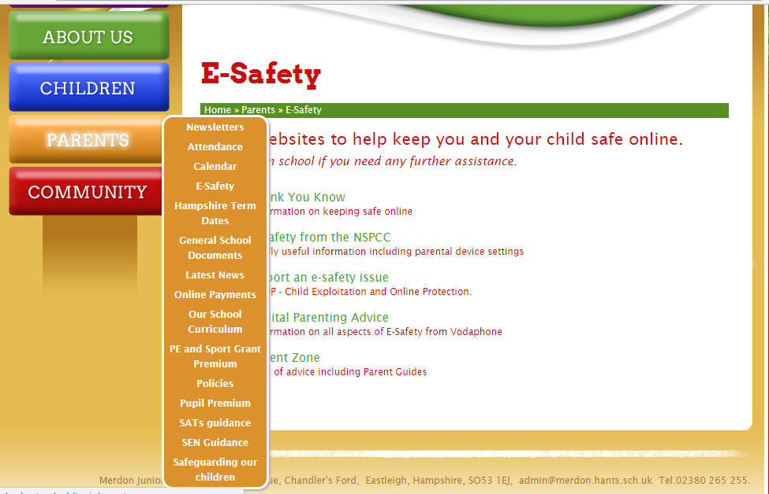
Important information:

Slide 14
Open door policy
Got some news to share? Want to speak about your child’s progress? Come and speak to us or arrange an appointment with the office.
If you think you are eligible for free school meals, please speak to the office about applying.
Concerned about a child’s welfare? Speak to our Designated Safeguarding Lead – Miss Loosemore or Deputy DSL, Mrs Tones.
Our pastoral team includes ELSA and FIEPS.
Our SENCo, Mrs Tones, can signpost you to further support. We are available for support beyond education.

Slide 15
Coming up…
Macmillan Coffee Morning – 28th September - 9am
  Bring a cake!
  After school cake sale
  Chance to meet other parents and sign up for volunteering
Kingswood meeting Monday 1st October
English and Maths open evenings
  English – 4th October 2018 – 6pm
  Maths - 8th November 2018 - 6pm
INSET day - 19th October.
Parent Outcome - 16th October 2-2.30pm

Slide 16


