Slide 1





Spring Term
CURRICULUM OVERVIEW Year 3
ENGLISH
Key Knowledge (Reading): This term, the children will be reading the fiction text “Krindlekrax” by Philip Ridley. Through this story, Year 3 will explore themes such as courage, friendship and mystery. We will also be exploring some shorter texts: The Barnabus Project, The Tin Forest and some texts centred around the idea of “innovation”. Explore and discuss underlying themes and ideas Draw inferences such as inferring feelings, thoughts and motives of main characters from their actions Locate and retrieve information using skimming, scanning and text marking Key Knowledge (Writing): Year 3 will begin by innovating a poem “Hurt No Living Thing”, then lead onto creating an explanation booklet for looking after an imaginary pet. We will also create a plaque for our junk models and innovate a narrative that we have learned. Introduce chunking ideas into a series of coherent paragraphs Introduce using varied nouns and pronouns Introduce use of inverted commas for speech
MATHS
Key Knowledge: - Measure and convert in mm, cm and m Bridge through ten on a number line (+ and -) add and subtract both with and without crossing 10s and 100 boundaries, using column (formal) method and supported by pictorial and concrete representations Interpret and draw pictograms/bar charts Know and apply multiplication and division facts for the 3,4 and 8 times tables Understand and count in tenths, add/subtract fractions with same denominator, understand a whole, unit and non-unit fractions of an amount Estimate, compare and order numbers to 1000 Count in 50s
OTHER INFORMATION
PE days: Monday and Thursday Library days: Tuesday – Goldfinch Wednesday - Robins Art shirts need to be available in school as they will be used a lot this term!
COMPUTING
Key Knowledge: -understand what a branching database is and how they are used in the world -create physical and on-screen branching database -how to use a range of techniques to create a stop-frame animation, and add other types of media to an animation, such as music and text
RE
Key Knowledge -why tree as a symbol is very important in Christianity in different stories -how and why Christians experience changing emotions during Easter week
PSHE
Key Knowledge -know how to keep personal details safe online. -understand why information online might not always be true -understand why medicines can be helpful or harmful
FRENCH
Key Knowledge -know the names of the main fruit, vegetables and ice creams in French -know whether to use ‘le’ or ‘la’ (male or female
PE
Key Knowledge (Gym) – how to make your balances look interesting by using different levels (Badminton) – how to serve and rally with control (Basketball) – the best place to move into so you can pass or shoot (Football) – dribble, pass and travel with the ball with control
© Vocabulary Ninja Ltd 2021

Slide 2
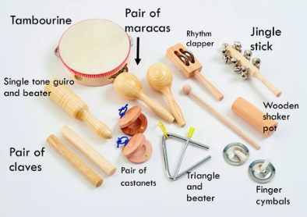

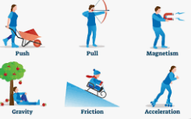
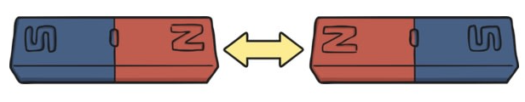

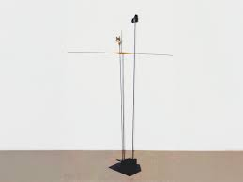
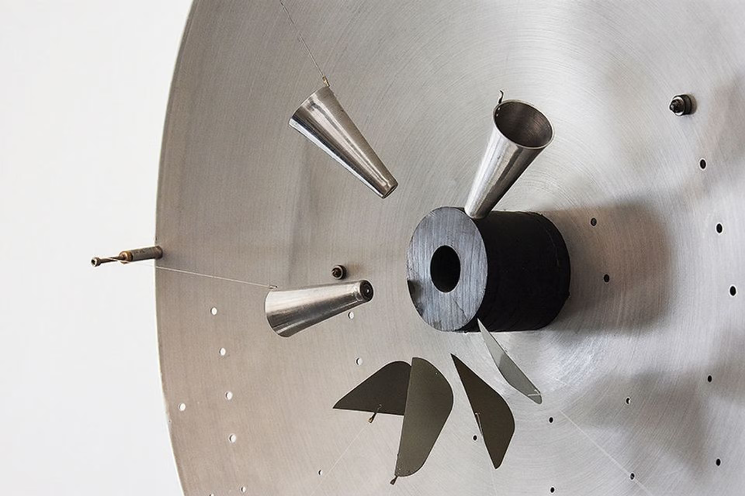
Innovation
PROJECT OVERVIEW
ESSENTIAL VOCABULARY
2D and 3D shapes | 2D shapes are flat and 3D shapes are solid and can be picked up
form | The shape or appearance of an object
product | Something that is made or improved for sale.
adapt | Change something to fit a new use or situation.
annotate | Add notes to a text or diagram, giving an explanation or comment.
strengthen | Make or become stronger
stiffen | Make something stiff or rigid
support | Bear the weight of something to keep it upright.
structure | A building or other object made from several parts.
texture | The feel of a surface.
prototype | An early model of a product to test it out.
functional | Designed to be practical and useful, rather than attractive.
sculpture | 3D art using materials like stone, metal, wood, or clay
evaluate | Carefully assess the quality or condition of something
criteria | the checklist items you use to judge something, or decide if something is good or successful,
Product Design
Products need to: appeal to the audience be strong and stable meet the purpose
What makes a good innovator?
Curiosity – ask "why?" and "what if?" Resilience - persist through frustration Imagination – thinking of better ways, Self-Confidence- believe in your ability to figure things out Challenging ideas - always look for improvement Experiment – test ideas Problem-Solving -find effective solutions. Collaboration - value different opinions and communicate effectively Attention to Detail - pay attention!
Percussion instruments
Forces
A push or pull on an object. A force can cause something to speed up, slow down, change shape or change direction.
Magnetic Force
Magnetic force is affected by: the strength of the magnet the distance between the magnet and the object how heavy the object is
Magnetic poles
Magnets have two poles: north-seeking and south-seeking Opposite poles on a magnet attract each other. Like poles on a magnet repel each other.
Friction
Friction is a force between two surfaces that are sliding, or trying to slide across one another, for example when you try to push a toy car along the floor. It always works in the direction opposite from the direction the object is moving, or trying to move, and it always slows a moving object down.
KEY QUESTIONS
What is innovation?
How does innovation improve my life?
How can my innovations help others?
How do we grow an idea?
Takis
Panayiotis Vassilakis, also known as Takis, was a self-taught Greek artist known for his kinetic sculptures. He exhibited his artworks in Europe and the United States.
© Vocabulary Ninja Ltd 2021

