Slide 1




Spring Term
CURRICULUM OVERVIEW (Year 4)
MATHS
Key Knowledge: We will be revisiting our place value learning, ordering numbers and deciphering Roman numerals. We will then be revisiting our learning on addition and subtraction, applying it to calculations with more than 1 exchange! This will help us to tackle word problems too. Before half term, we will be learning about factors pairs as well as how to multiply and divide by 10 and 100. We continue to work on our times tables daily.
ENGLISH
Key Knowledge (Reading): In Guided Reading we will be looking at non-fiction texts about London which will enhance our project learning as well as teaching reading strategies. Key Knowledge (Writing): In English our writing will be linked to the story ‘The Boy Who Swam with Piranhas.’ The writing will include a letter of complaint and a narrative. Later in the term the children will be writing their own non-fiction text about Rio de Janeiro.
OTHER INFORMATION
Trip to London Wednesday 25th February
COMPUTING
Key Knowledge: This term, the children will be learning how to programme using codes. This will eventually build up towards them creating and programming their own game on Scratch. - How to create programs by planning, modifying, and testing commands to create shapes and patterns. - Know how to modify existing animations and games using repetition.
PSHE
Key Knowledge Keeping Safe - Know people or things that might influence someone to take risks (e.g. friends, peers, media, celebrities), but know that people have choices about whether they take risks. - Know examples of positive and negative influences, including things that could influence making decisions.
FRENCH
Key Knowledge - Know the names of the main fruit, vegetables and ice creams in French - Know whether to use ‘le’ or ‘la’ (male or female
PE
Key Knowledge (Dance) – how to vary the space, dynamics and actions in a dance to suit your dance idea (Dodgeball) – how to use a variety of throws and changes in direction in a game (Netballl) – how to perform a chest, bounce, shoulder and overhead pass accurately within a game (Football) – how to tackle safely and with control
© Vocabulary Ninja Ltd 2021

Slide 2
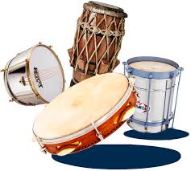
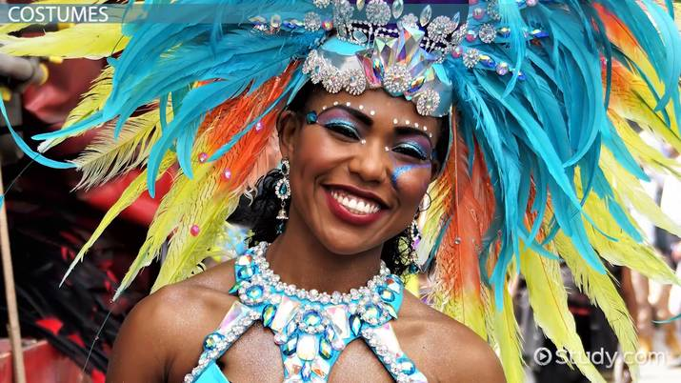
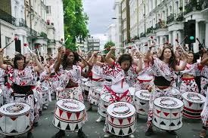
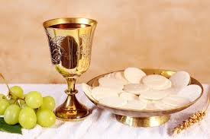
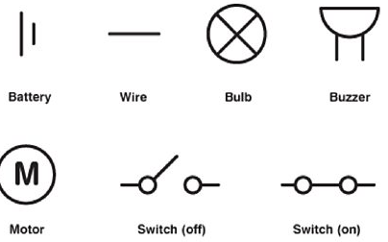
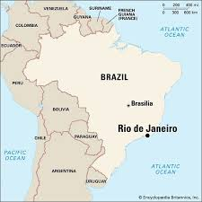
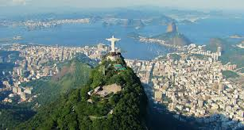
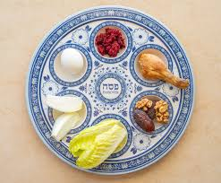
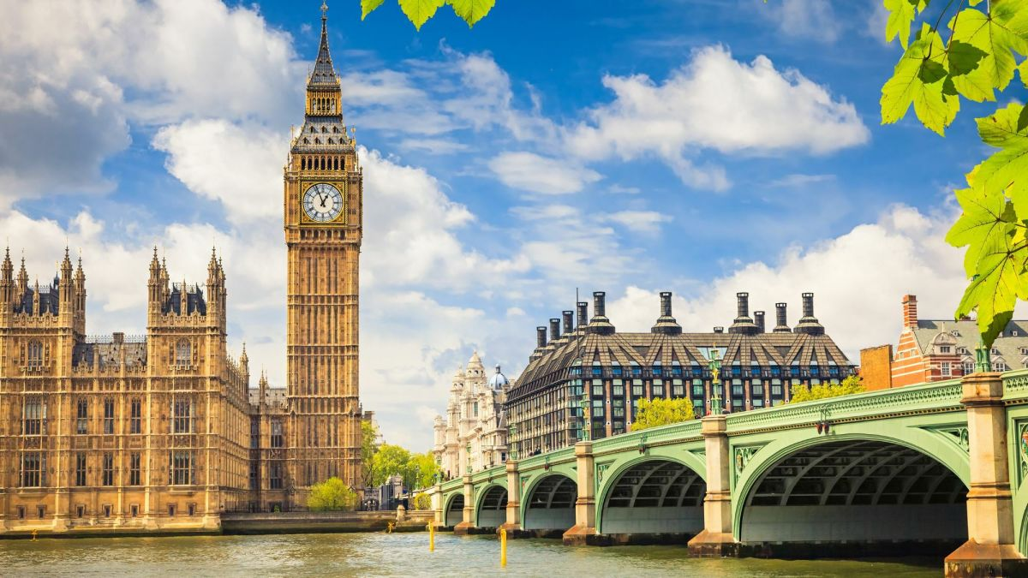
Joy
PROJECT OVERVIEW
ESSENTIAL VOCABULARY
Southern and Northern hemisphere | The Northern and Southern Hemispheres are the top and bottom halves of Earth
Equator | A imaginary line circling the middle of Earth, exactly halfway between the North Pole and the South Pole
physical features | Natural things on Earth like mountains, rivers, oceans, and forests that exist without people building them
human features | Things that people build or create on the Earth, like houses, roads, cities, farms, and bridges
ostinato | A short pattern of notes or a rhythm that repeats over and over again in a song
rhythm | A pattern of sounds of different lengths. The length of a sound is called the duration
electrical appliance | A tool or machine that uses electricity (from a plug or batteries)
electrical conductor | A material that lets electric current (tiny energy particles) through easily
electrical insulator | A material that stops electric current from flowing through it easily
Holy Communion | A special church meal where Christians eat bread and drink grape juice (or wine) to remember Jesus's sacrifice, symbolizing His body and blood
Gospel stories | The Gospels are the story of Jesus and his life and work
OS maps | Ordnance Survey maps are detailed maps of Great Britain that use special symbols and colours to show features
aerial image | A photo or picture of the view from above
Collage
Artists build contrasting elements, creating visual interest and new interpretations. The final piece can be abstract, representational, or surreal, depending on your intent.
Carnivals
The Rio Carnival is the world's biggest party, a huge festival in Brazil parades, music (especially samba!), colourful costumes, massive street parties (blocos), floats, dancing, and vibrant culture. Notting Hill Carnival is Europe's biggest street party, celebrating Caribbean culture with costumes, music (steel pans, reggae), food and dancing.
Samba Music
Rhythm & Beat: Focuses on a steady pulse and some off-beat rhythms, Instruments: Simple, fun percussion like hand drums, shakers (ganzá), and bells (agogô). Call & Response: A leader plays a rhythm, and the group answers Energy: Upbeat, joyful music perfect for parties and celebrating Simple Actions: Encourages clapping, stomping, and simple dance steps, like the "samba whisk”
Eucharist
The Eucharist is a Christian celebration, remembering Jesus's Last Supper: eating bread (his Body) and drinking wine (his Blood) as a way to feel close to him,
Electrical circuits
Rio
Rio de Janeiro (Rio) is a major city located in Brazil, a large country in South America, famous for its stunning beaches, Sugarloaf Mountain, Christ the Redeemer statue, and vibrant culture. It sits on Brazil's Atlantic coast, in the southeastern part of the country.
Passover
Passover is a Jewish holiday celebrating freedom, remembering how Moses led the Israelites out of slavery in Egypt. Jews celebrate with a big party called a Seder, eat unleavened bread (matzo) because they left in a hurry, and tell the story with songs, prayers, and special foods like bitter herbs (to taste the hard times) and apples/honey (to remember building with mortar). Passover is about family, hope, and remembering to be kind to others
KEY QUESTIONS
What brings us joy?
How do we share joy in our community?
How do other people share joy?
How is joy shared around the world?
London
London is the capital of the United Kingdom, a country in western Europe. It is also the capital of England, which is part of the United Kingdom. London lies on the Thames River. It is the largest city in the country. It has long been a major centre of culture, business, and banking.
© Vocabulary Ninja Ltd 2021

