Slide 1





Spring Term
CURRICULUM OVERVIEW Year 6
MATHS
Key Knowledge: This term in Maths will be having daily arithmetic sessions. These will include: Finding missing numbers in calculations Subtraction large numbers with several exchanges Decimals and place value in calculation Long multiplication using the formal method Decimal multiplication In our Maths lesson we will be learning about Time –including reading timetables Measures-length, mass and capacity Area and Perimeter Geometry-missing angles and triangles We will then follow a revision plan where we will revisit prior learning as well a new learning.
ENGLISH
Key Knowledge (Reading): To use a range of evidence to explain inferences To explain the meaning of words in context Key Knowledge (Writing): To use a wider range of punctuation including dashes and semi colons To include dialogue to advance a story or explain character To use relative clauses to add detail
OTHER INFORMATION
PE days : Tuesdays & Wednesdays Trip to the Itchen Navigation Mushroom - Monday 9nd February Clover - Tuesday 10rd February A walking trip along part of the Itchen Navigation. The children will follow the footpath from Shawford to St Catherine’s Hill.
RE
Key Knowledge -Muslims believe that Allah created the world and all living creatures and it is the job of everyone to look after the world -Christian beliefs about life after death are based around their belief in the death and resurrection of Jesus
COMPUTING
Key Knowledge: -what makes a good web page and how to link content - how to use a computer to produce 3D models
PSHE
Key Knowledge -how to keep our personal information safe -safety around sharing personal information or images -To have a definition of bullying and what is and isn’t bullying
FRENCH
Key Knowledge -know the names of common hobbies in French -know 'to go', 'to do', 'to have' and 'to be' in French
PE
Key Knowledge (Gym) – create sequences by fluently linking skills and balances confidently (Orienteering) – how to follow directional instructions including clockwise, anticlockwise, 90°, 180° and 360° turns and use a compass (Badminton) – use different shots and consider placement depending on if the rally is co-operative or competitive (Netball) – to be able to play a range of positions within a game situation
© Vocabulary Ninja Ltd 2021

Slide 2
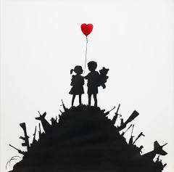
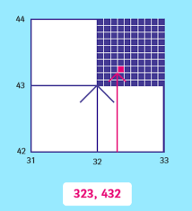
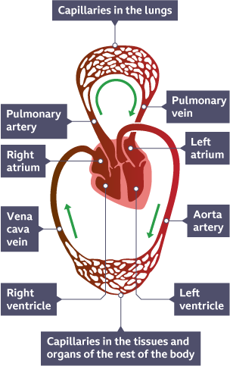
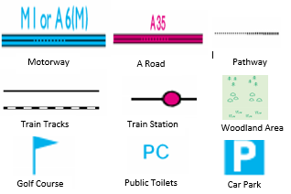
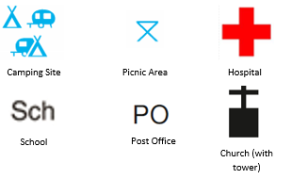
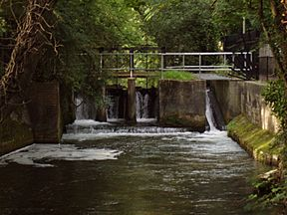
Legacy
KNOWLEDGE ORGANISER
ESSENTIAL VOCABULARY
prototype | A first draft or a test model of something new, made to see if the idea works before making the finished thing
innovate | Come up with new ideas or methods, or make something that already exists much better
aesthetics | How something looks and if it's pleasing to the eye.
legacy | Something special you leave behind for others
locality | A particular neighbourhood, place, or region
regional | To do with a particular area or region
heritage | Something that is handed down from the past, often as a tradition
navigate | To plan, direct, or plot the path or position of a ship, an aircraft, etc
toll | A small fee or tax you pay to use something like a bridge or road
demonstrations | A group of people gathering in public to show they feel strongly about a cause, either supporting it or protesting against it.
petition | A formal written request made by many people to an authority or organized body
bypass | A "bypass road" goes around a city, for example, instead of driving through it,
campaign | A campaign is a planned series of actions to reach a specific goal. It's not just one person doing something, but usually a team working together.
Bob Dylan
Bob Dylan's protest songs are about themes of change, justice, and individuality through tunes like "Blowin' in the Wind," "The Times They Are a-Changin'," and "Forever Young,"
M3 expansion
The M3 protests, especially around Twyford Down in the early 1990s, were big demonstrations by people who didn't want a new motorway cutting through ancient land near Winchester for the M3 motorway. Protesters set up camps, dug tunnels, and tried to stop the work to protect the "dongas" (old pathways) and chalk hills
Protest Art
When artists create an artwork to show they disagree with something, we call this protest art. An example of a protest artist is Banksy. Banksy uses simple imagery, like the innocent children in "Kids on Guns" surrounded by weapons, to highlight serious Issues like war, poverty, and homelessness
Types of bridges
Beam: Simplest, like a plank over water, with supports at each end Arch: Uses a curved shape (arch) to spread weight, common for rivers and valleys Suspension: Deck hangs from cables connected to tall towers, strong for long spans Truss: Uses triangles in a framework for extra strength Cantilever: Built from beams anchored at one end, extending outwards (like a diving board).
Six figure grid reference
Circulatory System
Ordnance Survey Maps
KEY QUESTIONS
What is the Itchen Navigation?
Why do people protest?
What’s your legacy?
What is the legacy of human changes in the local environment?
Itchen Navigation
The Itchen Navigation is a disused canal system in Hampshire, England. It is about 10.4 miles (16.7 km) long. For about 150 years, it was an important way to move goods from Winchester to the sea at Southampton. Improvements to the River Itchen began in 1665 and finished in 1710. It was called a "navigation“ because it used parts of the natural river.
© Vocabulary Ninja Ltd 2021

