Slide 1





Spring Term
CURRICULUM OVERVIEW Year 5
ENGLISH
Key Knowledge (Reading): This term, the children will be reading the fiction text ‘The Girl of Ink and Stars’. Year 5 will explore themes such as belonging, courage and understanding the natural world. The text shows human fragility as trust, safety and identity can easily be broken but carefully rebuilt. drawing inferences such as inferring characters’ feelings, thoughts and motives from their actions. discuss and evaluate how authors use language, including figurative language, considering the impact on the reader. Key Knowledge (Writing): Year 5 will begin by writing a non-chronological report and a narrative which links to their project of Fragility. using a wide range of devices to build cohesion within and across paragraphs. using further organisational and presentational devices to structure text and to guide the reader. - In narratives, describing settings, characters and atmosphere and integrating dialogue to convey character and advance the action.
MATHS
Key Knowledge: This term, Year 5 will start by recognising and understanding that percent relates to the number of parts per hundred. They will then discover how to find equivalent fractions, decimals and percentages. Following on from this, Year 5 will revisit some topics, building on their previous knowledge: know that angles are measured in degrees and will estimate and compare acute, obtuse and reflex angles. Using protractors, measure and draw different angles. Add and subtract whole numbers with more than 4 digits including using formal written methods. Add and subtract fractions with the same denominator beyond one and multiples of the same denominator. Identify 3-D shapes, including cubes and other cuboids, from 2-D representations.
OTHER INFORMATION
Minstead residential: Dragonfly class: Monday 9th- 11th March Centipede class: Wednesday 11th- Friday 13th March
COMPUTING
Key Knowledge: -know how to connect and program a microcontroller -know how to write algorithms and programs
RE
Key Knowledge -how Christians use stories from the gospels to show that Jesus was not just human, but Divine with power over nature and life itself -The Hajj is a pilgrimage to Mecca every Muslim is expected to do once in their life if they are healthy and can afford it
PSHE
Key Knowledge -why people sometimes aim to create an impression of themselves in what they post online that is not real and what might make them do this. -understand things that might influence a person to take risks online.
FRENCH
Key Knowledge -know the names of common pets in French -know how to say I don’t have or I don’t like in French
PE
Key Knowledge (Gym) – change the shape of your jumps and contrasting balances to make your sequence look interesting (Tag Rugby) – make quick decisions about when, how and who to pass to will help you to maintain possession (Badminton) – use a serve to start a game or rally (Netball) – perform the chest, bounce, shoulder and overhead pass accurately and understand when each pass is used in game play
© Vocabulary Ninja Ltd 2021

Slide 2
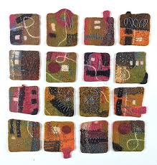
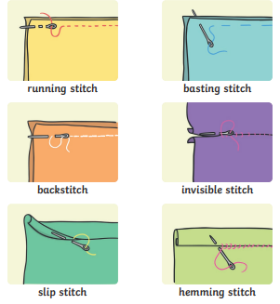
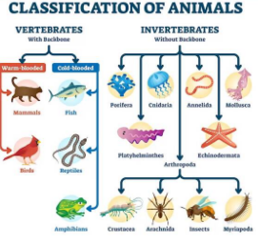
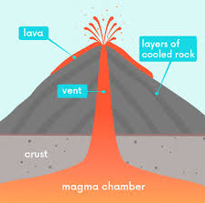
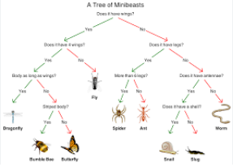
Fragility
PROJECT OVERVIEW
ESSENTIAL VOCABULARY
biome | A large area on Earth with a similar climate (hot/cold, wet/dry) that supports specific plants and animals
climate zone | A large area of the world with similar, long-term weather patterns
longitude | Imaginary lines (meridians) running up and down the Earth (North Pole to South Pole)
latitude | Imaginary horizontal lines (parallels) going around the Earth, measuring how far north or south a place is from the Equator (0°)
sustainable | Using Earth's resources (like water, energy, trees) carefully so they don't run out
classify | To sort living things (like animals and plants) into groups based on their shared similarities and differences
organisms | Any individual living thing
food chain | The flow of energy from one living thing to another, from a producer to a consumer.
evolve | For living things (plants and animals) to gradually change over very long periods of time to better fit their environment
impact | The powerful effect something has on a person or situation
biodiversity | The huge variety of all living things on Earth, like different animals, plants, and how they all work together in different places (habitats)
carbon footprint | The invisible trail of greenhouse gases (like carbon dioxide) we leave behind from our everyday actions, such as using electricity or traveling in cars
preserve | To keep something safe and in good condition
Mountains
Mountains form mainly when huge pieces of Earth's crust (tectonic plates) slowly crash into each other, causing the land to buckle, fold, and lift up over millions of years
Fiona Duthie
Fiona Duthie is a Canadian artist. She uses a process called felting, which is a very old way of making fabric from wool. It involves using water, soap, and lots of rubbing and pressing to make the loose wool fibres stick together into a strong, flat material.
Hans Zimmer
Hans Zimmer is known for mixing electronic sounds with traditional orchestra music. Since the 1980s, he has created music for over 150 movies. Some of his most famous works include The Lion King (1994) and Dune (2021), both of which earned him an Oscar. Other popular films he scored are the Pirates of the Caribbean movies, The Dark Knight films, Inception (2010), and Interstellar (2014).
Sewing stitches
Earthquakes
Earthquakes happen because the Earth's surface (tectonic plates) are always moving, and when they get stuck, pressure builds up until it suddenly releases, causing the ground to shake.
Living things
Volcanoes
Volcanoes form when hot, melted rock (magma) from deep inside the Earth finds cracks in the Earth's crust, often where tectonic plates move, and pushes its way up. When it erupts, it's called lava; this lava cools and hardens, and over many eruptions, layers build up to create the cone shape of a volcano.
KEY QUESTIONS
How fragile is our world?
Is our local environment fragile?
What can we look after in our local environment?
How can we improve our local environment?
Database
A branching database is a way of sorting things using yes/no questions to find one thing in a group
© Vocabulary Ninja Ltd 2021

