Slide 1
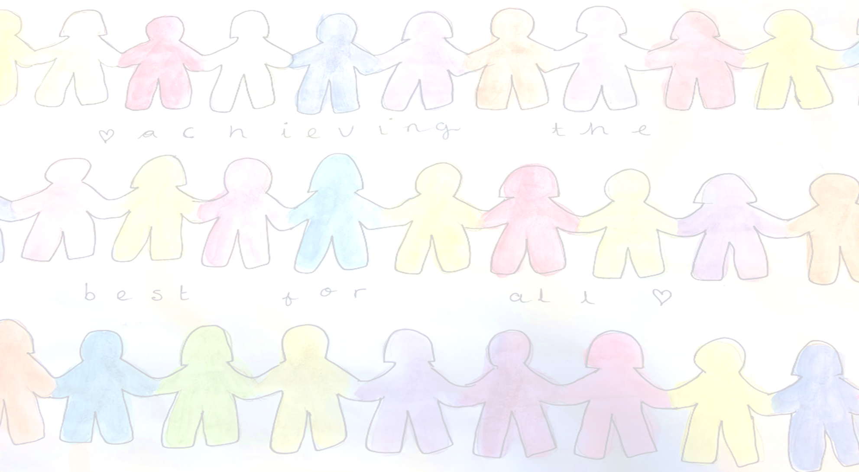

Meet the Teacher
Welcome to Year 4
The Year 4 team is:
Mrs Whitford,
Miss Johnson-Hall,
Miss Webb, Miss Vaughan and Mrs Way.
Mrs Smith and Mrs Leach will cover Miss Johnson-Halls ECT time

Slide 2
The aim of the meeting
Continue to develop the relationship between home and school
Share daily and weekly routines
Give you a little insight into what life looks like in school

Slide 3
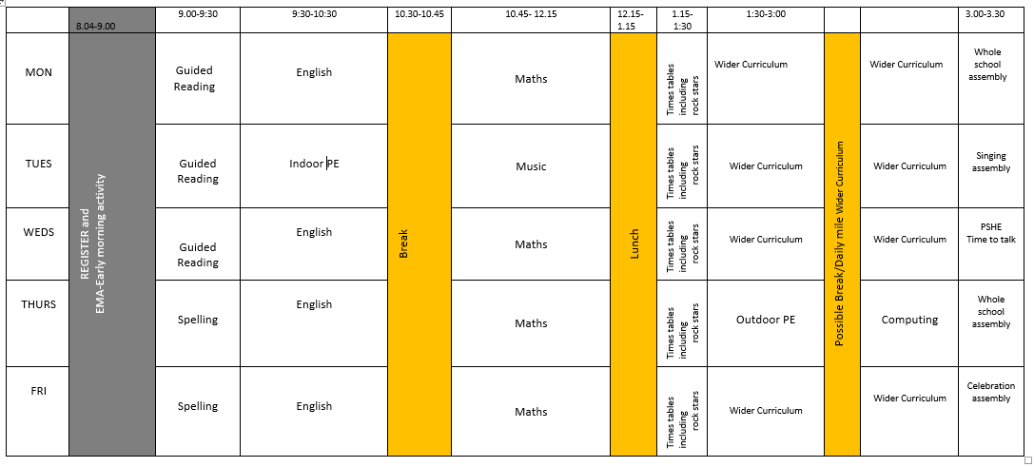
The School Day
Timetable across the week
Children will have the opportunity to visit the library on Wednesdays.

Slide 4
The School Day
School uniform -hair, jewellery, shoes-https://www.merdon.hants.sch.uk/uniform/
PE – kits PE lessons are on Tuesday and Thursday
PPA-cover Mrs Lane and Miss Howells
Music - L2M-Summer Term
Trips, visitors and a residential-Prices and dates to ne comfirmed.
Break - Healthy snacks please

Slide 5
Our Learning Approach
IGNITE Values
Expectations for learning in and out of school
Thinking School
Creative Curriculum
Building minds for the future
Recognising our achievements
  Be Inspiring - Newsletter
  House Points leading to an half termly House Treat
  IGNITE POINTS-celebrated in the weekly celebration assembly
  HEART AWARDS-half termly
  Worked share with Miss Cunningham, SLT and subject leaders.

Slide 6
How you can help at home
Homework - Google Platform plus homework books. This is set on Thursday for the following Tuesday. This will include spellings which are set through Spelling Shed.
Timetables – Year 4 times tables check: from Monday 3 June 2024.
Reading daily
Talk to us!

Slide 7
Information on the School Website
The website contains lots of information including;
Your child’s class page with updates on learning
School calendar
Policies
Safeguarding your child - E- safety
Weekly Newsletters
Information on FSM, SEN and wellbeing provision

Slide 8
Safeguarding
The Designated Safeguarding Team lead is Miss Cunningham, Mrs Whitford, Mrs Blake and Mrs Pugh are deputies, who alongside Mrs Martin and the whole staff, prioritise safeguarding and well-being. Mrs Caine will also be joining the DSL Team this year.
If you have ANY concerns about any child, please contact Mrs Cunningham or Mrs Blake .
There is a safeguarding page on the school website.

Slide 9
Wellbeing
The school is passionate about ensuring positive mental health and wellbeing for all members of the staff community. As a school, we offer;
ELSA-Miss Webb and Miss Stroud
TALA-Mrs Caine
Family Support-Mrs Caine
LEGO Therapy
Time to Talk
Daily Mile
If you have any questions regarding your child’s wellbeing, please contact Mrs Blake, our SENCO

Slide 10
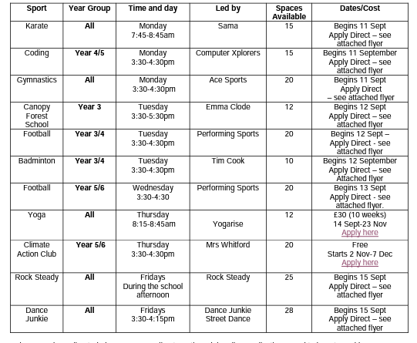
Clubs
A number of lunchtime clubs will be run by our staff and will be offered to the children next term including choir.

Slide 11

Our Vision

Slide 12

Any questions?

