Slide 1
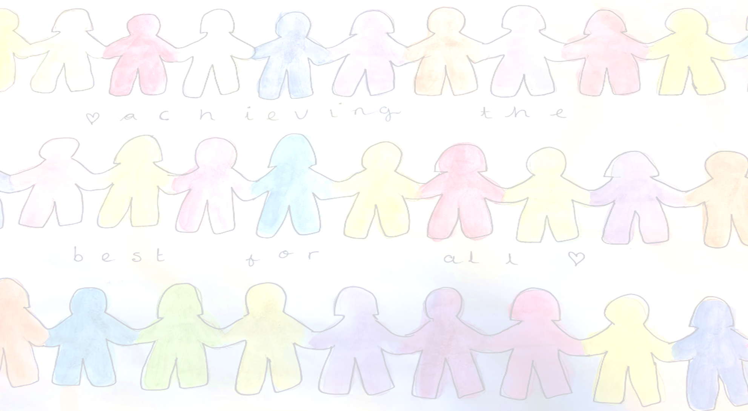

Meet the Teacher
Welcome to Year 6
The Year 6 team is Mrs Whitford, Mr Stevens, Mrs Bartlett, Mrs Stroud, Miss Webb
and Mrs Caine.

Slide 2
The aim of the meeting
Continue to develop the relationship between home and school
Share our Merdon Model curriculum and plans across the year
Share daily and weekly routines
Give you a little insight into what life looks like in school

Slide 3
The School Day
Timetable across a day
Timetable across a week
Break - Healthy snacks please!
Lunch routines

Slide 4
The School Day
School uniform -hair, jewellery, shoes
PE – kits PE lessons are on Tuesday and Thursday
French –Mrs Murray
Music - L2M-Spring Term
Outdoor Learning-at least once a half term linked to the curriculum.
Trips and a residential

Slide 5
Our Learning Approach
IGNITE Values
Expectations for learning in and out of school
Creative Curriculum
Recognising our achievements
  Be Inspiring - Newsletter
  Learner of the Week certificates linked to the terms IGNITE values
  Raffle Tickets
  Share with Mrs Martin and Miss Cunningham

Slide 6
Our Creative Curriculum
Cross - curricular links - Creative outcomes
High Quality Texts
TOGs
Website
Maths Mastery
Excellence in English
Let's Think in English and Maths and Opening Doors
Quality Marks in Geography, Music and PE

Slide 7
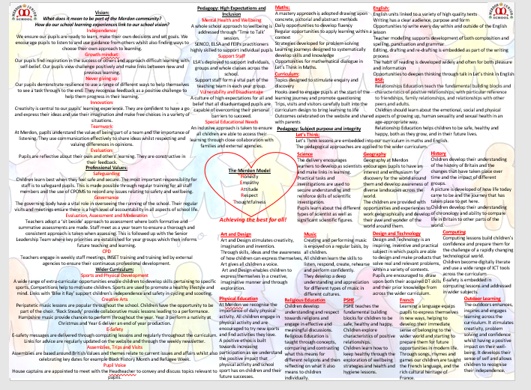
Our Merdon Model

Slide 8
How you can help at home
Homework - Google Platform plus homework books. This is set on Thursday for the following Tuesday.
Timetables
Spelling and handwriting
Reading
Talk to us!

Slide 9
Information on the School Website
The website contains lots of information including;
Your child’s class page with updates on learning
School calendar
Policies
Safeguarding your child - E- safety
Weekly Newsletters
Information on FSM, SEN and wellbeing provision

Slide 10
Safeguarding
The Designated Safeguarding Team lead is Miss Cunningham and Mrs Whitford and Mrs Pugh are deputies, who alongside Mrs Martin and the whole staff, prioritise safeguarding and well-being.
If you have ANY concerns about any child, please contact Miss Cunningham or Mrs Blake .
There is a safeguarding page on the school website.

Slide 11
Wellbeing
The school is passionate about ensuring positive mental health and wellbeing for all members of the staff community. As a school, we offer;
ELSA
TALA
LEGO Therapy
Time to Talk
Daily Mile
If you have any questions regarding your child’s wellbeing, please contact Mrs Blake, our SENCO

Slide 12
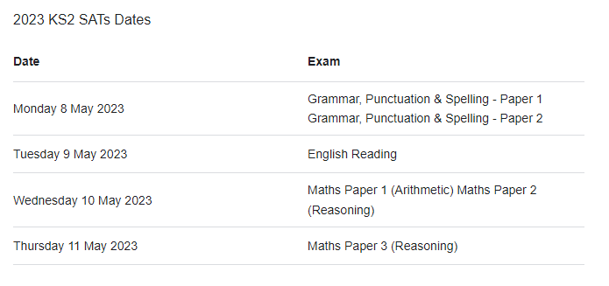
And finally…SATS
We will have a further meeting about this later in the year.

Slide 13

Any questions?

