Slide 1
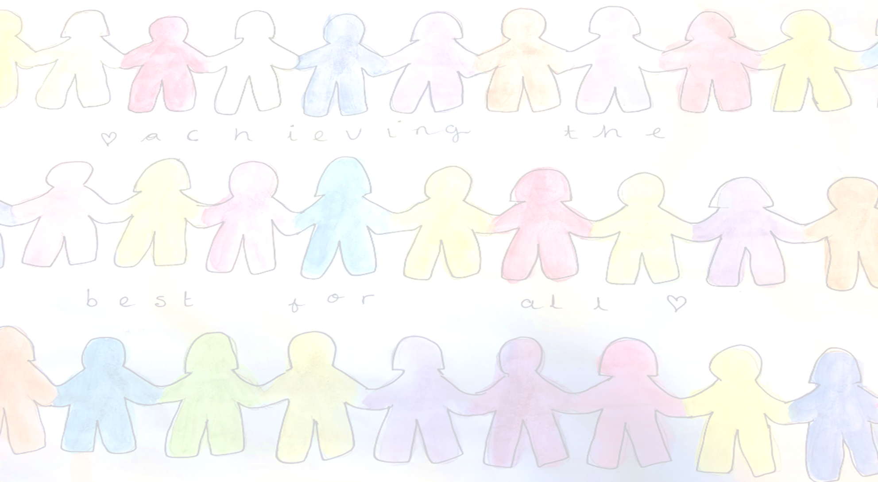

Meet the Teacher
Welcome to Year 4
The Year 4 team is:
Africa North – Mrs Yates and Mrs Lane
Africa South – Miss Gover
LSA Team – Mrs Buckley, Mrs Flood – Page, Mrs Niziolek and Mrs Owen.

Slide 2
The aim of the meeting
Continue to develop the relationship between home and school
Share our Merdon Model curriculum and plans across the year
Share daily and weekly routines
Give you a little insight into what life looks like in school

Slide 3
The School Day
Timetable across a day
Break - Healthy snacks please!

Slide 4
The School Day
School uniform -hair, jewellery, shoes
PE – kits PE lessons are on Wednesday and Friday
French –Mrs Murray
PE – Mrs Bartlett
Music - L2M-Summer Term
Trips and a residential

Slide 5
Our Learning Approach
IGNITE Values
Expectations for learning in and out of school
Creative Curriculum
Recognising our achievements
  Be Inspiring - Newsletter
  Learner of the Week certificates linked to the terms IGNITE values
  Raffle Tickets
  Share with Mrs Martin and Miss Cunningham

Slide 6
How you can help at home
Homework - Google Platform plus homework books. This is set on Thursday for the following Tuesday.
Timetables – Year 4 times tables check: 5th – 23rd June 2023.
Reading daily.
Talk to us!

Slide 7
Information on the School Website
The website contains lots of information including;
Your child’s class page with updates on learning
School calendar
Policies
Safeguarding your child - E- safety
Weekly Newsletters
Information on FSM, SEN and wellbeing provision

Slide 8
Safeguarding
The Designated Safeguarding Team lead is Miss Cunningham and Mrs Whitford and Mrs Pugh are deputies, who alongside Mrs Martin and the whole staff, prioritise safeguarding and well-being.
If you have ANY concerns about any child, please contact Mrs Cunningham or Mrs Blake .
There is a safeguarding page on the school website.

Slide 9
Wellbeing
The school is passionate about ensuring positive mental health and wellbeing for all members of the staff community. As a school, we offer;
ELSA
TALA
LEGO Therapy
Time to Talk
Daily Mile
If you have any questions regarding your child’s wellbeing, please contact Mrs Blake, our SENCO

Slide 10

Any questions?

