Slide 1
Year 4 Multiplication Tables Check (MTC) 2025
Parent Information
Tuesday 4th March 2025

Slide 2
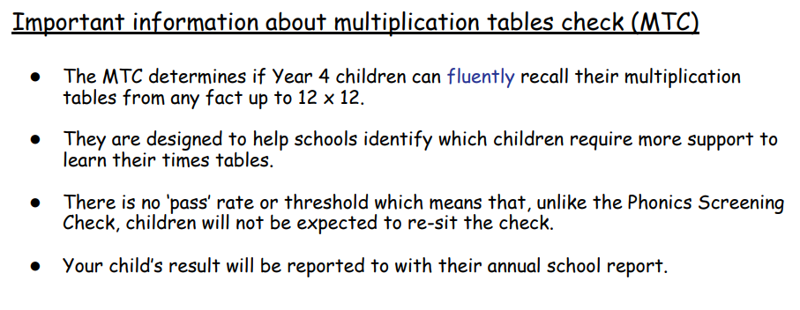

Slide 3
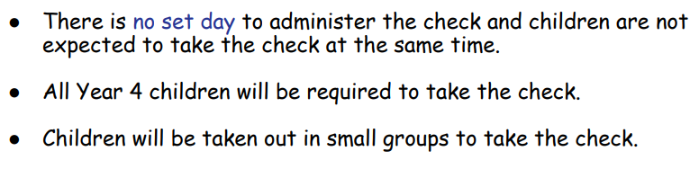
When the check will take place
There will be a 2 week window from Monday 2 June and Friday 13 June for schools to administer the check.

Slide 4
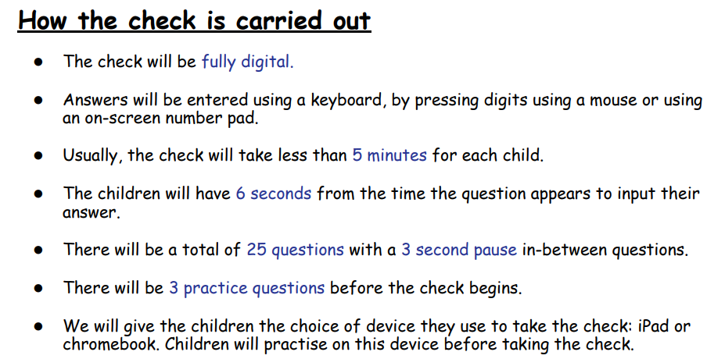

Slide 5
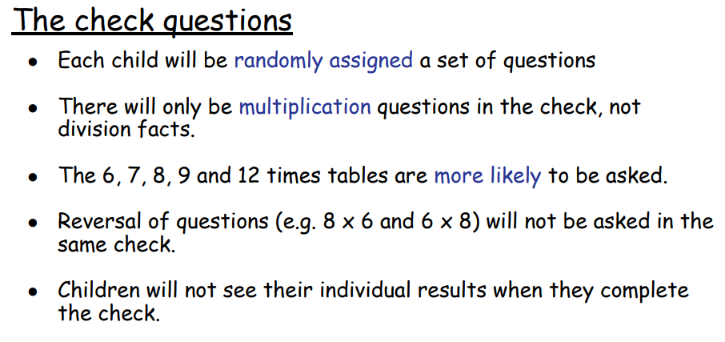

Slide 6
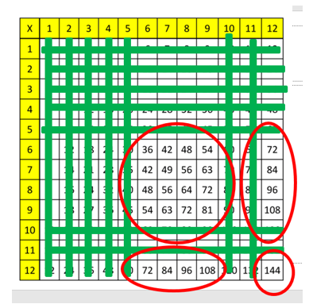
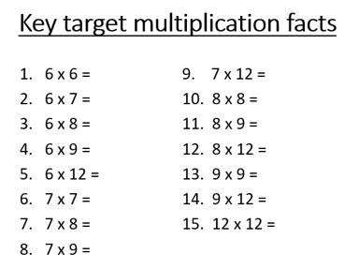

Slide 7
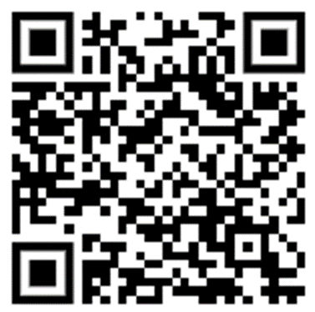
Have a go!
https://mathsframe.co.uk/en/resources/resource/477/Multiplication-Tables-Check
https://www.timestables.co.uk/multiplication-tables-check/

Slide 8
Log into TTR’s as a child

