Slide 1
Kingswood
Monday 19th – Friday 23rd February 2018

Slide 2
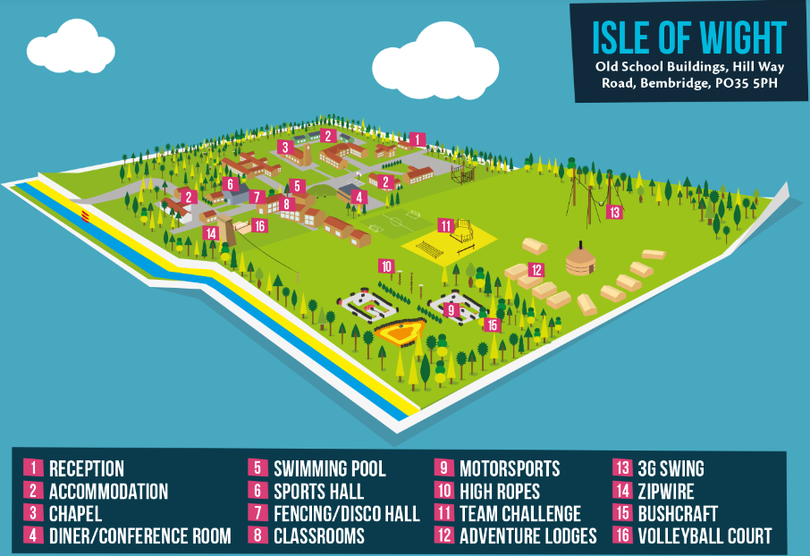
What does the site look like?

Slide 3
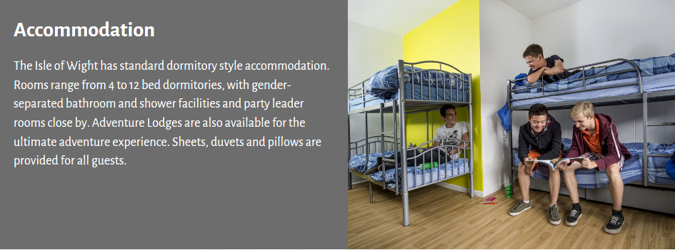
Ruskin House

Slide 4
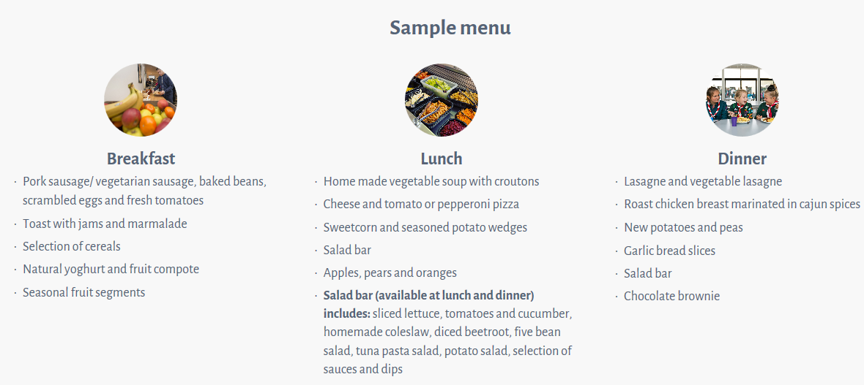
A typical menu

Slide 5
Day One
Meet in the Hall at the usual school opening time.
We will put a film on while we wait for the coach to arrive 11:30
Arrive in Portsmouth
Ferry to IoW 13:00. You need lunch in a carrier bag.
Coach to Kingswood to arrive at 14:30.
Welcome tour
Activity 1
Dinner 18:15
Evening activity – Mini Olympics

Slide 6
Tuesday, Wednesday, Thursday
Activity 1: 09:30 – 10:40
Activity 2: 10:50 – 12:00
Activity 3: 12:05 – 13:15
Lunch – 13:15 – 14:25
Activity 4: 14:30 – 15:40
Activity 5: 15:50 – 17:00
Activity 6: 17:05 – 18:15
Dinner: 18:15 – 19:25
Evening activity: 19:45 – 21:00

Slide 7
Activities Include…
3G Swing
Problem Solving
Orienteering
Team Tech
Jacobs Ladder
Field Games
Nightline
Scrapheap challenge
Archery
Aeroball
Low Ropes
Bottle Rockets
Culver Walk
Rock Pooling
Campfire
Fencing
Environmental Art
Buggy Build
Indoor Cimbing

Slide 8
Friday
Culver Walk activity 09:30 – 12:00
Lunch
Pick up at 12:30
Ferry 14:00
Arrive back at school around 16:00

Slide 9
Staff
Mr Blissett
Mrs Whitford
Mr Viney
Mrs Bartlett
Mrs Wotton
Mrs Townsend
Miss Bristow

Slide 10


