Slide 1
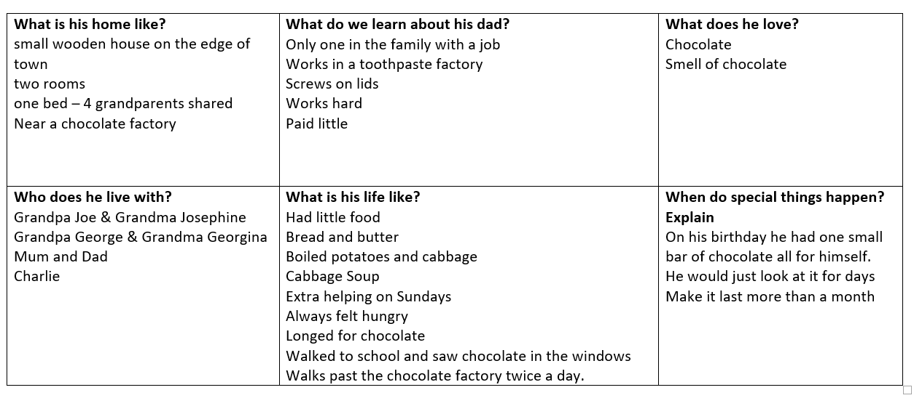
Example table - Information about Charlie Bucket and his life.

