Slide 1

Year 6 SATs Tests 2020

Slide 2
What are SATs
SATs is a term people use to refer to End of Key Stage 2 Assessments;
It lasts for four days beginning on Monday 11th May 2020 and ending on Thursday 14th May 2020;
Writing is assessed using evidence collected by your child’s teacher throughout Year 6, so there is no Year 6 SATs writing test.
There will be no Science sampling for Year 6 this year.
Therefore, no Year 6 Science SATs Paper in 2020.

Slide 3
Time Table for the Week
Children will sit the following SATs papers:
- Grammar, Punctuation and Spelling (Paper 1) – Monday 11th May 2020;
- Grammar, Punctuation and Spelling (Paper 2) – Monday 11th May 2020;
- Reading – Tuesday 12th May 2020;
- Maths Paper 1 (Arithmetic) – Wednesday 13th May 2020;
- Maths Paper 2 (Reasoning) – Wednesday 13th May 2020;
- Maths Paper 3 (Reasoning) – Thursday 14th May 2020.

Slide 4
Specific arrangements for SATs
Children with additional needs, who have similar provision in their day-to-day learning at school, may be allotted specific arrangements, including:
Additional (extra) time;
Tests being opened early to be modified;
An adult to read for them;
An adult to scribe (write) for them;
Written or spoken translations of the mathematics reasoning papers;
The use of prompts or rest breaks;
Arrangements for children who are ill or injured at the time of the tests.

Slide 5
What sort of results are reported?
Once marked, the tests will be given the following scores:
A raw score (the total number of marks achieved for each paper);
A scaled score (which is explained below);
A judgement of whether the National Standard has been met.
After marking each test, the external markers will convert each raw score into a scaled score to show whether each child is working below, at or above the national standard.
When the scaled score is given, it is given in a range from 80 to 120.
A scaled score of 100 or more is meeting the national standard.
There are no separate tests for higher achieving pupils; however, a scaled score close to 120 would show that a child is working above the national standard.

Slide 6
English Grammar, Punctuation and Spelling Test
The test will assess children’s ability in grammar, punctuation, spelling and vocabulary.
Paper 1 has short answer questions (40-50 questions) assessing grammar, punctuation and vocabulary (50marks) . Paper 2 assesses spellings (20 marks).
The results for the English test will be reported separately by the Department of Education. This means no overall English level will be given.

Slide 7
English Grammar, Punctuation and Spelling Test
The grammar and punctuation test will include two sub-types of questions:
Selected response, e.g. ‘Identify the adjectives in the sentence below’
Constructed response, e.g. ‘Correct/complete/rewrite the sentence below,’ or, ‘The sentence below has an apostrophe missing. Explain why it needs an apostrophe.’

Slide 8
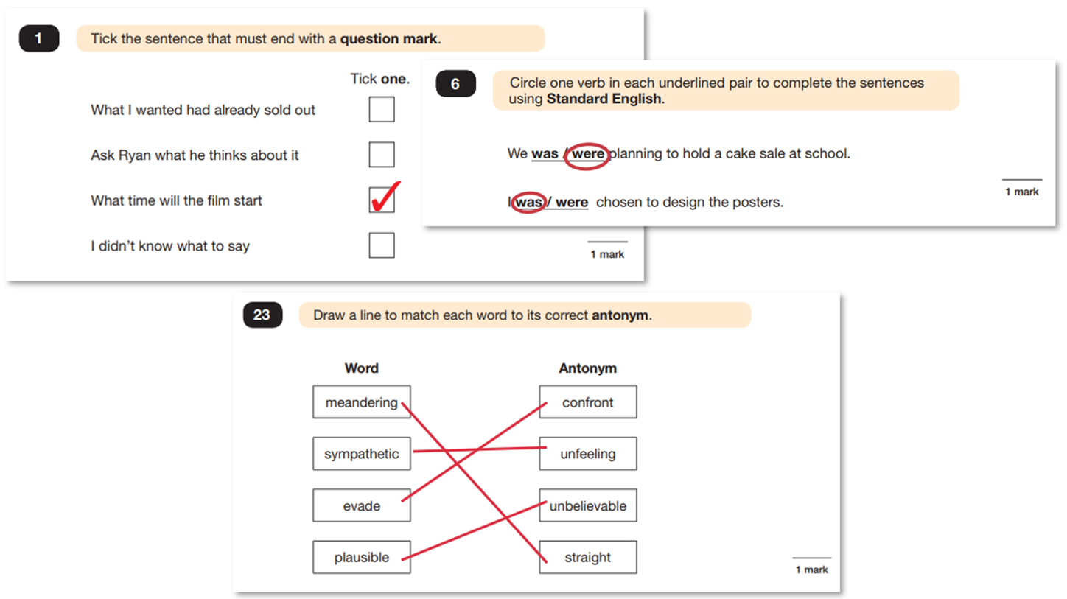
Grammar, Punctuation and Spelling (Paper 1)

Slide 9
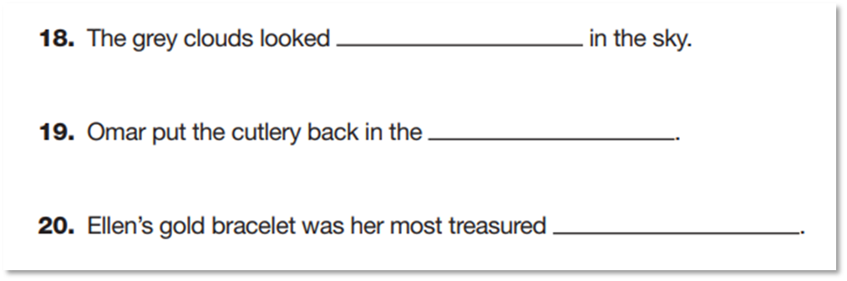
Grammar, Punctuation and Spelling (Paper 2) is the shorter paper lasting 20 minutes, which takes place on Monday 11th May 2020.
Example questions:

Slide 10
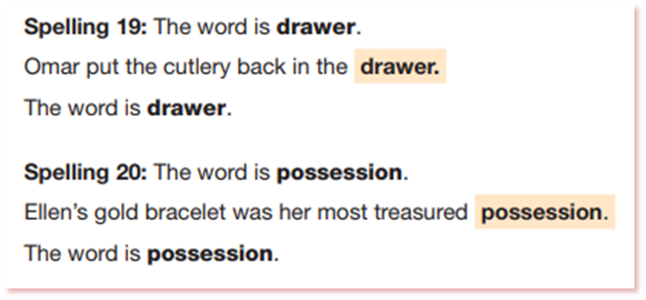
Grammar, Punctuation and Spelling (Paper 2)
Grammar, Punctuation and Spelling (Paper 2) is the shorter paper lasting 20 minutes, which takes place on Monday 11th May 2020.

Slide 11
The Reading Test
Children are given a reading booklet with three to four texts. There will be no common theme linking the texts. The least demanding text will come first with the following texts increasing in difficulty.
The children will have an hour to read the texts answer approximately 35 questions totalling 50 marks

Slide 12
The Reading Test
There will be a selection of question types, including:
Ranking/ordering, e.g. ‘Number the events below to show the order in which they happen in the story’
Labelling, e.g. ‘Label the text to show the title of the story’
Find and copy, e.g. ‘Find and copy one word that suggests what the weather is like in the story’
Short constructed response, e.g. ‘What does the bear eat?’
Open-ended response, e.g. ‘Look at the sentence that begins Once upon a time. How does the writer increase the tension throughout this paragraph? Explain fully, referring to the text in your answer.’

Slide 13
The Reading Test
Children can refer back to the texts in the reading booklet throughout the tests.
Questions are worth 1,2 or 3 marks.

Slide 14
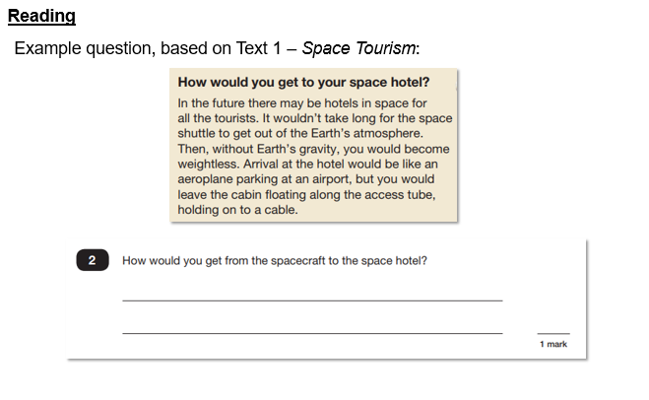

Slide 15
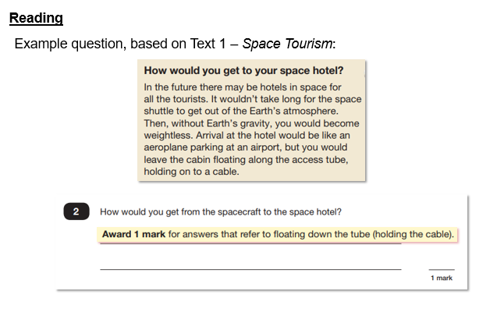

Slide 16
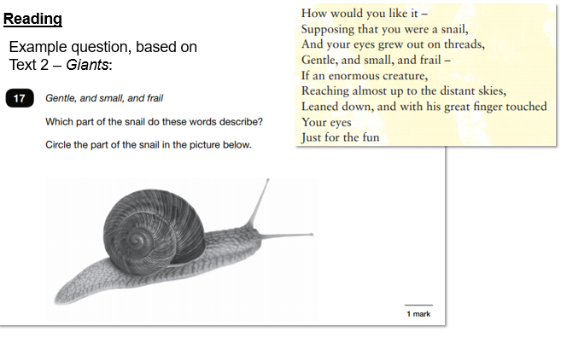

Slide 17
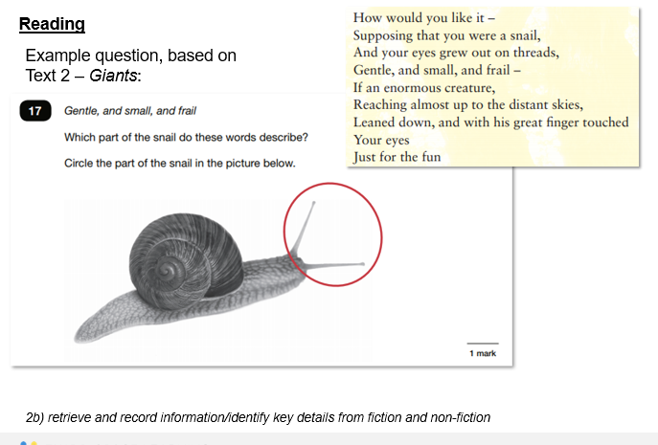

Slide 18
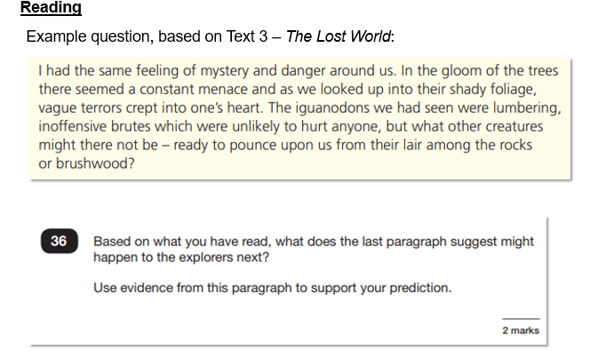

Slide 19
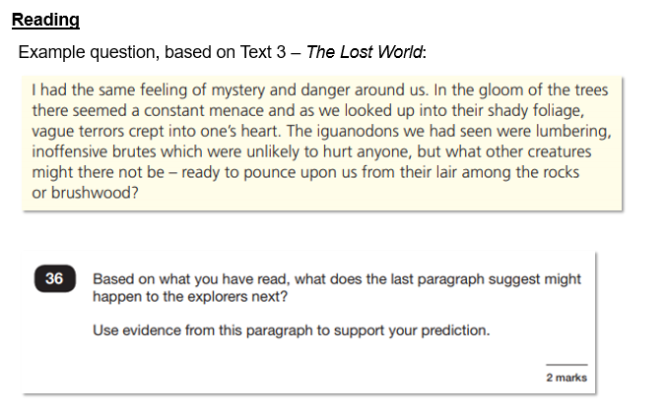

Slide 20
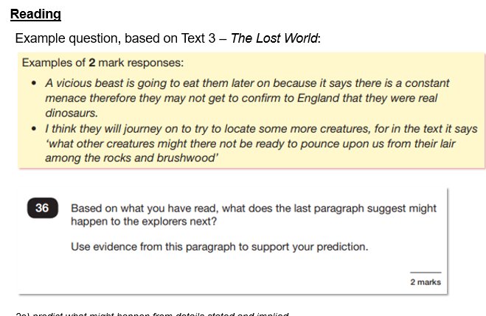

Slide 21
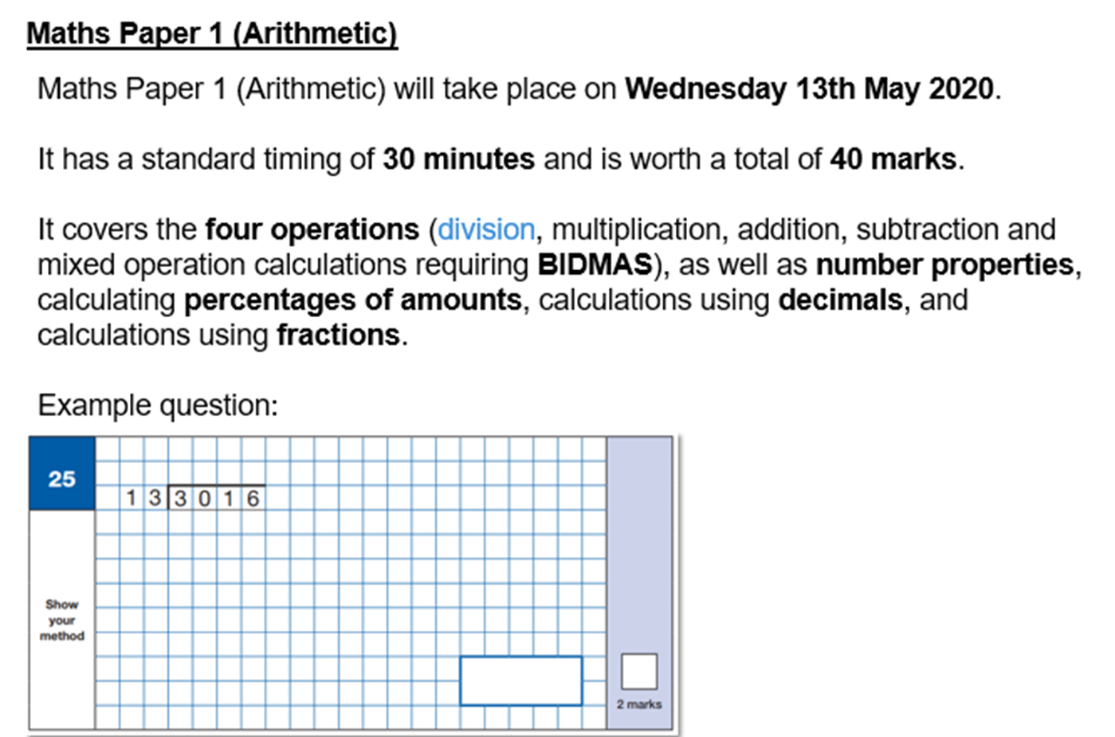
Mathematics Tests

Slide 22
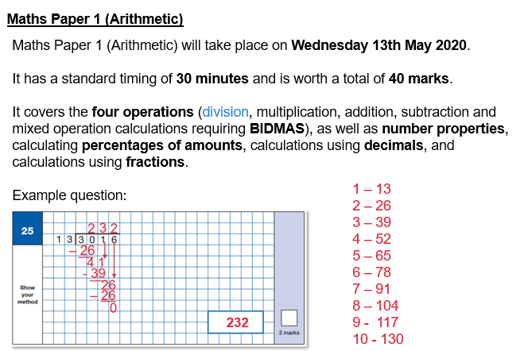

Slide 23
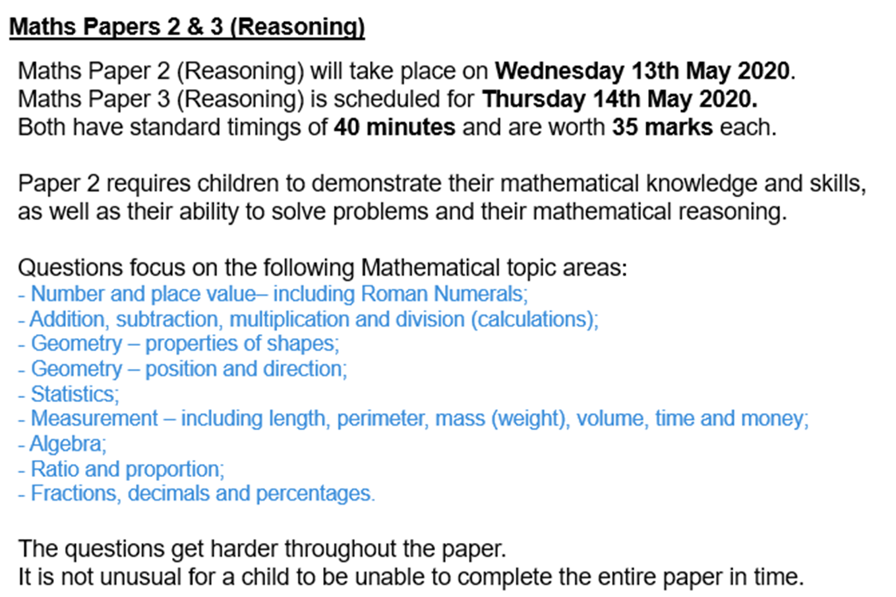
Mathematics Tests

Slide 24
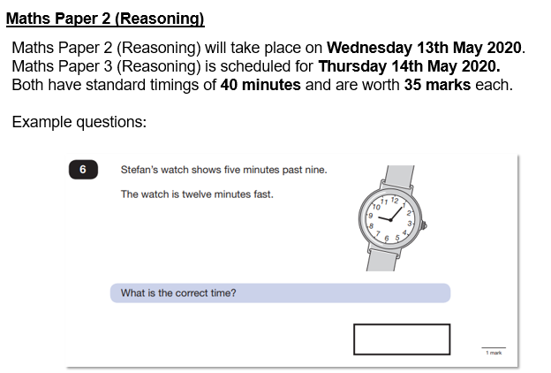

Slide 25
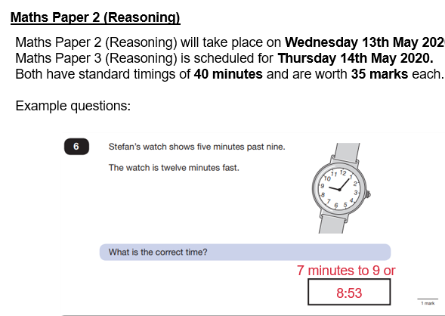

Slide 26
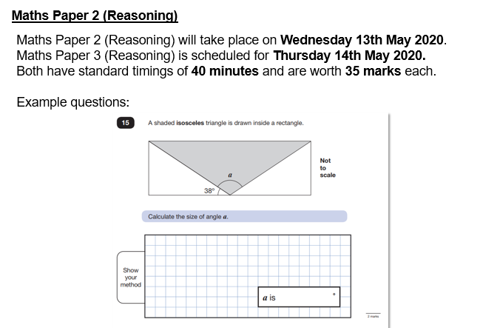

Slide 27
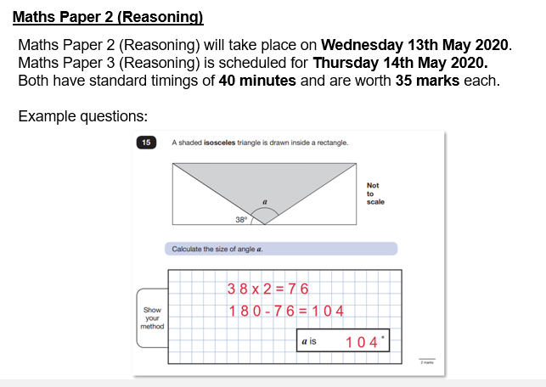

Slide 28
How you can help.
Your children are going to be issued with revision guides.
Sometimes their homework will relate to these books.
Continue to support them by ensure they know all their table facts.
Listen to them read or talk about books with them

Slide 29
Reporting the results.
The previous National Curriculum levels have been scrapped, and instead children will be given scaled scores. You will be given your child’s raw score (the actual number of marks they get), alongside their scaled score and whether they have reached the national average. The score needed to reach the national average has yet to be announced.

Slide 30
Top Tips
Ensure children have a good nights sleep before the tests.
Have breakfast or join us for breakfast at school
Talk to them about the tests.
Don’t put too much pressure on them.

Slide 31
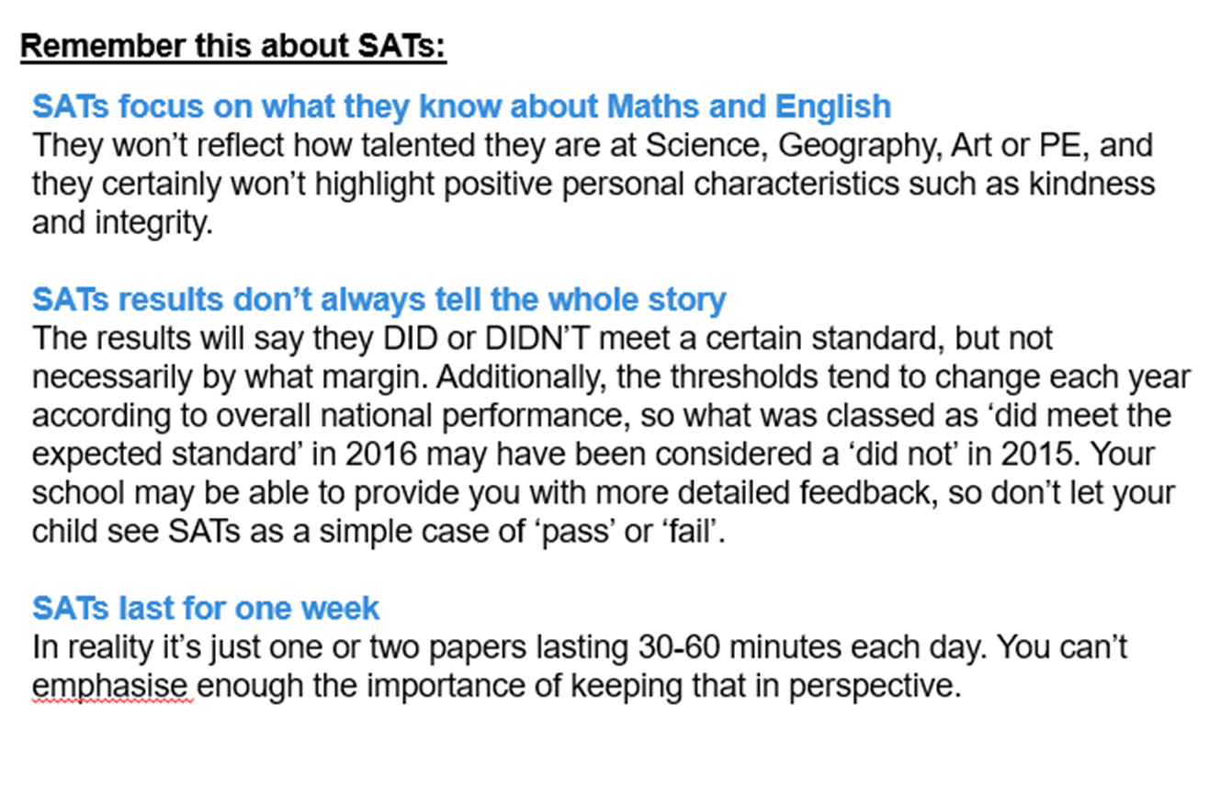
And finally……..

Slide 32


