Slide 1

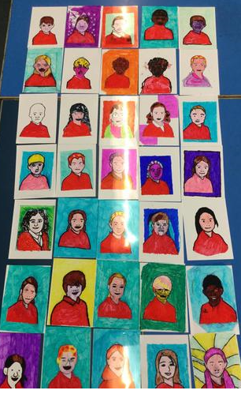
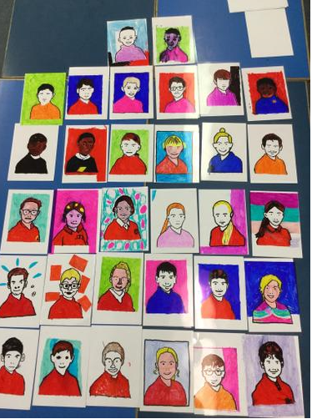
Welcome to America
Year 6

Slide 2
Aim of the meeting
Help to develop strong year group link
Put a face to the names
Develop the relationship between home and school
Share key dates for this year.
Share key systems and daily routines
Hooke Court residential meeting

Slide 3
Team America
Year 6 team:
North America– Mrs Whitford
South America- Mr Stevens
The rest of the team
Miss Loosemore, Mrs Townsend, Mrs Bartlett,
Mrs Caine, Miss Knight, Mrs Stroud and Mrs Buckley

Slide 4
Weekly Homework expectations
Reading – at least 3 times a week please! Plus a reading comprehension activity weekly.
Banded books are read at school-Read for pleasure at home
Multiplication and division and related facts up to 12 x 12 This supports the 4 x a week Rockstar sessions -children can practice their times tables online on Rockstars. They can also still use Mathlectics . Homework will be set weekly to revise the weeks Math topic.
Spelling through Spelling Shed the words are also on the website. Weekly spelling test on Wednesdays and spelling activies during the week. Focus 5/6 spelling words.
Their logins for Spelling Shed, Mathletics and Rockstars are the same
https://www.merdon.hants.sch.uk/homework-54/

Slide 5
Mathletics Awards
Bronze = the child has earnt 1000 points in the activities they have done that week.
Silver = 5 x bronze awards
Gold = 4 x silver awards (20 weeks of sustained effort)
Each child can only get one award each week.

Slide 6
What is Home Learning?
Topic home learning will come out at the start of each half term. It can be creative and is led by children’s ideas.
It will be displayed at the Parent Outcome.
https://primarysite-prod-sorted.s3.amazonaws.com/merdon-junior-school/UploadedDocument/40a58fe519084542b4571646012edad8/home-learning-year-6-autumn-1-marvellous-mayans-2019.pdf

Slide 7
Parent Outcome
These are half termly events that enable you to come in and celebrate your children’s achievements.
Once a term these events will be interactive outcomes, where the children will present something to you e.g. performances to watch, or recipes to try.
At other times the outcome will be an opportunity for you to come and see what your child has been learning.

Slide 8
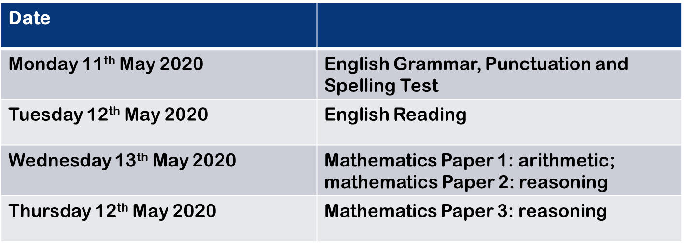
Dates for your diary
SATS
There will be an information evening later in the
Year.
Date
Monday 11th May 2020 | English Grammar, Punctuation and Spelling Test
Tuesday 12th May 2020 | English Reading
Wednesday 13th May 2020 | Mathematics Paper 1: arithmetic; mathematics Paper 2: reasoning
Thursday 14th May 2020 | Mathematics Paper 3: reasoning

Slide 9

Author visit 26th September
Parent Outcome 16th October
School photos 21st October
INSET 25th October.
Hooke Court 4th-6th November. Information to follow.

Slide 10
Helping in school….
Volunteers Wanted!!
Are you interested in becoming more involved
in school life?
Are you able to volunteer some of your time
(No matter how little!) to support us with:
• Governors
•PTA – Merdon Association
• Parent Readers
• Trips
• Fundraising
• And much, much more!!
If so, please come and talk to the office staff about completing a DBS check.

Slide 11

Systems and Routines
Healthy snacks – no nuts
After school clubs-letters have gone
Out clubs start this week.
PE days are Thursday and Friday
IGNITE and HEART
Working towards Awards- House points, Raffle Tickets, Pen Licence, Worker of the Week, HEART awards, HEART pin badges
Home work set on Thursday for the following Tuesday.

Slide 12
So far…
All the children have settled in well.
Have visited the library and have all taken out at least one book.
Have been introduced to our topic for this term –Marvellous Mayans
Have their Homework folders and have had their first week’s Homework

Slide 13
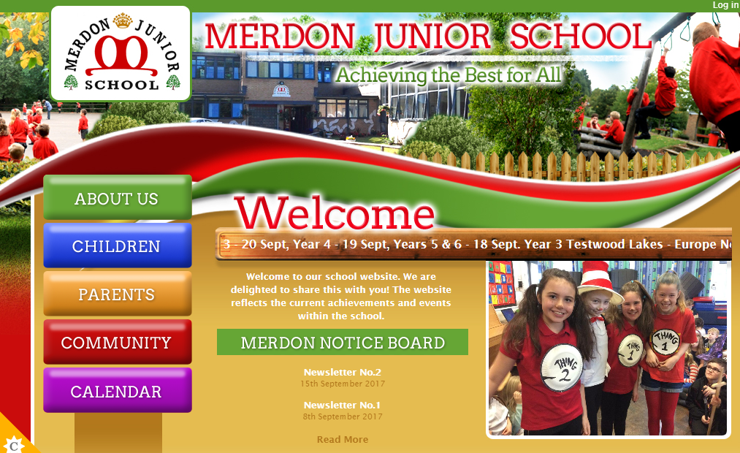
The Website…
You will be able to access;
Your child’s class page with updates on learning and homework
School calendar
Whole school events
Policies
Newsletters
Updates
Safeguarding and E-Safety
https://www.merdon.hants.sch.uk/year-6-5/

Slide 14
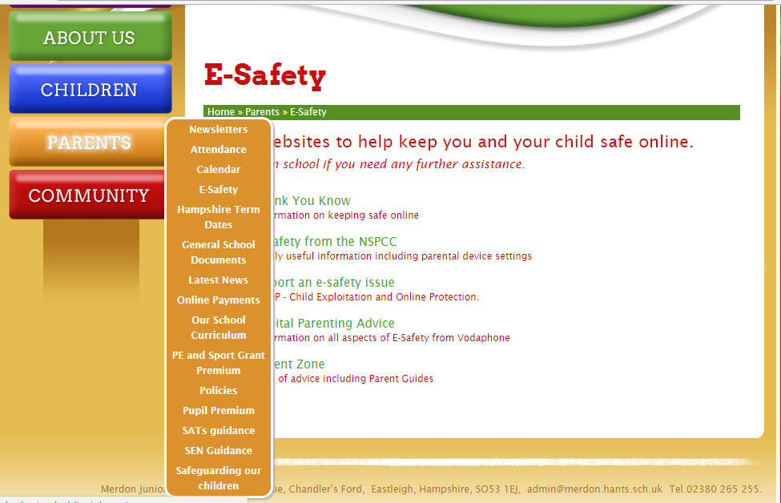
Important information:

Slide 15
Open door policy
Got some exciting news to share? Come and speak to us!
To discuss your child’s progress we have parents evening on 22nd and 24th October.
If you think you are eligible for free school meals, please speak to the office about applying.
Our Designated Safeguarding Lead is Miss Loosemore and our Deputy DSL is Mrs Tones.
Our pastoral team includes ELSA and FEIPS.
Our SENCo is Mrs Tones.

Slide 16
Coming up…
Macmillan Coffee Morning – 27th September
Thank you for coming- any questions?
Hooke Court info to follow.

