Slide 1

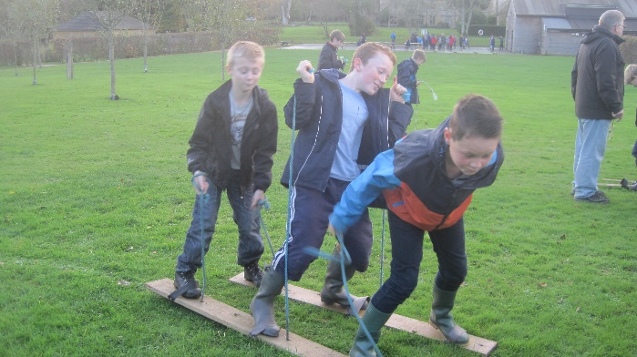
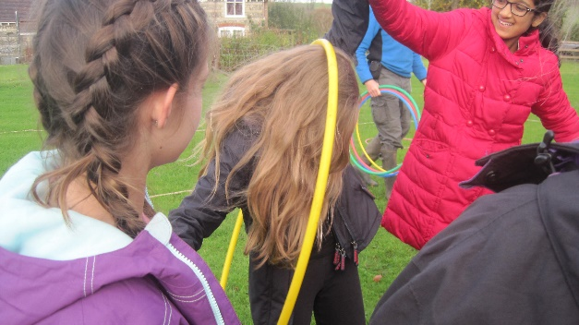
Year 6 2019 Residential Trip
Topic Trip

Slide 2
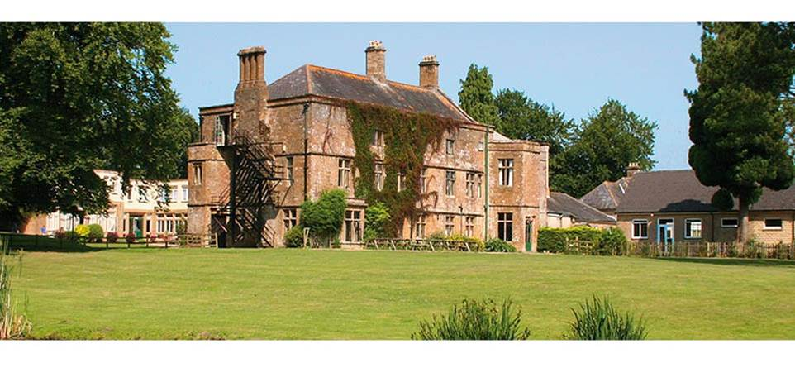
Hooke Court Residential Centre

Slide 3

Hooke Court Residential Centre
Situated 15 miles north west of Dorchester in the village of Hooke
Opened in 1994 by Peter and Mandy Cooper, Hooke Court remains a small family run business where the quality and safety of the service provided is paramount.

Slide 4
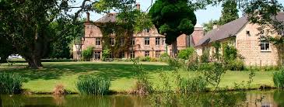
KEY FEATURES
Grade II listed 14th century manor house
Stunning historical, rural location that brings learning to life
Accommodation for up to 190
Twenty-four acres of landscaped grounds and woodlands
Playground, playing fields and low ropes course
All groups are fully catered for and accommodated in their own area

Slide 5
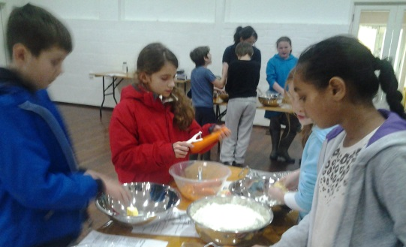
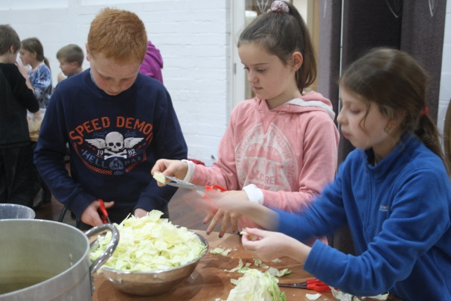
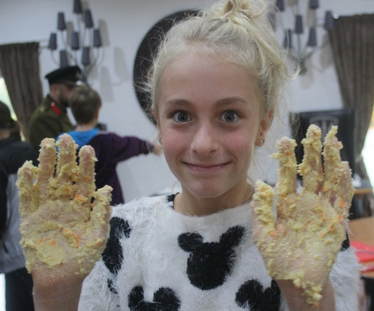
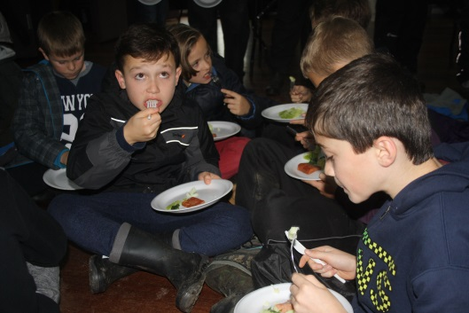
Food
Hooke Court provide locally sourced, home-cooked food for the children. Where possible the food grown at Hooke Court is included in the menus. The food is healthy and nutritious whilst still appealing to a child's taste.
They children are provided with a packed lunch, hot evening meal and breakfast.

Slide 6
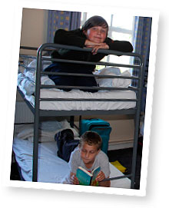
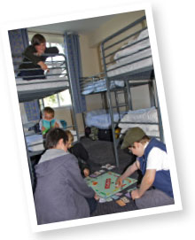
Where do we live?
Children sleep in bunk bedded dormitories each accommodating up to 8 to 10 children, with adjoining bathroom facilities. Duvets, sheets, pillows etc. are all provided, towels are not.
There are play areas immediately outside all of the accommodation units. There are staff bedrooms in the same unit. On the ground floor of the accommodation there is a common room, boot room and kitchenette equipped with fridge and kettle where groups can prepare their own bedtime and break time drinks if required.

Slide 7
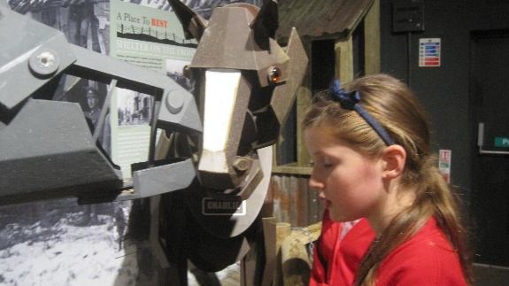
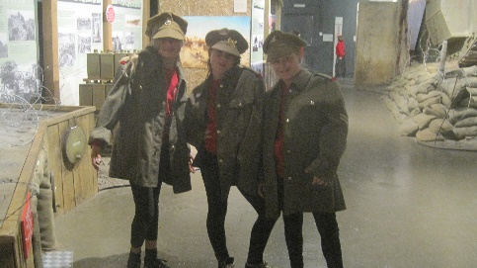
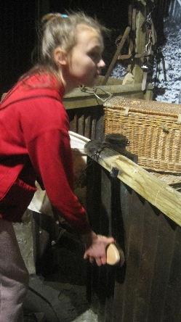
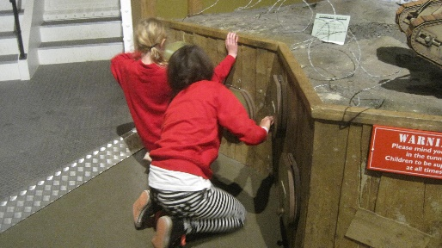
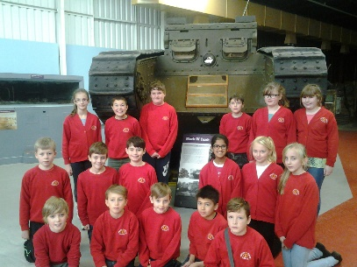
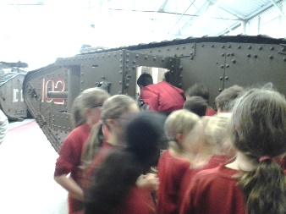
Dates
Monday 4th November–
Wednesday 6th November
On Wednesday afternoon, on the way home, we will visit the Tank Museum at Bovington
We plan to be back at school approximately 3.30pm.

Slide 8

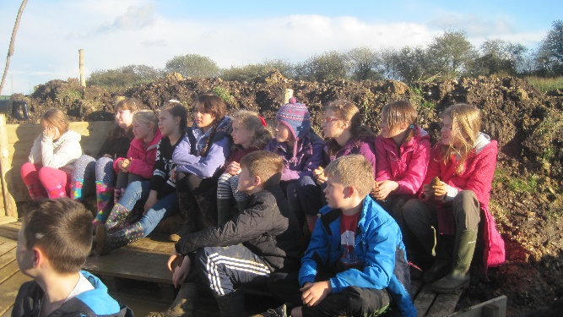
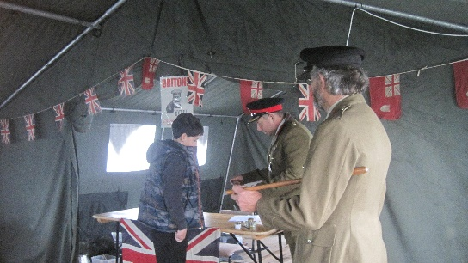
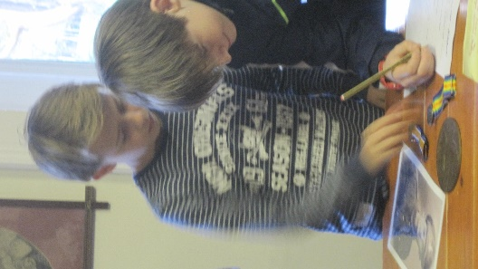
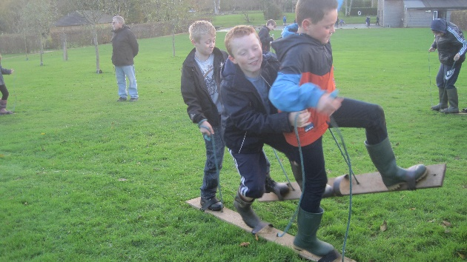
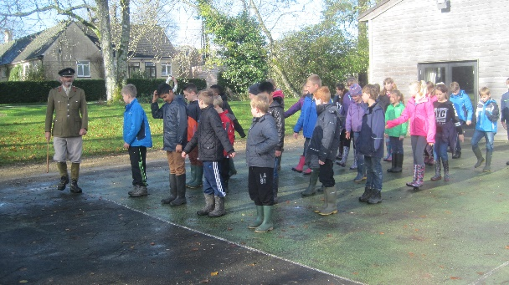
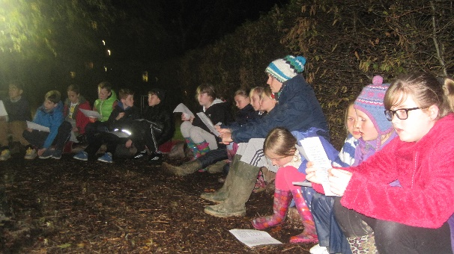
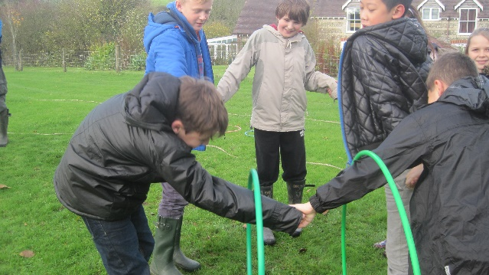
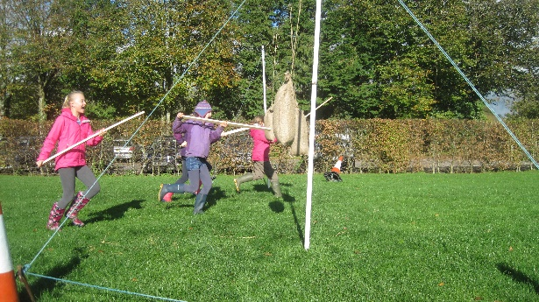
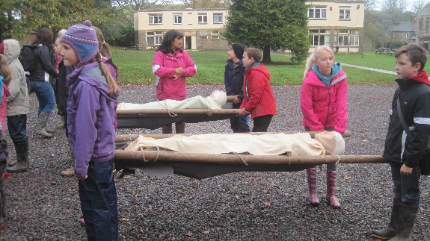
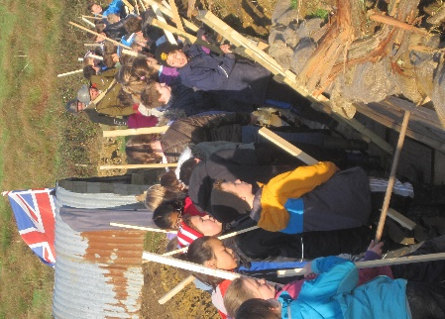
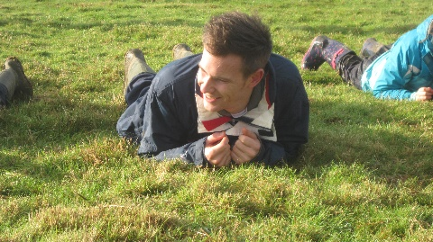
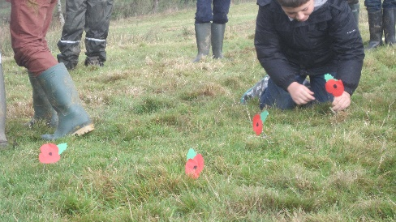
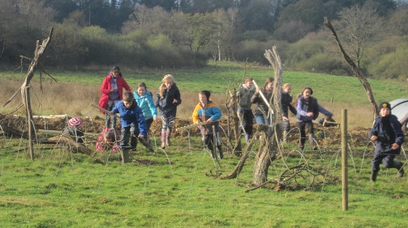
Fun times

Slide 9
Day One
Children to arrive at school at 8:15 we will be leaving promptly at 9:00
If the children have any medicines they will need to be handed to a teacher, clearly labelled with name of child and dosage required.
The children will need a packed lunch.
When we arrive, at Hooke Court, the children will be put into their dorms.
The children will be expected to make their own beds-all bedding provided.

Slide 10
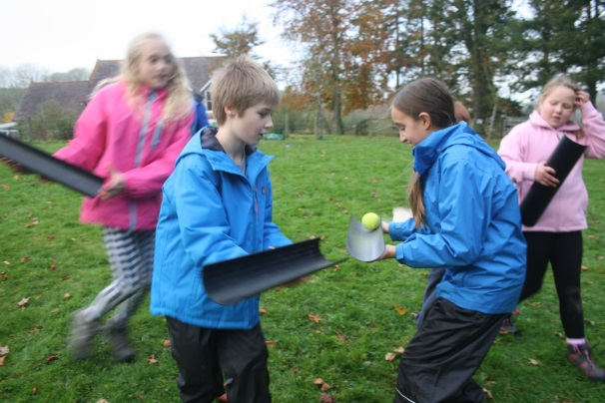
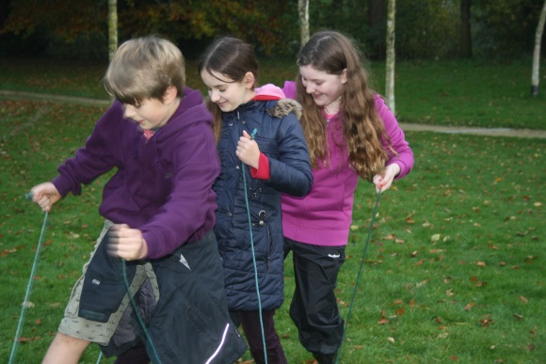
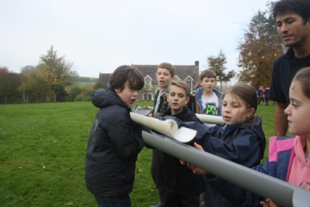
Day One
Travel and arrival at Hooke Court
Team Building activities.
Evening Meal
Day One (evening)
Songs from the war around the camp fire

Slide 11
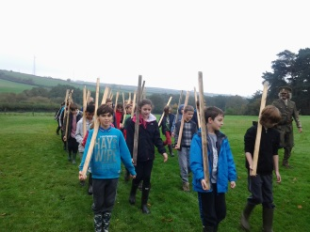
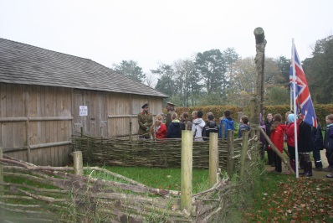
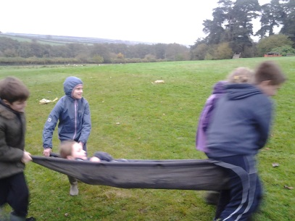
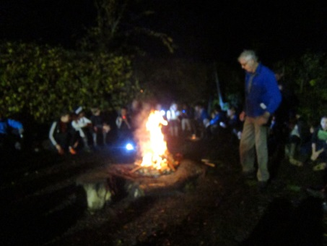
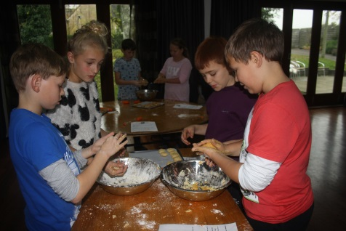
Day Two
Breakfast
WW2 Day
Lunch
WW2 Day Continued
Free Time
VE Party
Who Dunnit @ Hooke Court

Slide 12
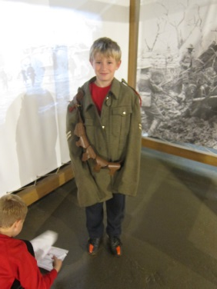
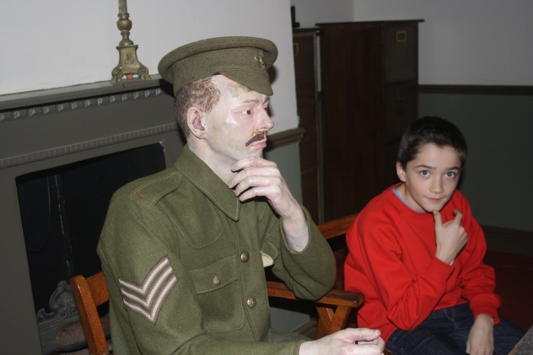
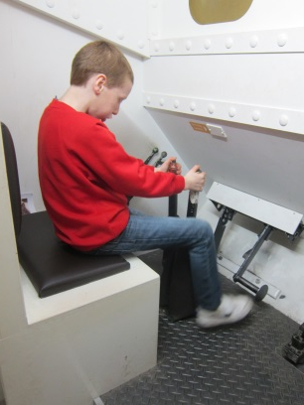
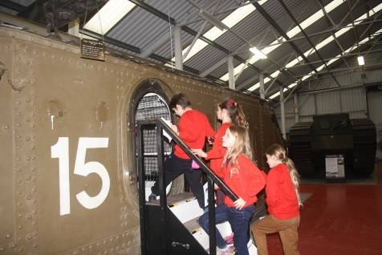
Day Three
The Tank Museum, Bovington –The children will need a school sweatshirt.
We will visit the World War Two exhibition at The Tank Museum where they will get inside a real Second World War tank and take part in some of their workshops.

Slide 13
A typical days menu
Breakfast:
Juice, cereal, beans on toast, hot drink.
Mid-Morning Snack:
Squash and biscuits.
Lunch:*
selection of sandwiches, homemade cake, fruit, yoghurt
Mid-Afternoon Snack:
Squash and biscuits.
Evening Meal:*
Pasta with a homemade tomato & vegetable sauce, served with cheese, garlic bread and salad. Yorkshire pudding with sausage, potato wedges, carrots, peas and gravy. Sweet & sour pork and rice.
Puddings:
Fresh fruit salad. Fruit crumble and custard.

Slide 14
Staff/Costs
8 members of staff will accompany the children.
Mrs Whitford and Mr Stevens plus 6 others, who will be confirmed before the trip.
There will be a letter sent home early next week detailing the costings for the trip.

Slide 15
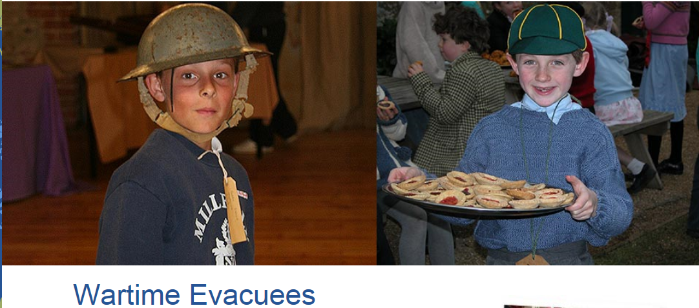
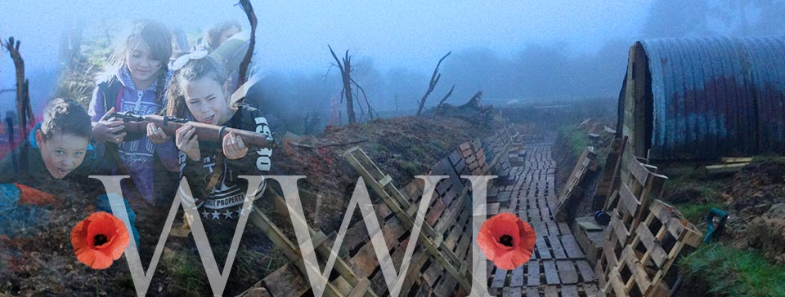
Any Questions?
https://www.hookecourt.co.uk/residential/programmes/history/wartime-evacuees/

