Slide 1
Choose one of the fossils on the following pages...
Draw a diagram of your fossil (pencil and ruler)
Describe it in detail.
Does it look like anything that is alive today? How? What are the similarities and differences between your fossil and what we have alive today?
Challenge!
What questions do you have about fossils?
What do you think scientists can find out by studying fossils?

Slide 2
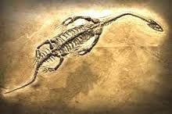
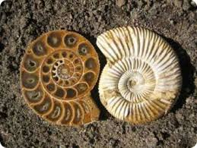
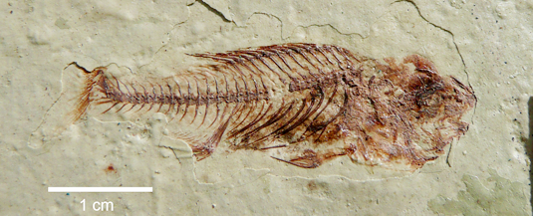
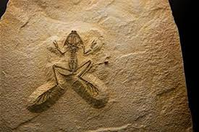

Slide 3


