Slide 1
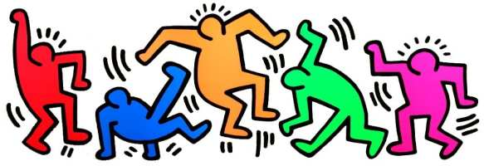
Keith Haring

Slide 2
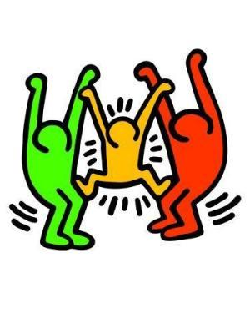
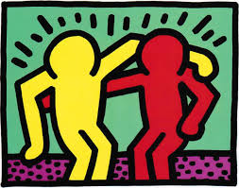
Keith Haring was an artist and sculptor.
He created ‘pop’ art using cartoon-like figures and he displayed them in public places all over the world.

Slide 3
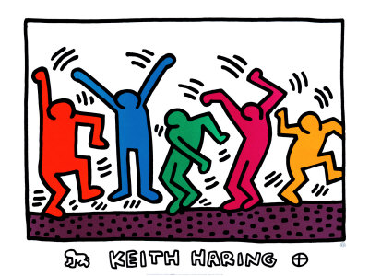
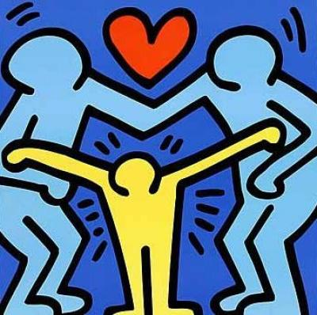
Some more examples of Keith Haring’s work…

Slide 4
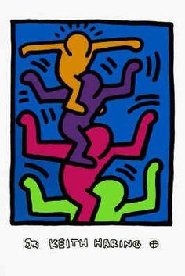
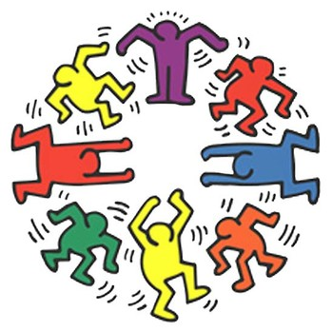
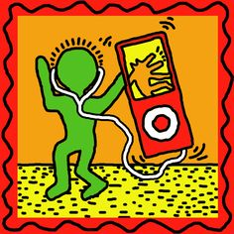
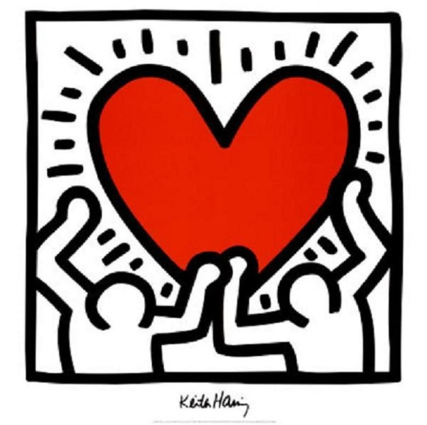
What do you notice about the cartoon figures in Haring’s art work?

Slide 5
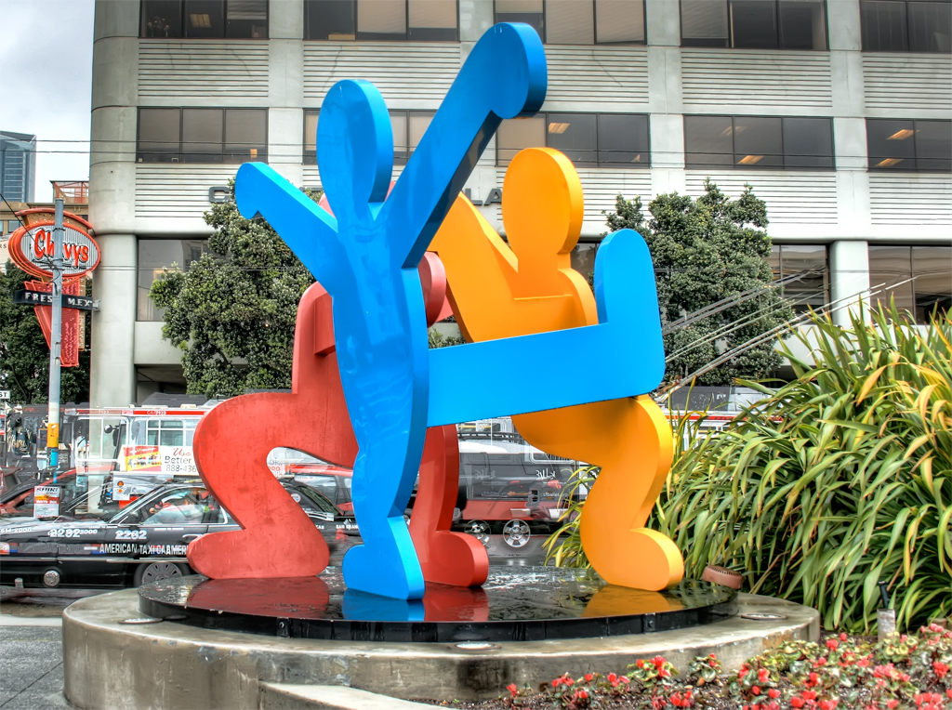
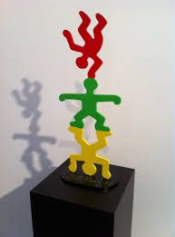
Keith Haring made sculptures too…
Some small…
Some BIG…

Slide 6
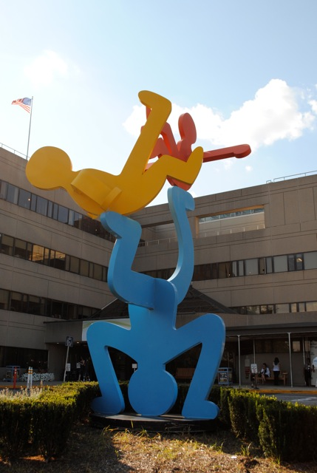
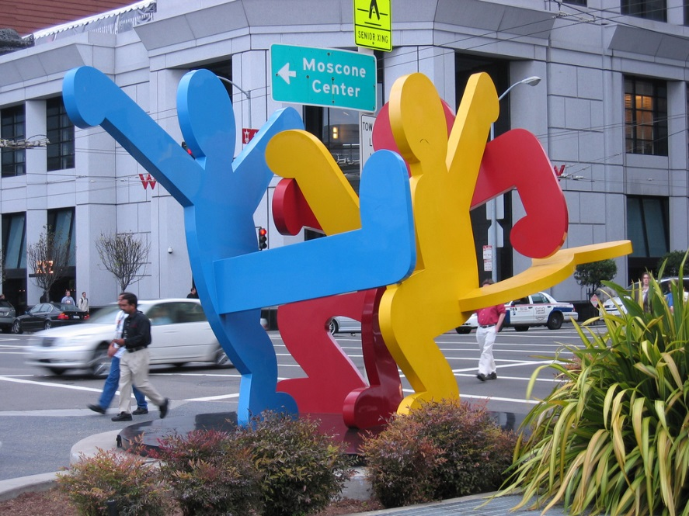
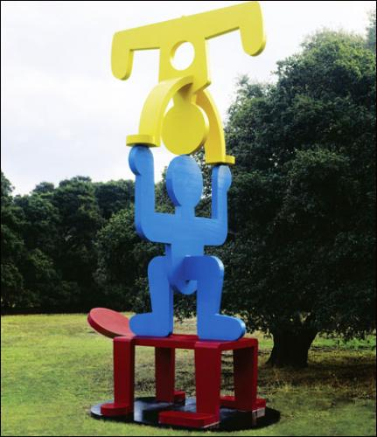
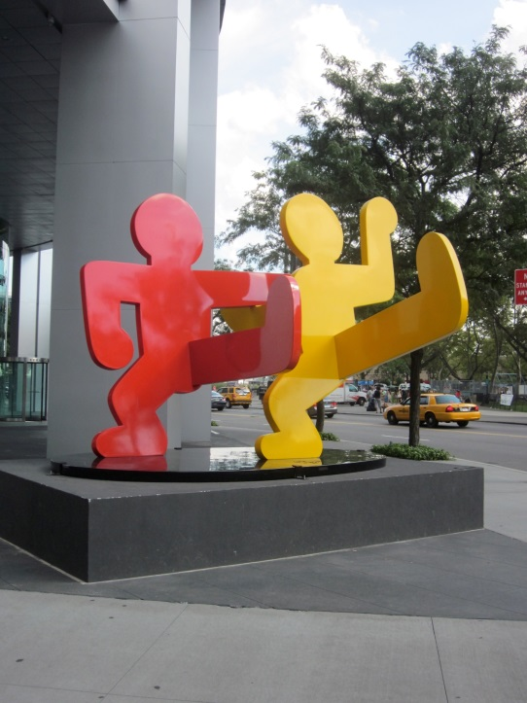
Let’s find out a little more about this Pop Artist…

Slide 7
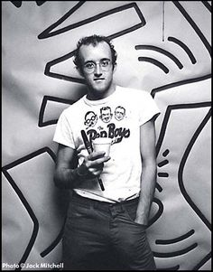
Keith Haring was born on May 4, 1958. He grew up in Pennsylvania in America. He was the oldest of four children. He started to draw from a very young age.
"My father made cartoons. Since I was little, I had been doing cartoons, creating characters and stories."
As Keith grew up, he continued to draw and make art. He saw modern art when he visited museums in Washington, DC.
After high school, he went to art school for a year. He started making big drawings, and when he was 19, he had his first public show.
In 1978, Keith moved to New York City to go to a different art school. He loved being in the big city. There were big museums with all kinds of art. In New York he found his style.

Slide 8
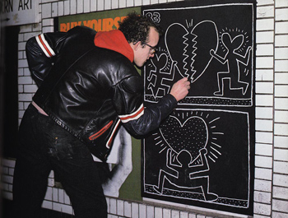
Graffiti
While he was in New York, Keith began to draw on the blank walls of the subway tunnels using chalk. His art was actually a type of graffiti!
Everyone who rode on the subway saw his work and he soon became famous! His art work was soon in newspapers and on the television.

Slide 9
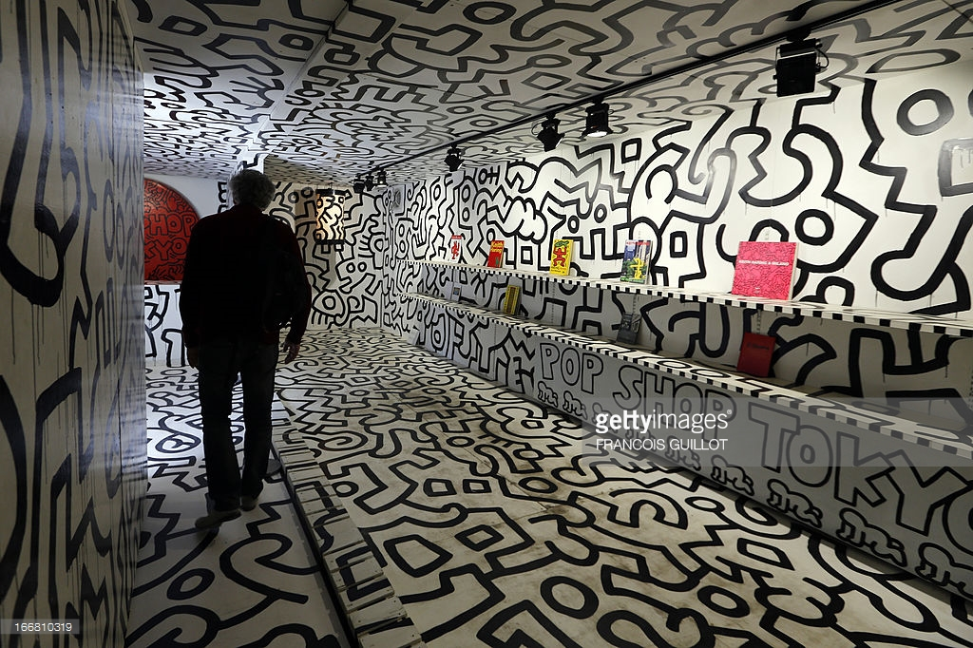
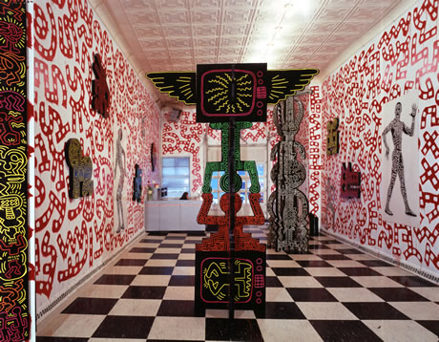
Art Shows
Keith soon began to show his art work in galleries and art exhibitions, where many people started to buy his work.
In his first show in New York, he painted all the walls with his art, and then put up his paintings and his sculptures. Hundreds of people came to the opening party, and it was a big success.

Slide 10
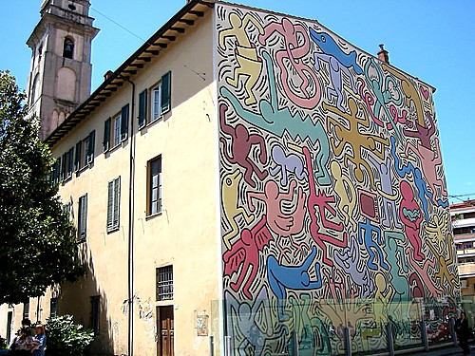
Famous!
Now Keith worked harder than ever, and he travelled around the world to show his work. He had shows in Europe, Japan, and all across the United States. He even painted the entire side of a church in Italy!

Slide 11
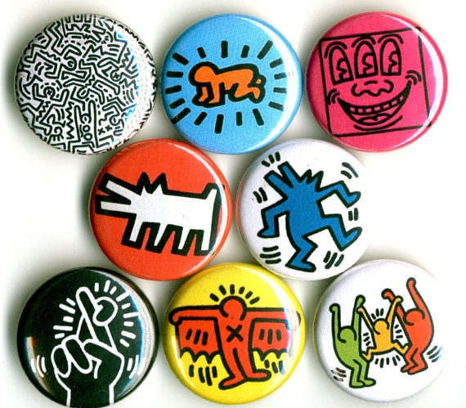
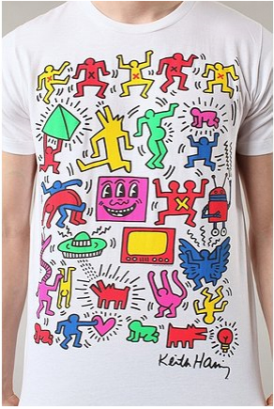
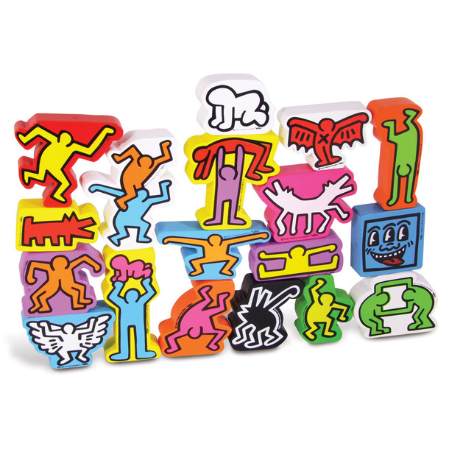
Pop shop…
His paintings and sculptures became very expensive. He wanted everyone to be able to buy his work, so he opened a new store called the Pop Shop to sell his art on posters, buttons, T-shirts, and games.

Slide 12
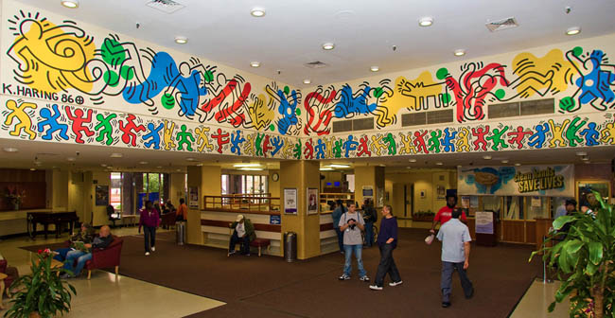
Working with children…
He also worked with children in schools to paint large murals with them, and he made paintings and sculptures for schools and hospitals in many places.

Slide 13
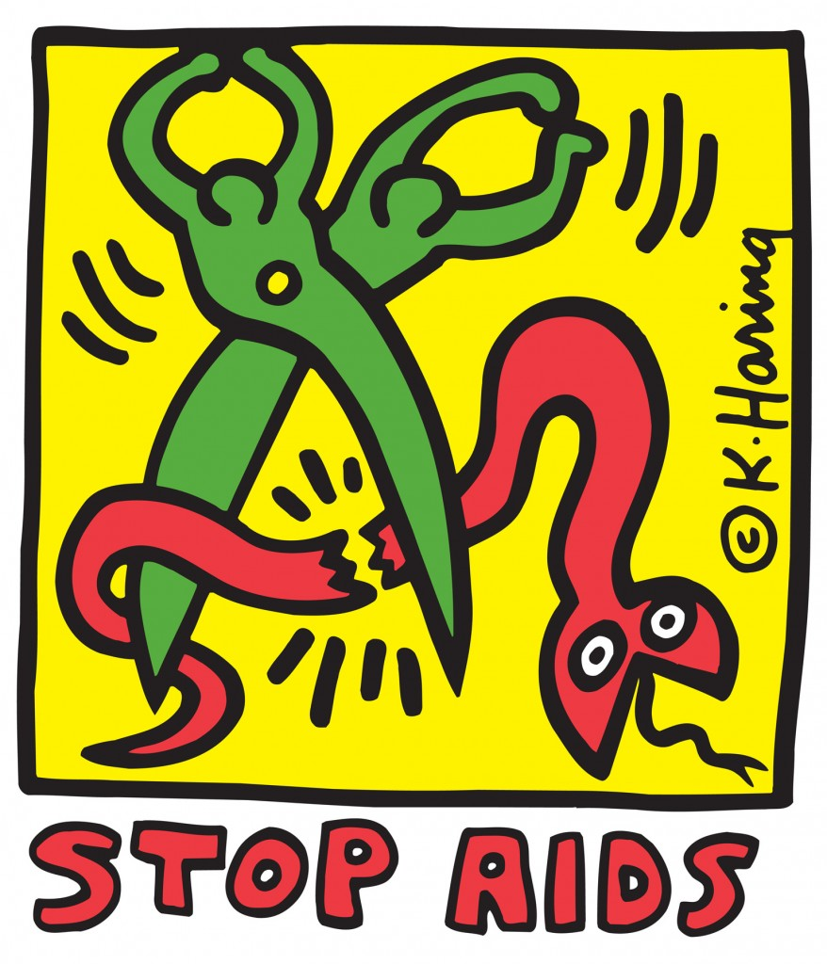
In 1988, Keith got very sick with a disease called AIDS. At that time, doctors could not help people with AIDS. Keith knew he was going to die, but he was very brave and kept working as hard as he could until the end. He also made posters to tell people about the sickness and gave money for doctors to search for a cure.
After Keith died, his work still lived. You can find it in museums, in books, on posters, on TV and on the World Wide Web.

Slide 14


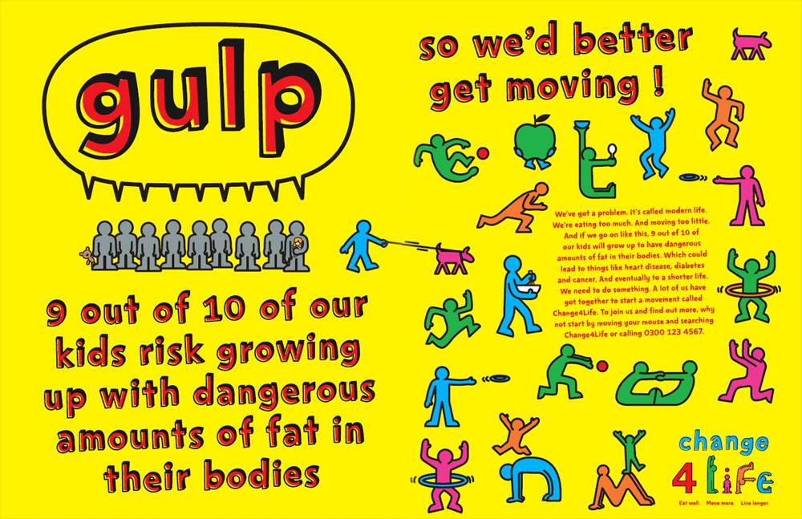

Another artist used Haring’s work as the inspiration to design the art work for the Change for Life campaign, which you have learnt about with Mrs Noble.

Slide 15
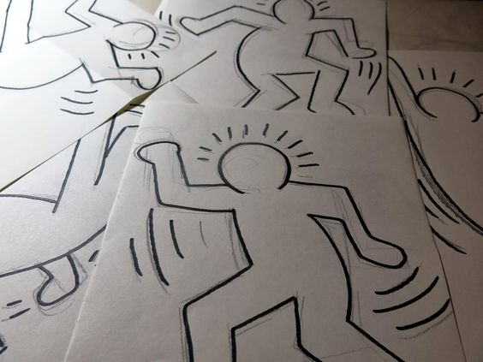
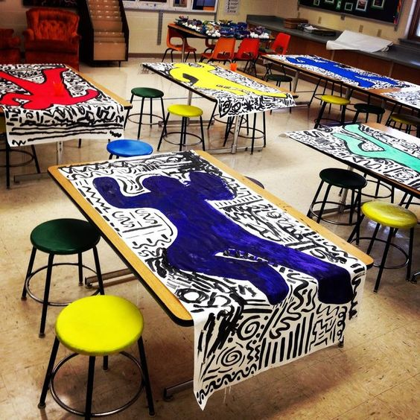
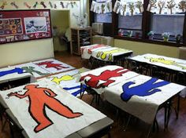
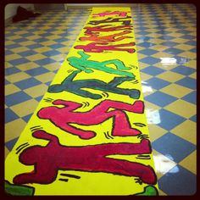
Keith Haring wanted everyone to make art, especially children. So that is what we are going to do!
Maple will draw round the children from Willow.
Put your Willow child into the most interesting position you can think of and draw a basic outline of their head, body, arms and legs. Keep it simple!
Then we will work together to paint them in bright colours, just like Keith Haring did!

Slide 16
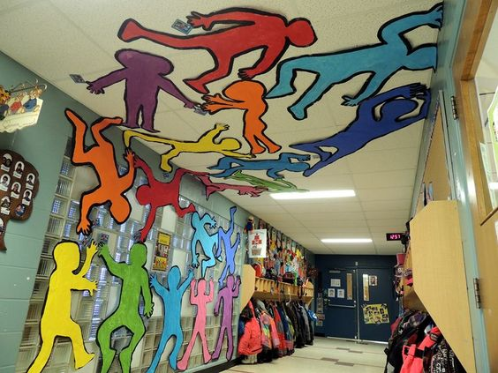
We could display them like this!
Do you think Mrs Good would be pleased?

Slide 17
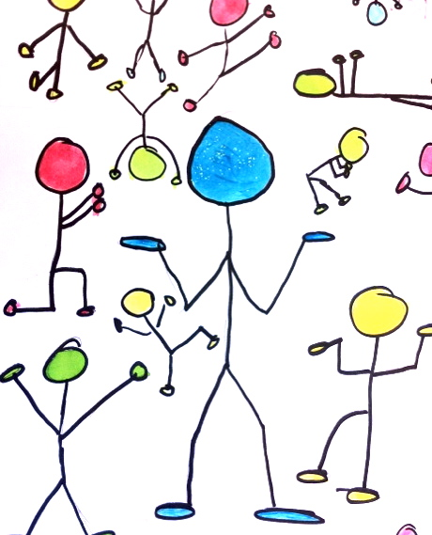
Stick people in action…
Draw stick men in as many different positions as you can think of. They can be sideways or upside down!
Then paint or colour the heads, hands and feet!

Slide 18
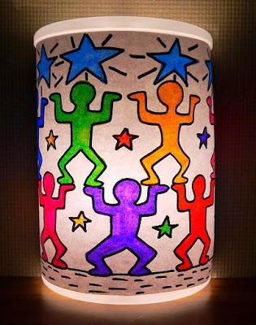
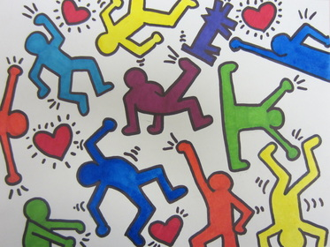
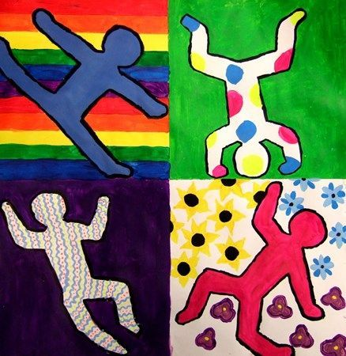
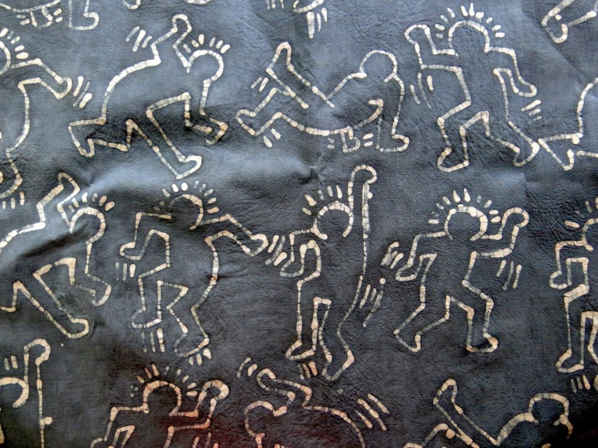
Other ideas…

Slide 19
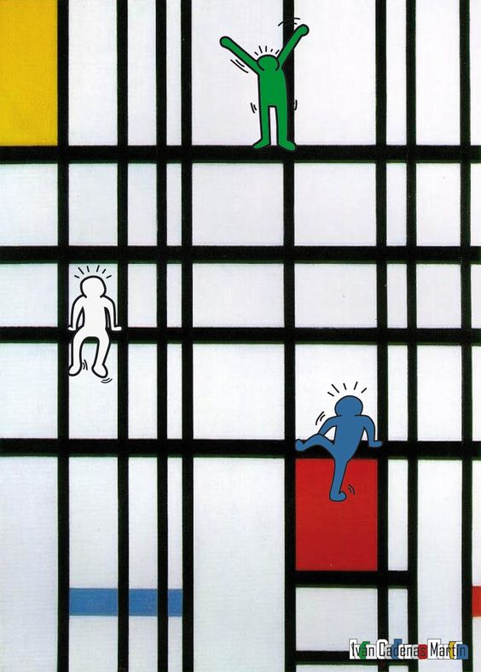
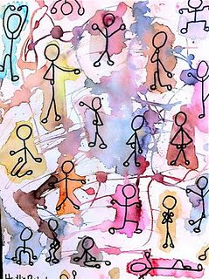
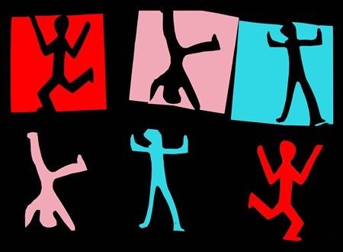
Other ideas…

